Slide 1
THE 1950s:
“Conservatism, Complacency, and Contentment”
OR
“Anxiety, Alienation, and
Social Unrest” ??
Ms. Susan M. Pojer Horace Greeley HS Chappaqua, NY

Slide 2
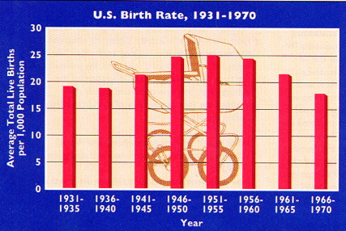
1A. Baby Boom
It seems to me that every other young housewife I see is pregnant. -- British visitor to America, 1958
1957 → 1 baby born every 7 seconds

Slide 3
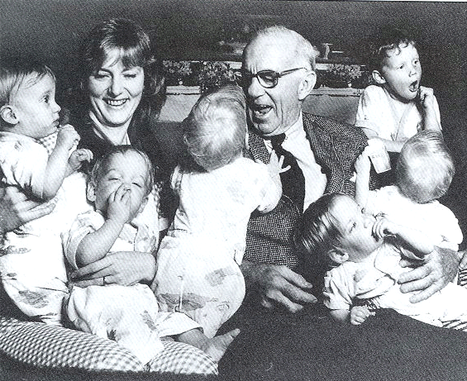
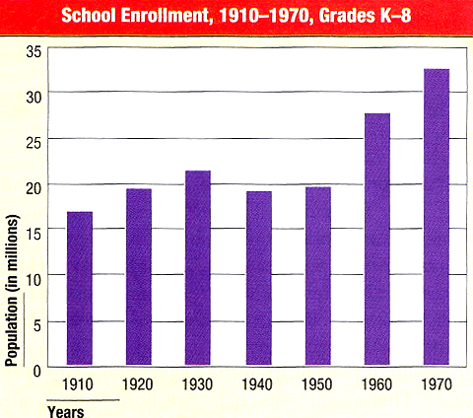
1B. Baby Boom
Dr. Benjamin Spock and the Anderson Quintuplets

Slide 4
2A. Suburban Living
Levittown, L. I.: “The American Dream”
1949 → William Levitt produced 150 houses per week.
$7,990 or $60/month with no down payment.

Slide 5
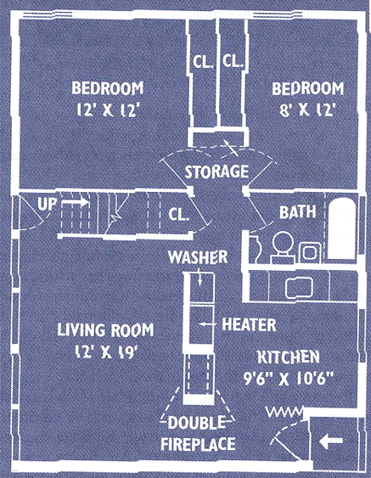
2A. Suburban Living: The New “American Dream”
1 story high
12’x19’ living room
2 bedrooms
tiled bathroom
garage
small backyard
front lawn
By 1960 → 1/3 of the U. S. population in the suburbs.

Slide 6
2B. Suburban Living
SHIFTS IN POPULATION DISTRIBUTION, 1940-1970
1940 1950 1960 1970
Central Cities 31.6% 32.3% 32.6% 32.0%
Suburbs 19.5% 23.8% 30.7% 41.6%
Rural Areas/ 48.9% 43.9% 36.7% 26.4%
Small Towns
U. S. Bureau of the Census.

Slide 7
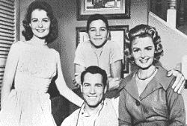
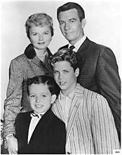
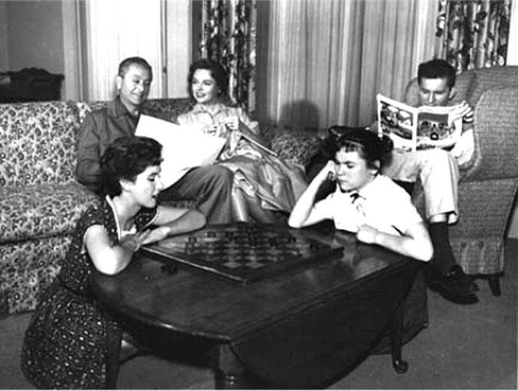
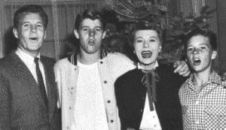
2c. Suburban Living: The Typical TV Suburban Families
The Donna Reed Show 1958-1966
Leave It to Beaver 1957-1963
Father Knows Best 1954-1958
The Ozzie & Harriet Show 1952-1966

Slide 8
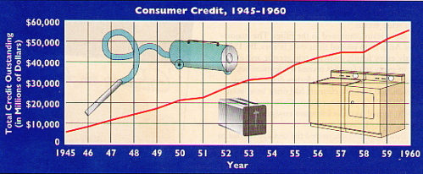
3a. Consumerism
1950 → Introduction of the Diner’s Card
All babies were potential consumers who spearheaded a brand-new market for food, clothing, and shelter. -- Life Magazine (May, 1958)

Slide 9
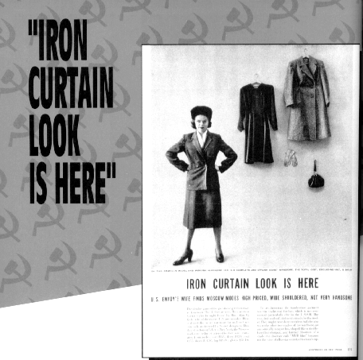
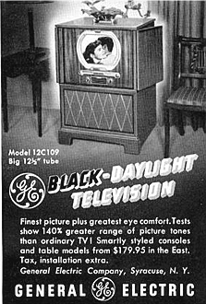
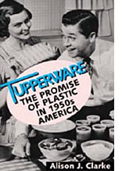
3B. Consumerism

Slide 10
4A. A Changing Workplace
Automation:
1947-1957 → factory workers decreased by 4.3%, eliminating 1.5 million blue-collar jobs.
By 1956 → more white-collar than blue-collar jobs in the U. S.
Computers → Mark I (1944). First IBM mainframe computer (1951).
Corporate Consolidation:
By 1960 → 600 corporations (1/2% of all U. S. companies) accounted for 53% of total corporate income.
WHY?? Cold War military buildup.

Slide 11
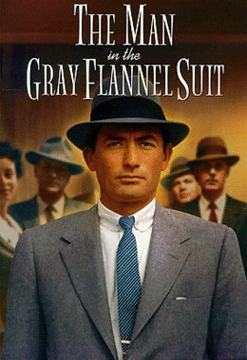
4B. A Changing Workplace
New Corporate Culture: “The Company Man”
1956 → Sloan Wilson’s The Man in the Gray Flannel Suit

Slide 12
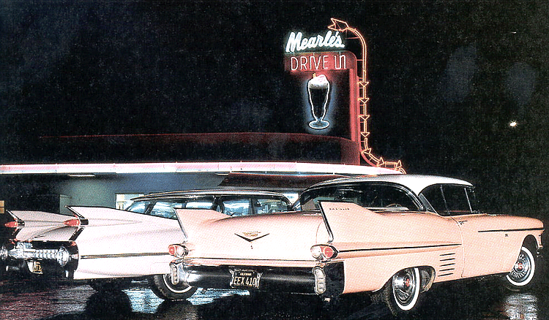
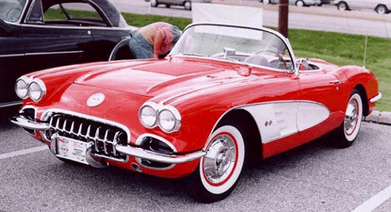
5A. The Culture of the Car
Car registrations: 1945 → 25,000,000 1960 → 60,000,000
2-family cars doubles from 1951-1958
1958 Pink Cadillac
1959 Chevy Corvette
1956 → Interstate Highway Act → largest public works project in American history!
Cost $32 billion.
41,000 miles of new highways built.

Slide 13
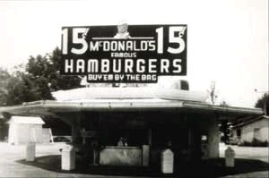
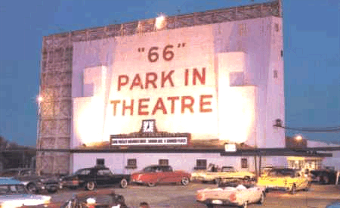
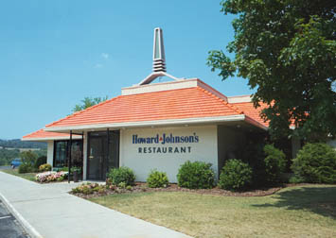
5B. The Culture of the Car
America became a more homogeneous nation because of the automobile.
First McDonald’s (1955)
Drive-In Movies
Howard Johnson’s

Slide 14
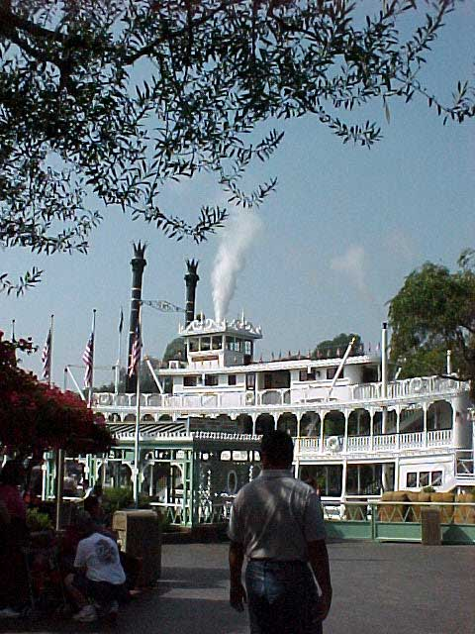
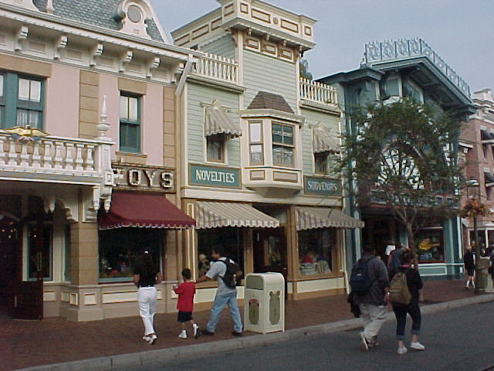
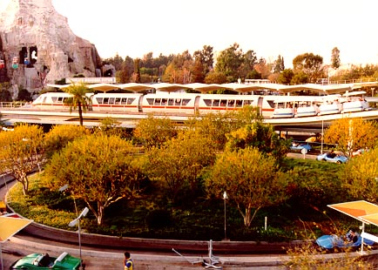
5C. The Culture of the Car
The U. S. population was on the move in the 1950s.
NE & Mid-W → S & SW (“Sunbelt” states)
1955 → Disneyland opened in Southern California. (40% of the guests came from outside California, most by car.)
Frontier Land
Main Street
Tomorrow Land

Slide 15
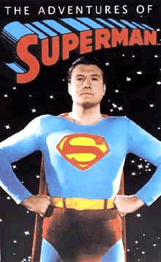
6A. Television
1946 → 7,000 TV sets in the U. S. 1950 → 50,000,000 TV sets in the U. S.
Television is a vast wasteland. → Newton Minnow, Chairman of the Federal Communications Commission, 1961
Mass Audience → TV celebrated traditional American values.
Truth, Justice, and the American way!

Slide 16
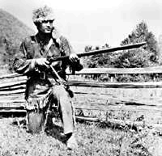
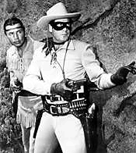
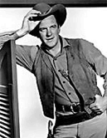
6B. Television – The Western
Davy Crockett King of the Wild Frontier
Sheriff Matt Dillon, Gunsmoke
The Lone Ranger (and his faithful sidekick, Tonto): Who is that masked man??

Slide 17
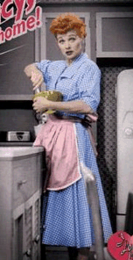
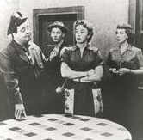
6C. Television - Family Shows
Glossy view of mostly middle-class suburban life.
But...
I Love Lucy
The Honeymooners
Social Winners?... AND… Loosers?

Slide 18
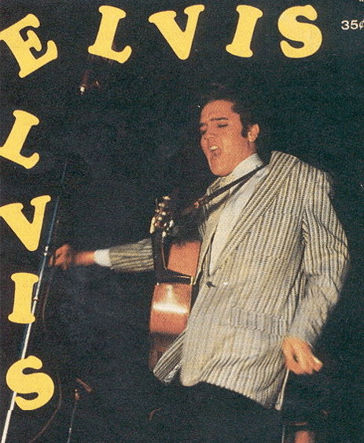
7A. Teen Culture
In the 1950s → the word “teenager” entered the American language.
By 1956 → 13 mil. teens with $7 bil. to spend a year.
1951 → “race music” → “ROCK ‘N ROLL”
Elvis Presley → “The King”

Slide 19
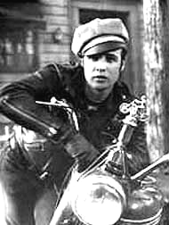
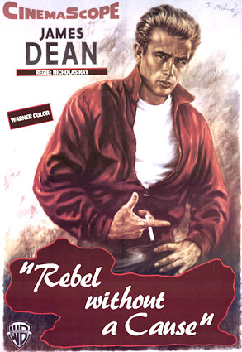
7B. Teen Culture
“Juvenile Delinquency” ???
1951 → J. D. Salinger’s A Catcher in the Rye
Marlon Brando in The Wild One (1953)
James Dean in Rebel Without a Cause (1955)

Slide 20
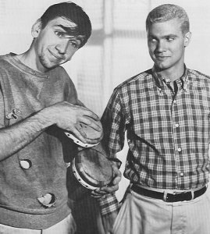
7C. Teen Culture
The “Beat” Generation:
Jack Kerouac → On The Road
Allen Ginsberg → poem, “Howl”
Neal Cassady
William S. Burroughs
“Beatnik”
“Clean” Teen

Slide 21
7D. Teen Culture
Behavioral Rules of the 1950s:
Obey Authority.
Control Your Emotions.
Don’t Make Waves → Fit in with the Group.
Don’t Even Think About Sex!!!

Slide 22
8A. Religious Revival
Today in the U. S., the Christian faith is back in the center of things. -- Time magazine, 1954
Church membership: 1940 → 64,000,000 1960 → 114,000,000
Television Preachers:
1. Catholic Bishop Fulton J. Sheen → “Life is Worth Living”
2. Methodist Minister Norman Vincent Peale → The Power of Positive Thinking
3. Reverend Billy Graham → ecumenical message; warned against the evils of Communism.

Slide 23
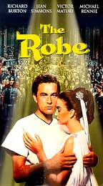
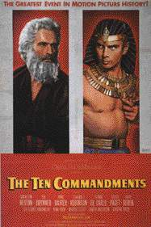
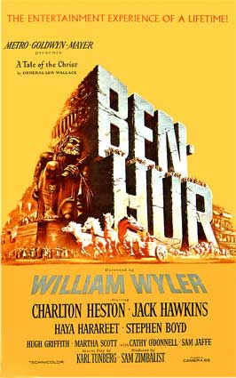
8B. Religious Revival
Hollywood: apex of the biblical epics.
The Robe The Ten Commandments Ben Hur 1953 1956 1959
It’s un-American to be un-religious! -- The Christian Century, 1954

Slide 24
9A. Well-Defined Gender Roles
The ideal modern woman married, cooked and cared for her family, and kept herself busy by joining the local PTA and leading a troop of Campfire Girls. She entertained guests in her family’s suburban house and worked out on the trampoline to keep her size 12 figure. -- Life magazine, 1956
Marilyn Monroe
The ideal 1950s man was the provider, protector, and the boss of the house. -- Life magazine, 1955
1956 → William H. Whyte, Jr. → The Organization Man
a middle-class, white suburban male is the ideal.

Slide 25
9B. Well-Defined Gender Roles
Changing Sexual Behavior: Alfred Kinsey: 1948 → Sexual Behavior in the Human Male 1953 → Sexual Behavior in the Human Female
Premarital sex was common.
Extramarital affairs were frequent among married couples.
Kinsey’s results are an assault on the family as a basic unit of society, a negation of moral law, and a celebration of licentiousness. -- Life magazine, early 1950s

Slide 26
10A. Progress Through Science
1951 -- First IBM Mainframe Computer
1952 -- Hydrogen Bomb Test
1953 -- DNA Structure Discovered
1954 -- Salk Vaccine Tested for Polio
1957 -- First Commercial U. S. Nuclear Power Plant
1958 -- NASA Created
1959 -- Press Conference of the First 7 American Astronauts

Slide 27
10B. Progress Through Science
1957 → Russians launch SPUTNIK I
1958 → National Defense Education Act

Slide 28
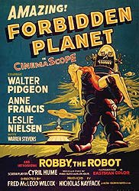
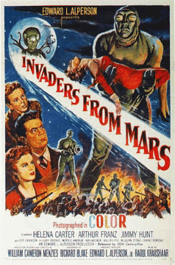
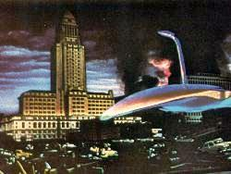
10C. Progress Through Science
UFO Sightings skyrocketed in the 1950s.
War of the Worlds
Hollywood used aliens as a metaphor for whom ??

Slide 29
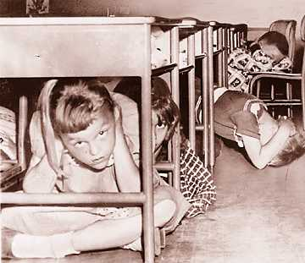
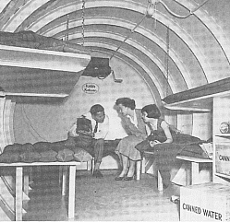
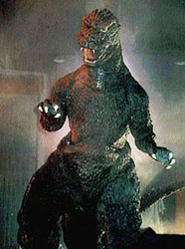
10D. Progress Through Science
Atomic Anxieties:
“Duck-and-Cover Generation”
Atomic Testing:
1946-1962 → U. S. exploded 217 nuclear weapons over the Pacific and in Nevada.

Slide 30
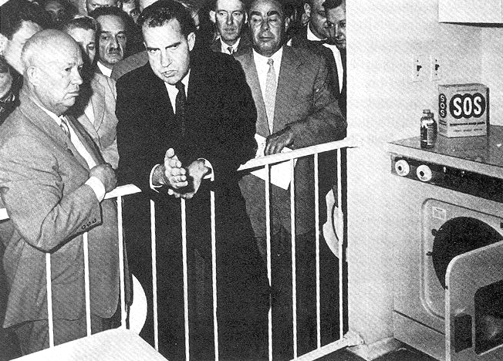
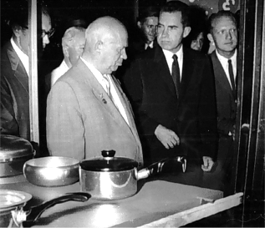
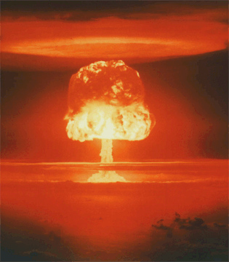
The 50s Come to a Close
1959 → Nixon-Khrushchev “Kitchen Debate”
Cold War -----> Tensions
<----- Technology & Affluence

Slide 31
Class Discussion Topic:
The postwar era witnessed tremendous economic growth and rising social contentment and conformity. Yet in the midst of such increasing affluence and comfortable domesticity, social critics expressed a growing sense of unease with American culture in the 1950s.
Assess the validity of the above statement and explain how the decade of the 1950s laid the groundwork for the social and political turbulence of the 1960s.

