Slide 1
Colonies in America

Slide 2
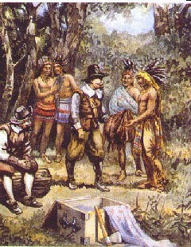
New Netherlands
-Henry Hudson
-Englishman sailing for the Dutch
-Explored the Hudson R. and Hudson Bay areas
-Dutch found colony at New Amsterdam
-lots of different immigrants
-religious freedom
-English take colony in 1664
-renamed New York
-Part of the region divided into the colony of New Jersey

Slide 3
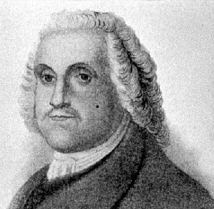
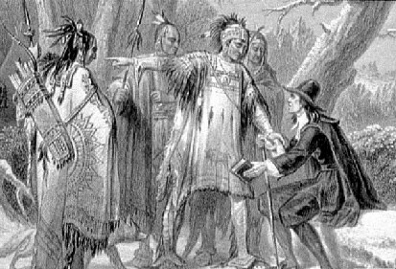
Rhode Island
-founded by Roger Williams
-land peaceably acquired from Indians
-based on religious freedoms that Williams promoted
-church and the government are separate

Slide 4
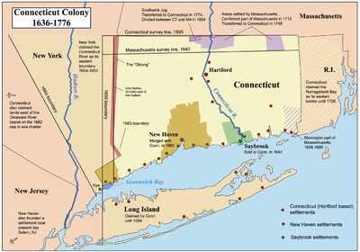
Connecticut
-founded by Thomas Hooker
-wanted more religious freedom than Massachusetts allowed
-disliked the requirement of citizens to be church members
-Fundamental Orders
first constitution in the nation

Slide 5
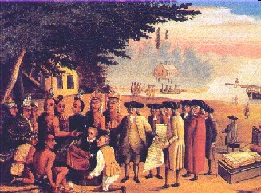
Pennsylvania
-William Penn
-Quakers
religious group who practiced worship without ministers and were pacifists
-Philadelphia
“City of Brotherly Love”
-fair treatment of Indians
-thriving colony

Slide 6
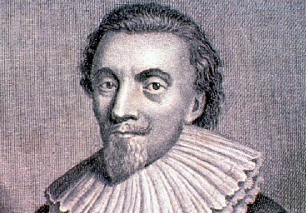
Maryland
-George Calvert
Lord Baltimore
-established as safe haven for English Catholics
-Catholics soon outnumbered
-Toleration Act guaranteed religious freedom (for all?)

Slide 7
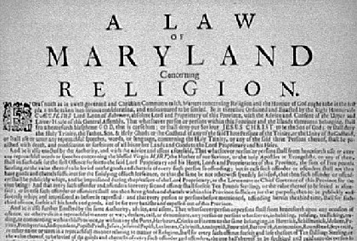
Maryland
-George Calvert
Lord Baltimore
-established as safe haven for English Catholics
-Catholics soon outnumbered
-Toleration Act guaranteed religious freedom

Slide 8
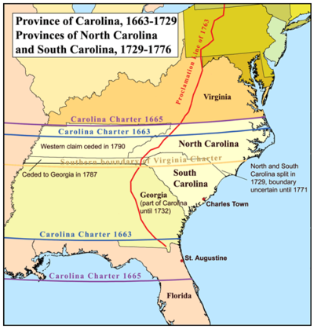
Carolina
-royal colony named after King Charles
-Charles Town became major port city
-large slave populations
-North Carolina created as refuge for the poor and dissenters
-remained thinly populated until mid 1700’s

Slide 9
Other Colonies
-Georgia
James Olgethorpe
haven for debtors
also was a buffer from Spanish areas
-NewHampshire and Maine
-founded by Puritan communities
-N.H. becomes royal colony
-Maine was eventually sold to Massachusetts and remained part of Mass. Until the 1820

Slide 10
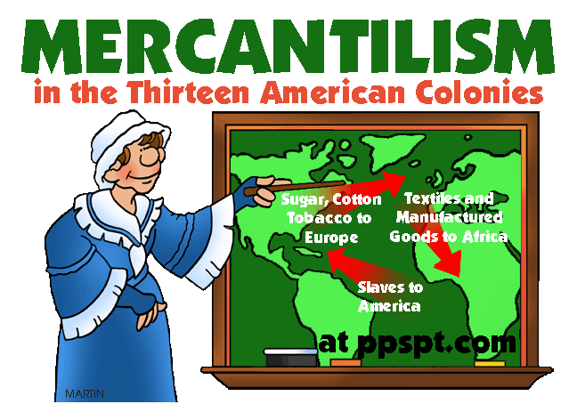
Colonial System
-mercantilism
system of nations increasing their wealth and power through trade with colonies
-English wanted a favorable balance of trade which meant they sold more than they imported from colonies
-Social System
widely available prosperity

Slide 11
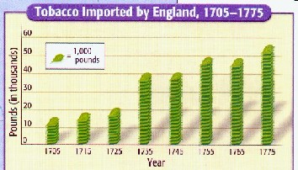
English Control
-colonies were very successful traders
-lumber, furs, fish, grain, tobacco sent to Europe
-large quantities of finished goods bought
-Parliament passes the Navigation Acts
Restricted how colonists could do business

Slide 12
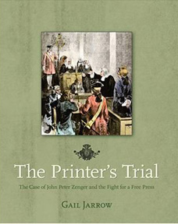
Seeds of Independence
-Glorious Revolution in England, 1688
-Parliament becomes the dominant force in English government
-salutary neglect
very loose supervision of the colonies
-lack of control led to self government
religious, political, economic, and social freedoms
John Peter Zenger Trial

