Slide 1
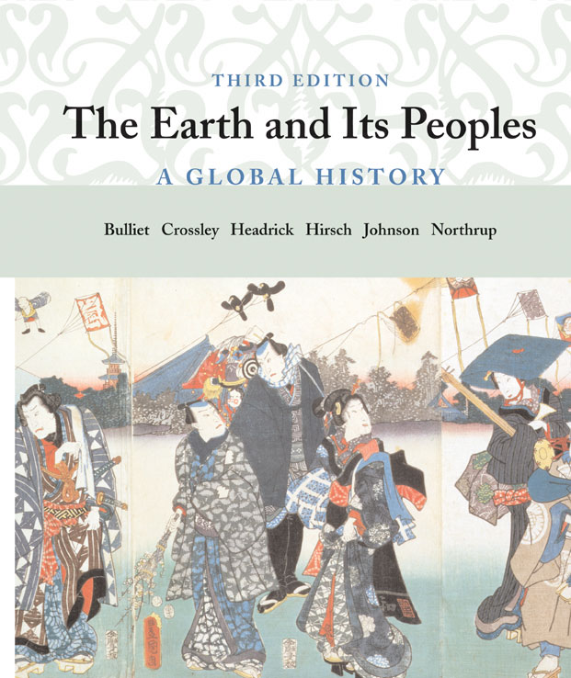
Cover Slide
The Earth and Its Peoples
3rd edition
Chapter 14
Tropical Africa and Asia, 1200-1500
Copyright © Houghton Mifflin Company. All rights reserved.

Slide 2
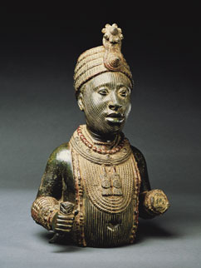
Bronze striated head, Oni of Ife
Bronze striated head, Oni of Ife
Some of the most famous African sculptures were created by the Yoruba, a group of people in the rain forest of what is now Nigeria. Two successive groups of Yoruba people made fine bronze sculptures between 1100 and 1600. One group governed a forest kingdom called Ife; the second Yoruba group formed the state of Benin. The bronze heads of Ife were natural and lifelike. This exquisite bronze (actually an alloy of brass and zinc) bust of a crowned Oni marks the magnificent final stage of Ife art. The delicate modelling of the features is emphasized by the lines running up the face (striations). The rosette above the face proves that this was an Oni. (Jerry Thompson)
Copyright © Houghton Mifflin Company. All rights reserved.

Slide 3
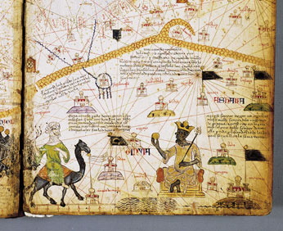
Cresques map, Africa, of Mansa Musa
Cresques map, Africa, of Mansa Musa
Abraham Cresques, a Jewish geographer from the Mediterranean island of Majorca, drew this lavish map in 1375, incorporating all that was known in Europe about the rest of the world. This portion of the Catalan Atlas shows a North African trader approaching the king of Mali, who holds a gold nugget in one hand and a golden scepter in the other. A caption identifies the black ruler as Mansa Musa, "the richest and noblest king in all the land." (Bibliotheque nationale de France)
Copyright © Houghton Mifflin Company. All rights reserved.

Slide 4
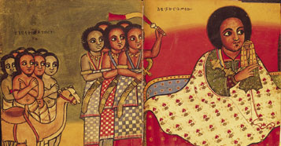
Emperor Yekuno Amlak
Emperor Yekuno Amlak
The Ethiopian emperor Yekuno Amlak's claim that he possessed Solomon's blood won him considerable popular support in his war against the decaying Zagwe dynasty, which he overthrew in 1270. Here he receives Muslim ambassadors while slaves attend him. (British Library)
Copyright © Houghton Mifflin Company. All rights reserved.

Slide 5
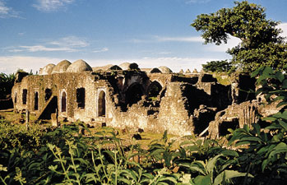
Great Mosque at Kilwa
Great Mosque at Kilwa
By the late thirteenth century, Kilwa had become the most powerful East African coastal city and a great commercial empire comparable to Venice and Genoa. Built between the thirteenth and fifteenth centuries to serve the Muslim commercial aristocracy of Kilwa, this Great Mosque attests to the wealth and power of the East African city-states. (Marc & Evelyn Bernheim/Woodfin Camp & Associates)
Copyright © Houghton Mifflin Company. All rights reserved.

Slide 6
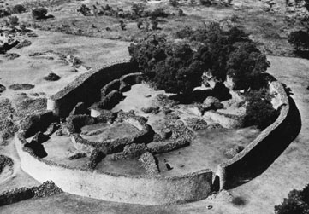
Great Zimbabwe
Great Zimbabwe
At its peak, in about 1400, Great Zimbabwe occupied 193 acres and may have had 18,000 inhabitants. Between 1250 and 1450, local African craftsmen built stone structures for Great Zimbabwe's rulers, priests, and wealthy citizens. The largest structure, a walled enclosure the size and shape of a large football stadium, served as the king's court. Its drystone walls were up to 17 feet thick and 32 feet high. Inside the walls were many buildings, including a large conical stone tower. The stone ruins of Great Zimbabwe are one of the most famous historical sites in sub-Saharan Africa. (Courtesy of the Department of Information, Rhodesia)
Copyright © Houghton Mifflin Company. All rights reserved.

Slide 7
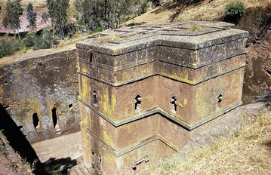
Lalibela
Lalibela
King Lalibela, who ruled the Christian kingdom of Ethiopia between about 1180 and 1220, had a series of churches carved out of solid volcanic rock to adorn his kingdom's new capital (also named Lalibela). The church of Saint George, excavated to a depth of 40 feet and hollowed out inside, has the shape of a Greek cross. (S. Sassoon/Robert Harding Picture Library)
Copyright © Houghton Mifflin Company. All rights reserved.

Slide 8
Map: Africa Before 1500
Africa Before 1500
For centuries trade linked West Africa with Mediterranean and Asian societies. Note the various climatic zones, the trans-Saharan trade routes, and the trade routes along the coast of East Africa. (Copyright (c) Houghton Mifflin Company. All Rights Reserved.)
Copyright © Houghton Mifflin Company. All rights reserved.

Slide 9
Map: African and the Indian Ocean Basin; Physical Characteristics
African and the Indian Ocean Basin; Physical Characteristics
Seasonal wind patterns control rainfall in the tropics and produce the different tropical vegetation zones to which human societies have adapted over thousands of years. The wind patterns also dominated sea travel in the Indian Ocean. (Copyright (c) Houghton Mifflin Company. All Rights Reserved.)
Copyright © Houghton Mifflin Company. All rights reserved.

Slide 10
Map: Arteries of Trade and Travel in the Islamic World, to 1500
Arteries of Trade and Travel in the Islamic World, to 1500
Ibn Battuta's journeys across Africa and Asia made use of land and sea routes along which Muslim traders and the Islamic faith had long traveled. (Copyright (c) Houghton Mifflin Company. All Rights Reserved.)
Copyright © Houghton Mifflin Company. All rights reserved.

Slide 11
Map: The Kingdom of Mali
The Kingdom of Mali
The economic strength of the kingdom of Mali rested heavily on the trans-Saharan trade. (Copyright (c) Houghton Mifflin Company. All Rights Reserved.)
Copyright © Houghton Mifflin Company. All rights reserved.

Slide 12
Map: South and Southeast Asia in the Thirteenth Century
South and Southeast Asia in the Thirteenth Century
The extensive coastlines of South and Southeast Asia and the predictable monsoon winds aided seafaring in this region. Note the Strait of Malacca, through which most east-west sea trade passed. (Copyright (c) Houghton Mifflin Company. All Rights Reserved.)
Copyright © Houghton Mifflin Company. All rights reserved.

Slide 13
Map: Trade Routes Between East Africa and India
Trade Routes Between East Africa and India
The Indian Ocean, controlled by the Muslim merchant fleet until the arrival of the Portuguese in the late fifteenth century, was of far greater importance to world trade than the Mediterranean. Gold from Great Zimbabwe passed through the cities on the East African coast before shipment north to the Middle East and east to India and China. (Copyright (c) Houghton Mifflin Company. All Rights Reserved.)
Copyright © Houghton Mifflin Company. All rights reserved.

