Slide 1
The Crises of 1905-1911
(click to go to)
The First Moroccan Crisis, 1905
The Bosnian Crisis of 1908.
The Second Moroccan Crisis of 1911
(the ‘Agadir Crisis’).
The Sarajevo Crisis of 1914

Slide 2
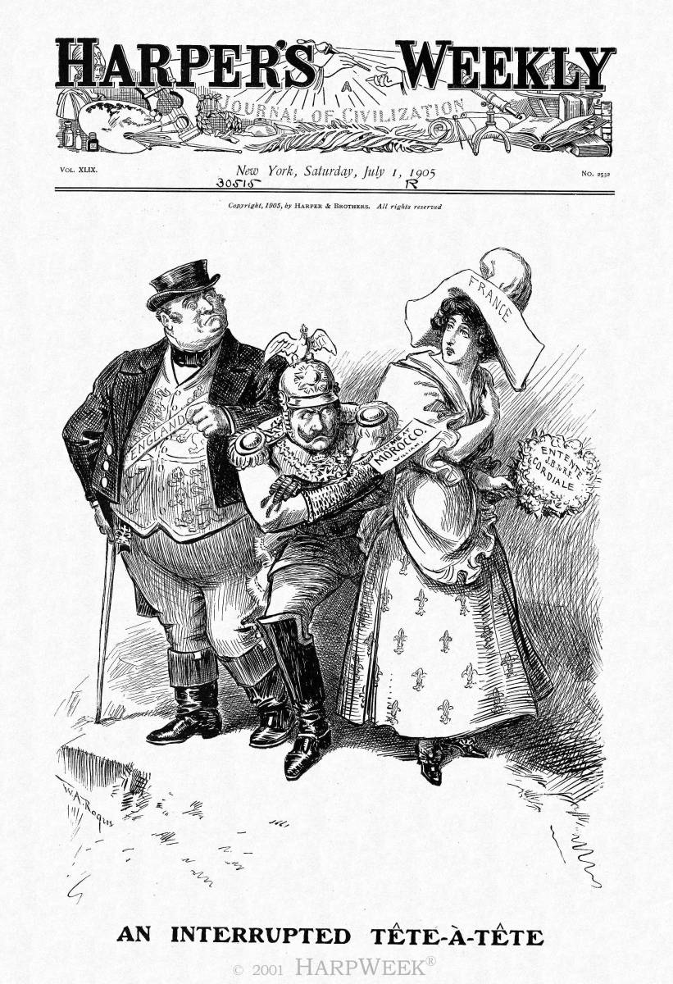
H Harper’s Weekly July 1, 1905
United States

Slide 3
The First Moroccan Crisis of 1905
BACKGROUND:
Background of tension & rivalry (esp. Imperialism - Kaiser Wilhelm wanted 'a place in the sun‘).
Morocco was weak; France hoped to conquer it.
In 1903, the French based an army on the Moroccan border.
In 1904 France and England agree to the Entente Cordial (later Russia will be added)
In Feb. 1905, France demanded control over the Moroccan army and police. The Sultan refused.

Slide 4
The First Moroccan Crisis of 1905
MAIN STORY:
In March 1905, Kaiser Wilhelm visited Tangiers in Morocco.
He told the French agent (Count Cherisay) that he wanted free trade for Germany in Morocco - then dismissed him before he could reply.
He then gave a speech in which he promised to defend Morocco as 'free and independent ‘ and ‘subject to no foreign control'.

Slide 5
The First Moroccan Crisis of 1905
END:
There was an international crisis - both France and Germany threatened war..
The French (scared of another war with Germany) were going to back down, but the British encouraged them to take a firm line..
A Conference was held at Algeciras (1906).
Britain and Russia supported France (Britain stationed a navy patrol outside Algeciras harbour). Roosevelt chosen to mediate
Germany had to promise to stay out of Morocco.

Slide 6
The First Moroccan Crisis of 1905
RESULTS:
The French were ANGRY with Germany.
Britain was frightened of Germany’s Empire.
At the Algeciras Conference (1906) Germany, France, Britain, Italy, Russia, and the United States were in attendance
France, Britain, and Russia forced Germany to promise to stay out of Morocco. Germany felt humiliated. In 1907, Britain and Russia, alarmed by German ambitions, made an Entente - adds to alliances.
Algeciras convinced Germany that the other countries were 'ganging up' on Germany - from this moment, Germany began preparing for war.

Slide 7
The Second Moroccan Crisis, 1911
BACKGROUND:
Background of tension & rivalry (Imperialism - Kaiser Wilhelm wanted 'a place in the sun‘).
At Algeciras (1906), Germany promised to keep out of Morocco - the French Foreign Legion went into Morocco.
In 1910, France made a huge loan to Morocco, and took control of customs and taxes.
In 1910 France sent a gunboat to Agadir in southern Morocco (German newspapers were angry).

Slide 8
The Second Moroccan Crisis, 1911
MAIN STORY:
In March 1911 there was a rebellion in northern Morocco. The French sent an army to defend (= angers the Germans).
In June 1911, the Germans announced that they needed to protect German citizens in southern Morocco (even though there were no German citizens in southern Morocco).
In July 1911, Kaiser Wilhelm sent the gunship Panther to Agadir. It 'rescued' ONE German.

Slide 9
The Second Moroccan Crisis, 1911
END:
There was an international crisis - war-fever in Germany and Britain.
Lloyd George attacked Germany and promised support for France ('Mansion House speech').
Nov 1911: Treaty of Berlin - Germany was forced to remove the gunship and accept instead a small piece of land in the Congo.
Morocco became a French colony.

Slide 10
The Second Moroccan Crisis, 1911
RESULTS:
War-fever in Germany and Britain.
Nov 1911: Treaty of Berlin - Germany was forced to remove the gunship and accept instead a small piece of land in the Congo. Morocco became a French colony.
German resentment: Wilhelm said: 'these events have shown the German people where its enemy is'.
One historian has written: 'the Kaiser was determined not to be the loser in the next crisis'.

Slide 11
The Bosnian Crisis, 1908
BACKGROUND:
Background of tension & rivalry – especially 'Panslavism' (the nationalism which wanted the little nations of the Balkans to be able to rule themselves) and Alliances (esp Russia's alliance with Serbia).
By the Treaty of Berlin (1878), Austria-Hungary had the right to occupy and administer Bosnia.
Turkey was weak and corrupt - 'the sick man of Europe'. In 1908 there was a revolution in Turkey.

Slide 12
The Bosnian Crisis, 1908
MAIN STORY:
In 1908, Austria fully annexed Bosnia (i.e. it became part of the Austrian Empire).
Serbia - which had been hoping to get part of Bosnia (so it could have a port on the Adriatic Sea) - protested. Serbia called up its army demanded a strip of land across Bosnia to the Adriatic Sea.
Serbia was supported by Russia, which proposed a conference.
Austria Hungary, Turkey and Germany said that a Conference wasn't necessary. There was an international crisis.

Slide 13
The Bosnian Crisis, 1908
END:
There was an international crisis - Germany threatened war.
Russia and Serbia were forced to back down and humiliated. Serbia was forced to agree publicly to Austria's annexation.
The Kaiser boasted that he had stood by Austria 'in shining armour'.

Slide 14
The Bosnian Crisis, 1908
RESULTS:
There was more trouble in the Balkans (Balkans War) in 1912-13.
Serbia was furious (Bosnia included many Serbs). This led to the assassination at Sarajevo, 1914.
Russia vowed not to back down again – which led to Nicholas's decision to mobilise in 1914.
Kaiser Wilhelm was proud he had helped Austria - so after Sarajevo he gave Austria a 'blank cheque‘ … which helped cause the slide to war in 1914.

Slide 15
The Sarajevo Crisis, 1914
BACKGROUND:
'Panslavism‘ - 28 June was Serbia's National Day and the visit was an insult to Serbia.
Austria-Hungary (the 'polyglot empire') feared panslavism - the Austrian Army had asked for a war with Serbia 25 times.
Sarajevo was in Bosnia (the province annexed by Austria-Hungary in 1908).
In the 1912-13 Balkans Wars, Serbia had grown. Its Prime Minister Pasic said: 'The first round is won. Now for the second round - against Austria'.

Slide 16
The Sarajevo Crisis, 1914
MAIN STORY:
Franz Ferdinand was heir to the throne of Austria-Hungary.
28 June: Six young Bosnian Serbs - linked to the Black Hand - lined up to assassinate him as he drove along the Appel Quay in Sarajevo.
Nedeljko Cabrinovic threw a bomb. He missed and was arrested. The Archduke decided to return home immediately via a different route.
No one told the driver, so he turned into Franz Josef Street, then stopped the car ... in front of Gavrilo Princip, who shot Franz Ferdinand and Sophie.

Slide 17
The Sarajevo Crisis, 1914
END:
The assassination caused horror, but not at first an international crisis (the Kaiser went on holiday).
Austria provoked the international crisis by sending Serbia an ultimatum on 23 July 1914...

Slide 18
The Sarajevo Crisis, 1914
RESULTS:
The Crisis caused a sequence of events which resulted in the First World War.

