Slide 1
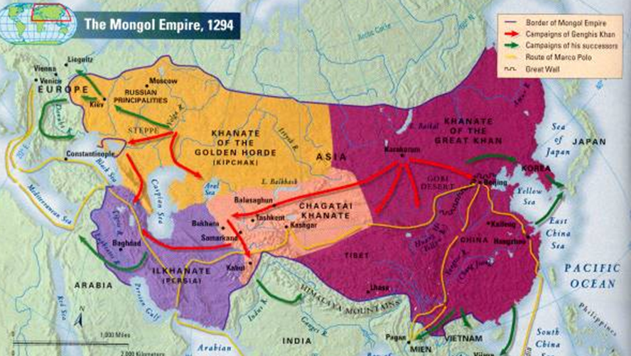
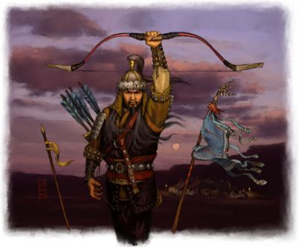
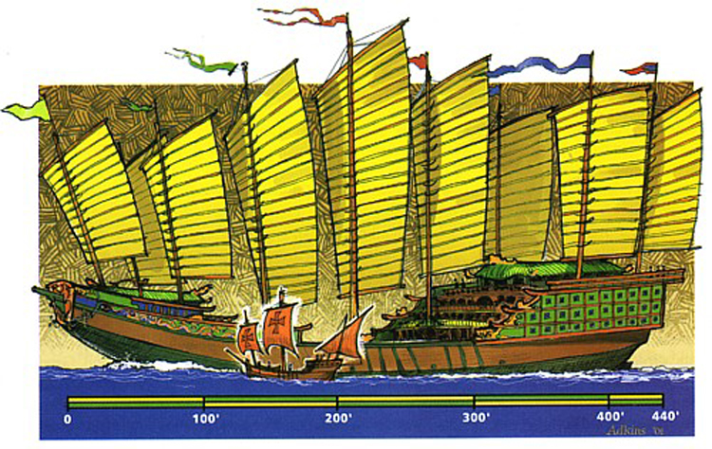
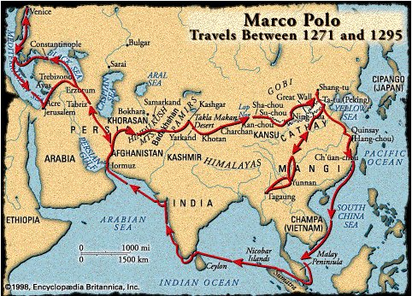
Chapter 12: Mongol Eurasia, 1200-1500

Slide 2
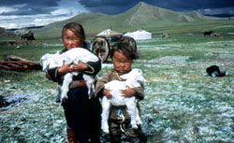
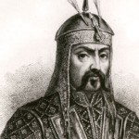
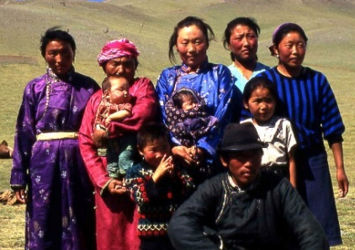
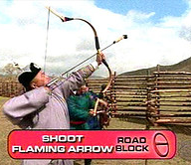
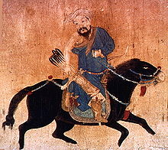
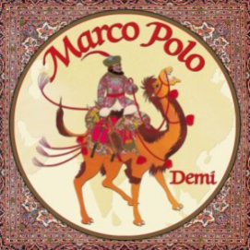
The Rise of the Mongols, 1200-1260
Nomadism in Central and Inner Asia
Nomadism – continual migration in search of pastures and water.
Mongol Society
Council of powerful families ratified Khan’s decisions
If you disagreed, you could leave
Slaves did the small stuff
Weaker groups paid for protection
Mongol Women – pawns and place holders
The Khan – in touch with heaven & earth
The Mongol Conquests, 1215-1283
Genghis Khan takes NW China and East of Caspian Sea
Genghis Khan’s Successors
Ogodei – Northern China, up to the Song, Kievan Russia, Poland
Guyuk – captures Baghdad (no more Abbasid)
Capital Karakorum – controlled the other domains
Ogodei dies, Khubilai capital Beijing, Yuan Empire takes Song, Annam & Champa
Military Techniques – cavalry equipped with long range bows
Siege and Terror – throwing things on fire, surrender only option
Overland Trade and Disease
Traveler’s Accounts: (Venetian) Marco Polo – inspired European trade
Rats and fleas – bubonic plague, typhus, small pox, the flu does west

Slide 3
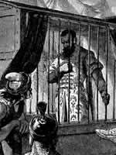
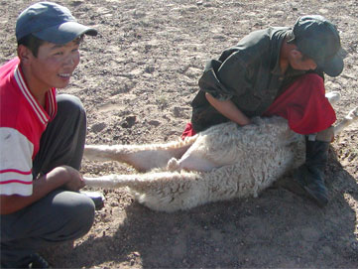
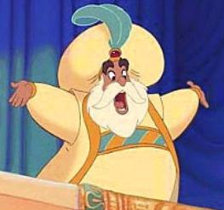
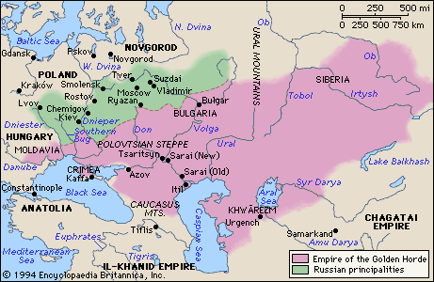
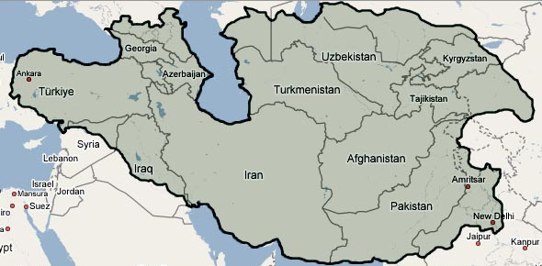
The Mongols and Islam, 1260-1500
Mongol Rivalry
Il-khans (Iran/Iraq) and the Golden Horde (SW Russia) – ruling over Muslim populations
Mongols - melting pot of religions with advisors that match
Mongol practices clash with Muslims (slaughter of animals and idols)
Golden Horde leader converts to Islam moves south through Caucasus Mts
Ghazan (Il-Khan) converts to Islam
Islam and the State
Taxes and Administration – tax farming
Paper Money – complete failure
Sultanate = domain of a Muslim ruler
Timur takes most of Il-Khan and part of sultanate of Delhi (1398), Ottoman Sultan (1402)

Slide 4
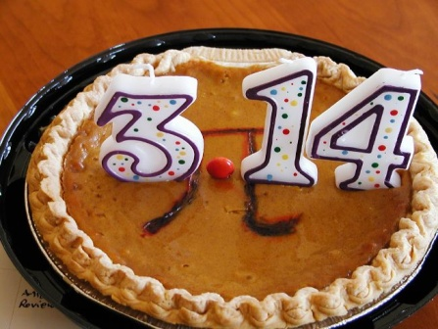
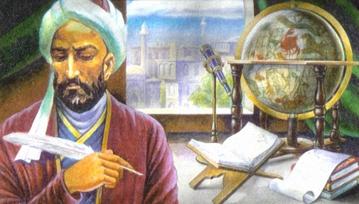
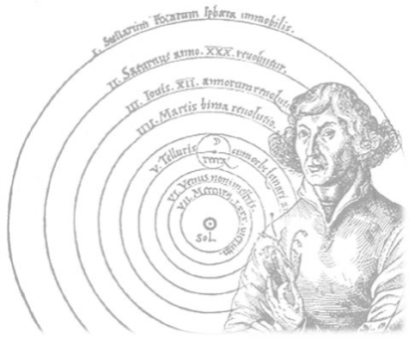
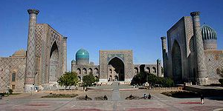
The Mongols and Islam, 1260-1500 continued…
Culture and Science in Islamic Eurasia
Middle East scholars, artists, craftsman transported to Samarkand
Administrators and historians – Rashid al-Din (Il-Khan PM)
In Samarkand and Herat – Timurid rulers sponsored historical writing in Persian/Turkish
Islamic Science and Astronomy
Nasir al-Din – math (algebra/trig) and cosmology (study of the universe)
Followers used the math to better understand celestial orbits
Copernicus uses data for heliocentric theory
Frameworks: Eclipse predictions – make the circuit – Mamluk (Arabic), Byzantine monks (Greek), Spanish Christian (Latin), Sultan of Delhi (Sanskrit)
Decimal Notation
Ghiyas al-Din Jamshid al-Kashi – inspired by Chinese to use decimal notation.
Further defines pi
Frameworks: His work gets to Europe via Byzantine (Greek)

Slide 5
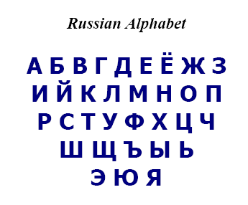
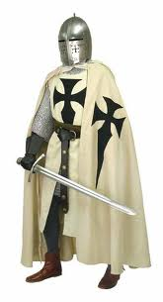
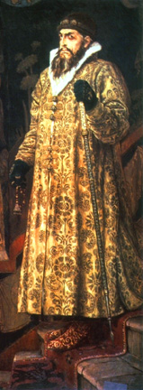
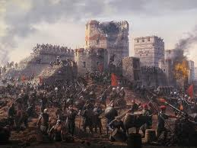
Regional Responses in Western Europe
Russia and rule from afar
(Old) Sarai – Golden Hoarde (GH) Capital
Growth of Russian Language – Russian princes used by GH as assistants
Economic Problems – epic fail on paper money… again, barter
Alexander Nevskii – cooperation win Novgorod & Moscow favor
The “Mongol Yoke” vs. Russian tax farmers & isolation due to Constantinople alignment
Title of Tsar (Caesar) – Ivan III
New States in Eastern Europe and Anatolia
Teutonic Knights – German speaking northern crusaders
Frameworks: xfer of knowledge from Mongols to Europe
Coal Mining
Movable type
High temperature metallurgy
Mathematics
Gun Powder
Lithuania – sidestepped the Mongols
Serbian Empire – dies out with Kosovo (1389)
Ottoman Empire – Osman starts (1300)
Timur speed-bump (1402)
Mehmet II – Istanbul (1453)

Slide 6
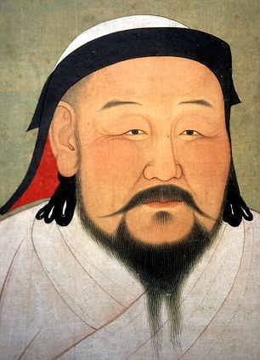
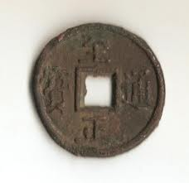
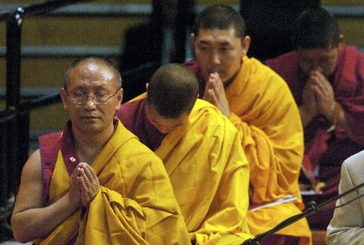
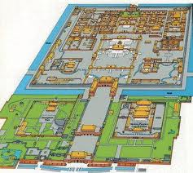
Mongol Domination in China, 1271-1368
Yuan Empire, 1271-1268
Khubilai gave oldest son Chinese name and tutored by Confucians
Buddhist priests (lamas) favored by Mongol leaders
Beijing as Yuan Capital – eastern terminal of silk road
Forbidden City – Imperial complex
Summers in Shangdu
Yuan Society
Mongols – Warriors
Central Asians & Middle Eastern = census/tax collectors
Confucians loose power b/c disfavor merchants/doctors
Yuan Administration – organized China into provinces
Growth of Commerce – investor groups & copper coinage
Merchant Tastes – specialized shops, entertainment, vernacular
Agriculture – neglected – 90% lived there
Population Loss – 40% in 80 years
Fall of the Yuan
Farmer rebellions & inter Mongol feuds
Zhu Yuanzhang establishes Ming
Not all Mongols conquered

Slide 7
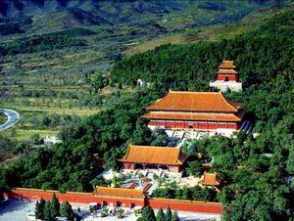
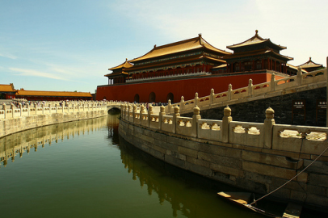
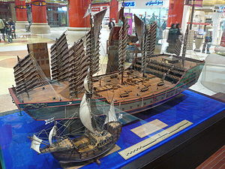
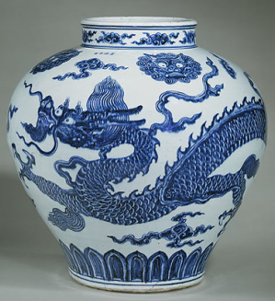
The Early Ming Empire, 1368-1500
Ming China on a Mongol Foundation
Emperor Hongwu
Moves capital to Nanjing
Utilizes Buddhism to get into power than switches to Confucianism
Becomes inner focused (Confucianism?)
Emperor Yongle
Coup d'état
Capital back to Beijing, enlarges forbidden city
Restored commercial links with Middle East (silk road in Mongol territory)
Explorer Zheng He
Muslim Eunuch – eased travel in Middle East
7 voyages as far as Madagascar?
Cement relations and collect taxes – 50 new tributary states
End of Ming Sea Expeditions – with deaths of Zheng He and Yongle
Technology and Population
Technological Slowdown – high taxes on mining trickle down, slow farmers
Population growth/agriculture – growth caused domestic farming shift
Military Technology – classification of knowledge to avoid losing it
The Ming Achievement
Chinese Novels
Ming ware

Slide 8
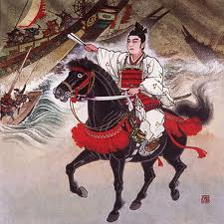
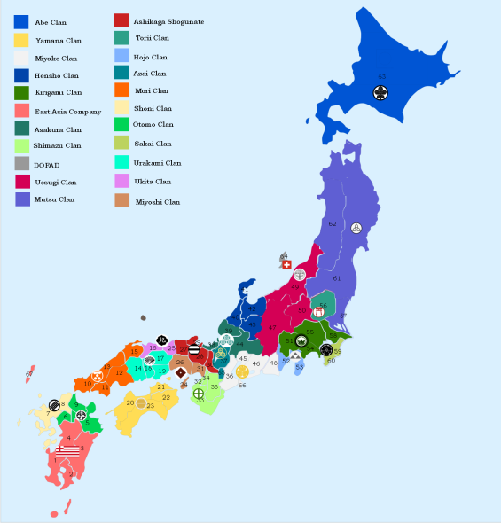
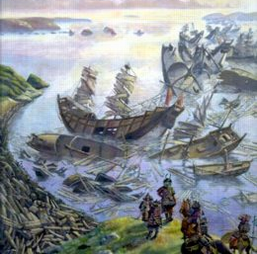
Centralization and Militarism in East Asia, 1200-1500
Korea from the Mongols to the Yi, 1231-1500
Mongol Conquest – Korea a great place to control shipping from
Breakdown of Isolation – cotton, gunpowder, & commerce, resulting in educated class
Yi Dynasty – out with the Mongol friendly Koryo, Confucian Yi in – Seoul
Korean Printing – laid foundation for hi literacy rate
Cotton - provides cash crop, Gunpowder - makes navy effective against pirates
Political transformation in Japan, 1274-1500
Mongol Attacks – somewhat thwarted by a bad storm, Give Japanese time to prepare
Kamakura Shogunate –
Attempts to get Shoguns focused/organized on Mongols
Builds wall to prevent access to Hakata Bay
Boarding parties welcome Mongols with Japanese swords
Kamikaze: “Divine Wind” – typhoon sinks half of Mongol ships
Ashikaga Shogunate – took control of Kyoto imperial center
Zen Buddhism
Onin War – battle of warlords
The Emergence of Vietnam, 1200-1500
Annam (NV) and Champa (SV)
Annam’s Victory

