Slide 1
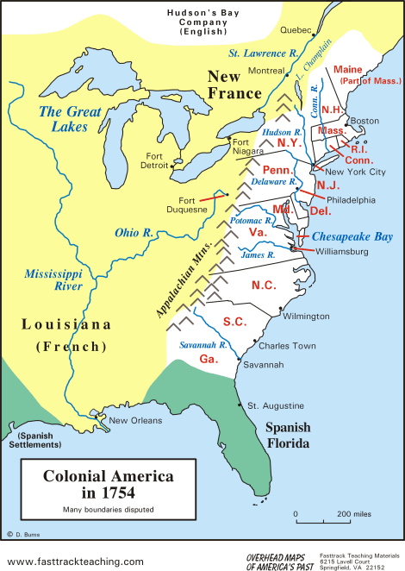
Colonial Life in the American Colonies
A Comparison Prior to 1754

Slide 2
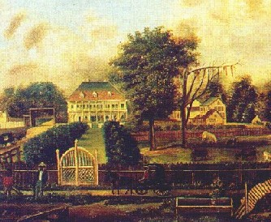
Agricultural South
-growth of cash crops
tobacco, rice, indigo
-large plantations dominate economy
-many small farms also
-few towns and cities because of the agricultural lifestyle

Slide 3
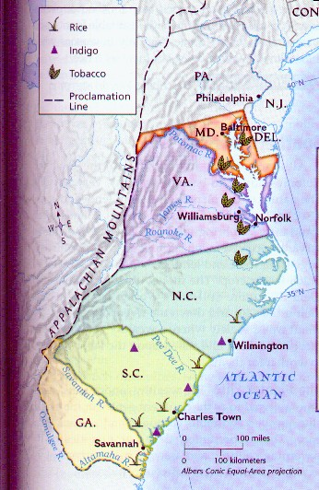
Agricultural South
-growth of cash crops
tobacco, rice, indigo
-large plantations dominate economy
-many small farms also
-few towns and cities because of the agricultural lifestyle

Slide 4
Southern Society
-plantation owners were top of society
-small farmers were most of the population
-second class role of women
-indentured servants
-slaves were lowest level
-slavery as a “necessary evil” to support the agricultural lifestyle

Slide 5
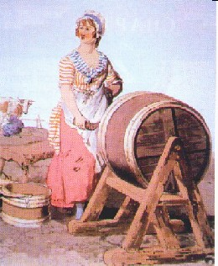
Southern Society
-plantation owners were top of society
-small farmers were most of the population
-second class role of women
-indentured servants
-slaves were lowest level
-slavery as a “necessary evil” to support the agricultural lifestyle

Slide 6
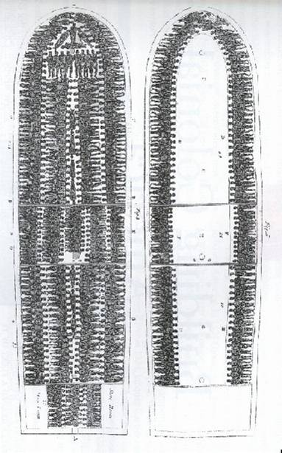
Slavery in America
-slaves would replace Indians and indentured servants
-Triangular Trade
slaves-sugar-rum
-Middle Passage
-Slave culture
dance, religion
-slave resistance

Slide 7
Settlement Patterns
-development of cities
Most were port cities---Boston--New York—Philadelphia—Charleston
-lots of different immigrant groups and religions
-English, Germans, and Irish were largest groups
-resentment begins

Slide 8
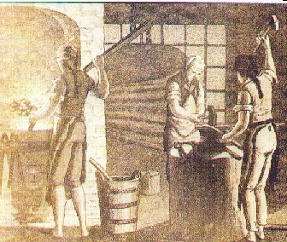
Industrial North
-diversified economy
-harsher weather conditions
-food exports
-lumber industry
-ship building
-iron making

Slide 9
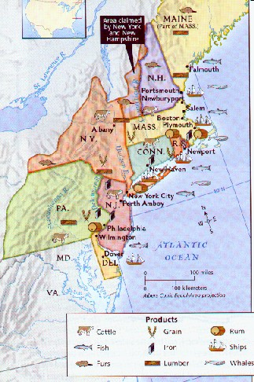
Industrial North
-diversified economy
-harsher weather conditions
-food exports
-lumber industry
-ship building
-iron making

Slide 10
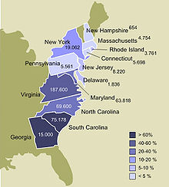
Northern Slavery
-not as much slavery
-crops required less labor
-many house or dock workers
-slaves had more rights than southern slaves but were still not equal with free citizens
-as immigrants provided cheap labor, many slaves were emancipated or slavery abolished in northern areas

Slide 11
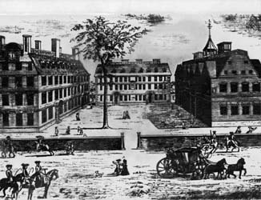
Colonial Education
-rate of education higher in colonies than in England
-religious purposes
-establishment of universities
Harvard, Colombia, Princeton, Yale

Slide 12
Enlightenment Thought
-stresses the use of reason and scientific method
-led to many scientific discoveries
-Benjamin Franklin as leading American scientist
-also led to increasing education

Slide 13
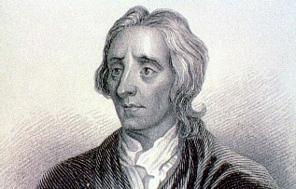
Philosophy
-John Locke
-Natural Rights
life, liberty, property
-Social Contract---an agreement between a people and their gov’t to protect their rights
-Baron Montesquieu
separation of powers in government

Slide 14
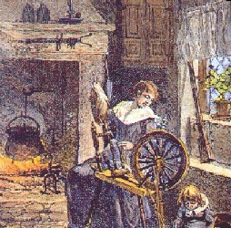
Colonial Women
-few legal rights
-did many jobs on the farms of the region
-only single women could own property or run a business
-religion also helped to make women submit to men

Slide 15
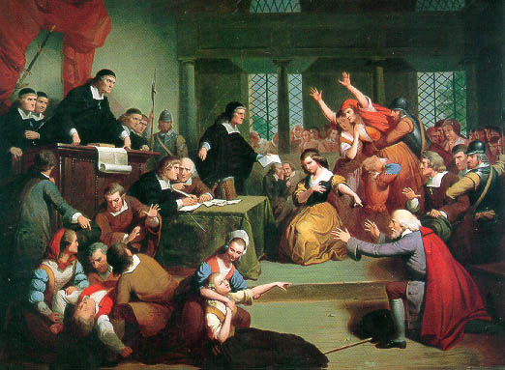
Witch Trials
-1692 - Salem , Massachusetts
https://youtu.be/wDdtOwYi8vY
-Puritan community standards being challenged
-young girls accused people of being witches
-the accused named other witches
-witches were often executed
-trials later suspended due to poor evidence

Slide 16
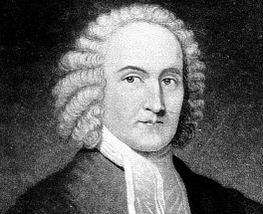
Great Awakening
-a revival of the Puritan faith
-Jonathan Edwards
“Sinners in the Hands of an Angry God”
-George Whitefield
-new religious denominations
Long term Impact?
https://youtu.be/n-dk4-HBNWQ

