Slide 1
Unit Zero
AP World History: Modern

Slide 2
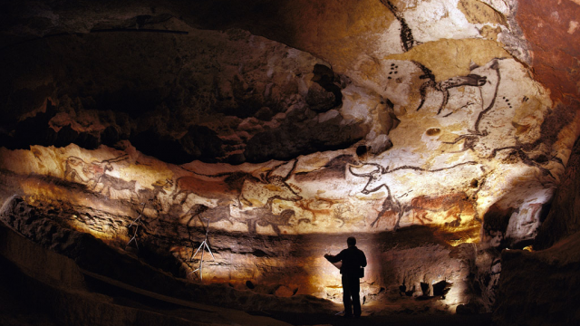
Foundations to 1200 CE
Lascaux Caves - France

Slide 3
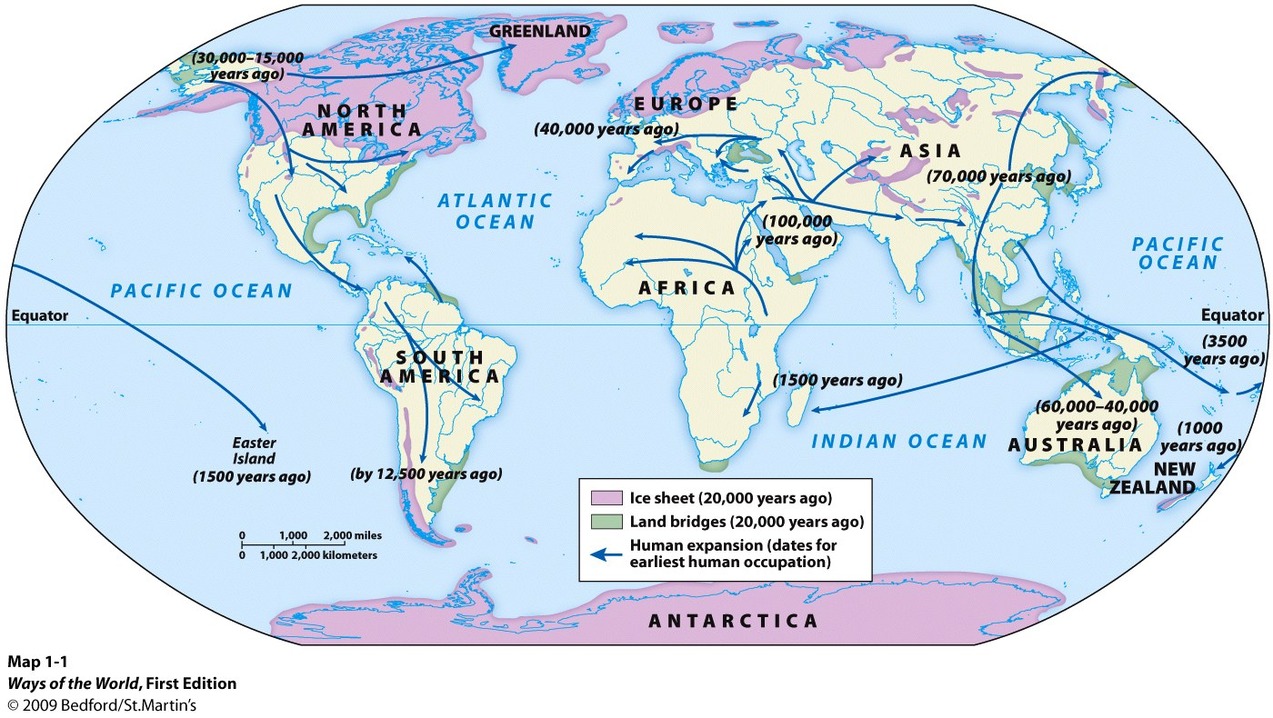
Paleolithic Age
Out of Africa Theory: Began ~100,000 years ago
Paleo Characteristics:
Nomadic
Hunter-gatherers
Simple stone tools
Kinship based clans
No full time leaders/specialized occupations
Oral language
Fire

Slide 4
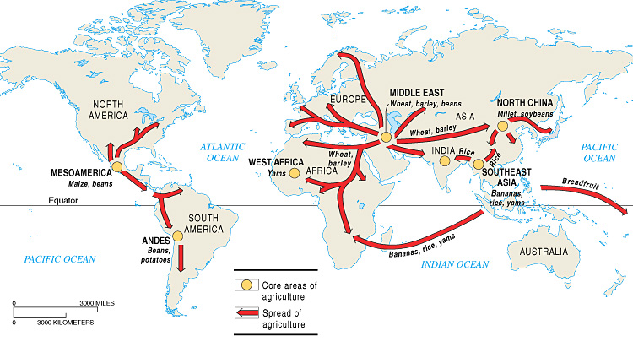
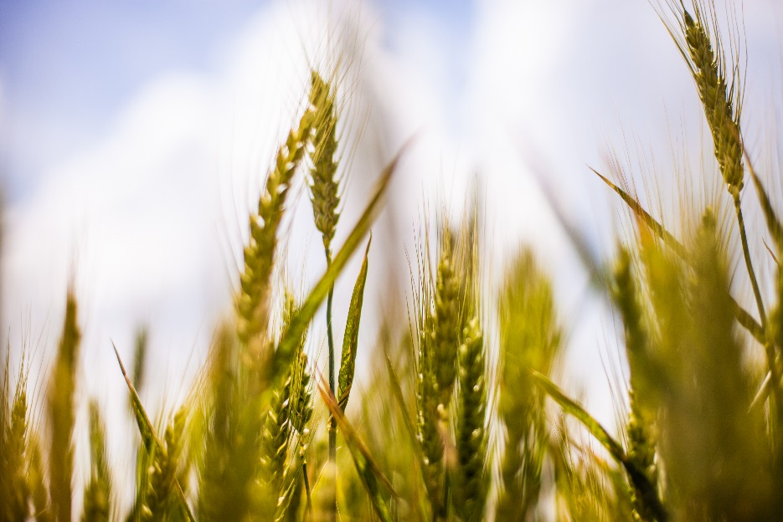
Neolithic Age
Agriculture – Emerges around 10,000 years ago; the domestication of plants and animals
Result? People settled into permanent, farming villages and subsistence patterns changed!

Slide 5
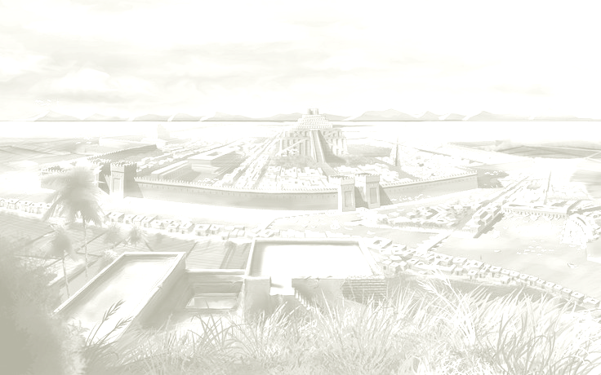
Neolithic Age
Less egalitarian
Epidemic diseases spread
3. Villages 🡪 cities 🡪 civilization
4.Specialized labor
5. Writing develops
6. Population increases
Big Picture Question – How did agriculture change human life?

Slide 6
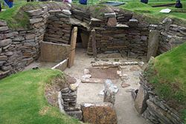
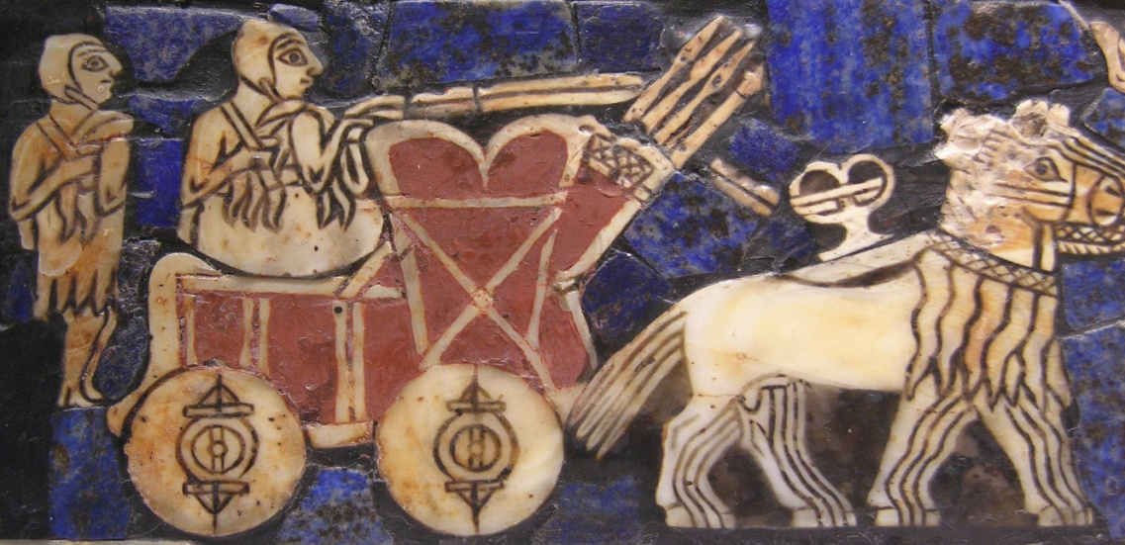
Neolithic Age
Wheeled vehicle in the Sumerian “Battle Standard of Ur”, 2500 BCE
Skara Brae – Europe’s most complete Neolithic village
CONTINUITY:
Pastoralism – Semi-nomadic peoples who herded animals/foraged but did not practice agriculture on a large scale (seen as “barbaric” by settled people)
Developed on grasslands of Central Asia
Domestication- 1st animal to be domesticated was the dog, then goats (gaol to provide labor or food)
Impact of pastoralists? Degraded grassland by overgrazing, but spread ideas/technology quickly (ex: Hittites spreading iron)

Slide 7
Was farming a good idea?
Directions- Students split into four groups - two groups will come up with an argument that it was, two will argue the opposite
Students will have 10 minutes to brainstorm
5 minutes to put up on a whiteboard
Then must switch to next group and argue the other side

Slide 8
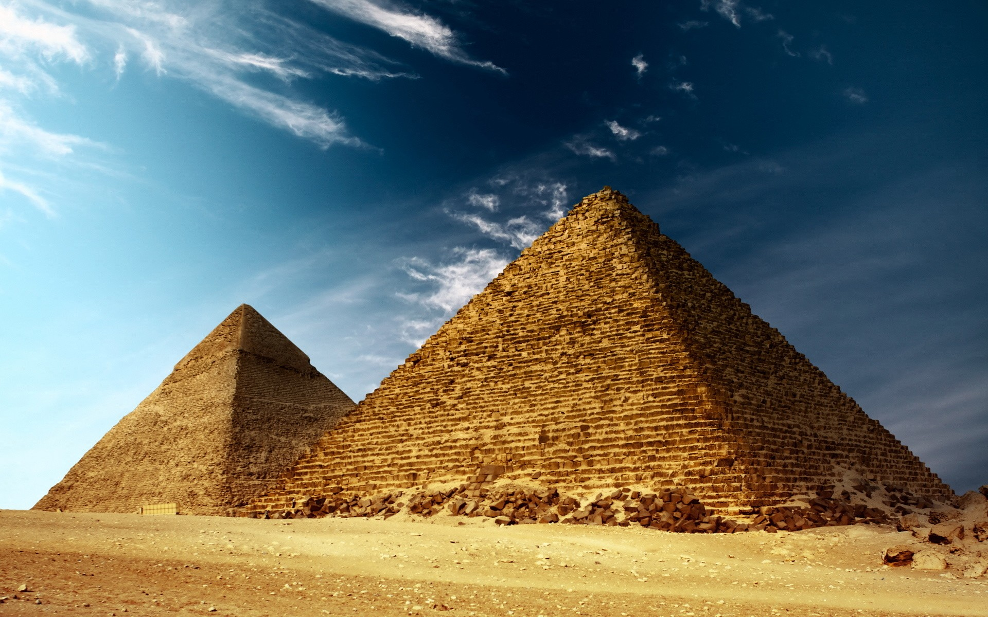
Rise and Fall of Civilizations

Slide 9
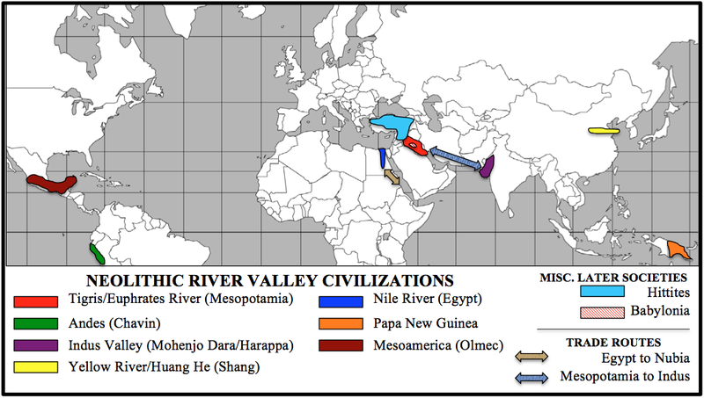
1st Wave/River Valley Civilizations

Slide 10
2nd Wave/Classical Empires
Big Picture Question – What are some common characteristics of 1st and 2nd wave civilizations?

Slide 11
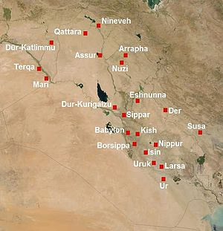
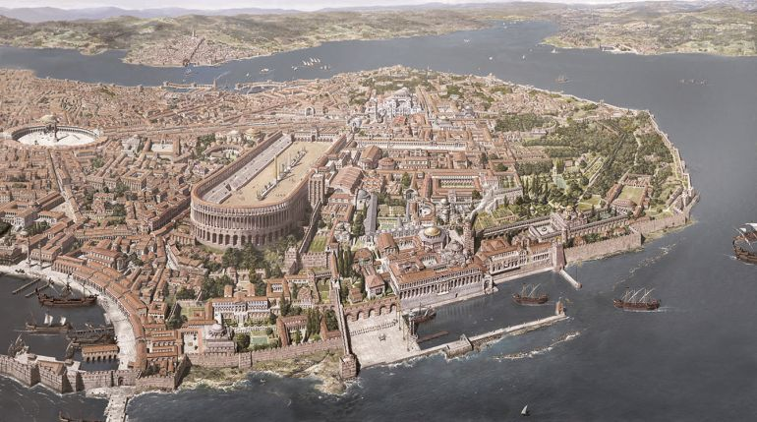
1. Urban Focus
Urbanization – movement into cities
Mesopotamian city-states, Harappa, Mohenjo-daro, Greek city-states, Rome, Persepolis, Pataliputra, Constantinople
Constantinople
Map of Mesopotamia

Slide 12
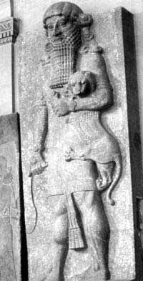
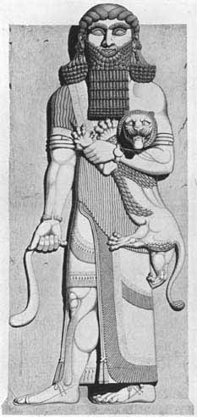
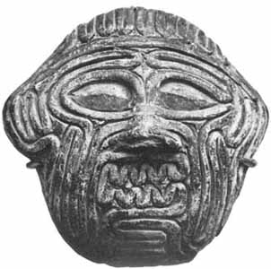
Come the, Enkidu, to ramparted Uruk,
Where fellows are resplendent in holiday clothing,
Where every day is set for celebration,
Where harps and drums are played.
And the harlots too, they are fairest of form,
Rich in beauty, full of delights,
Even the greatest gods are kept from sleeping at night.

Slide 13
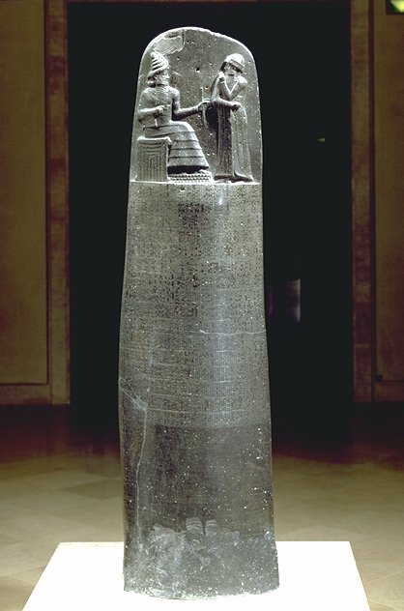
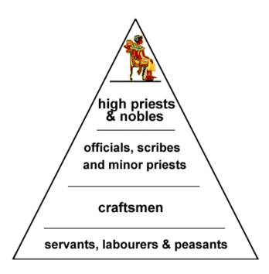
2. Social Hierarchy
Social Hierarchy (or stratification) – divisions/inequality within society
Specialization led to these inequalities
Law codes reflected inequality
Wealth piled up, not out
Slavery
Social stratification in Mesopotamia
Code of Hammurabi

Slide 14
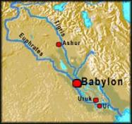
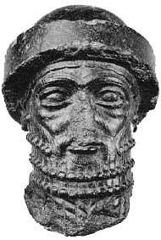
If any one strike the body of a man higher in rank than he, he shall receive sixty blows with an ox-whip in public.
-198 Hammurabi’s Code

Slide 15
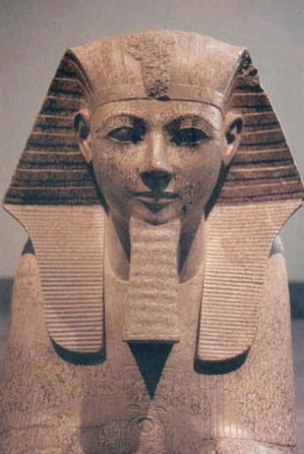
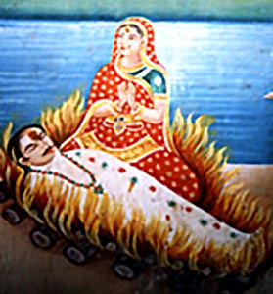
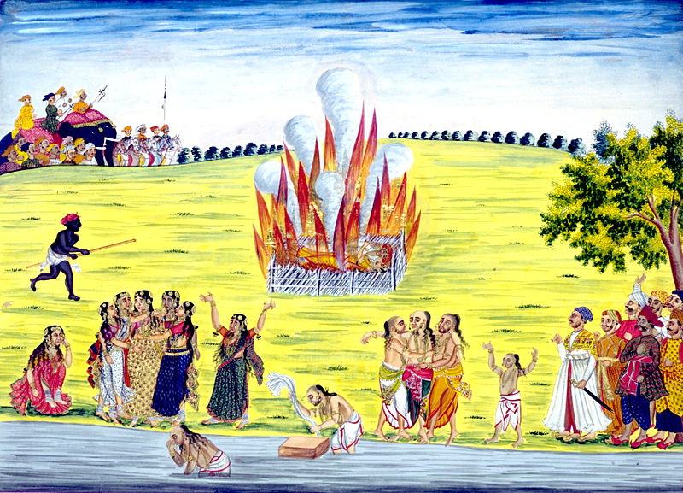
3. Patriarchy
Physical strength needed for agricultural tools
Farmland outside the city so women stayed home
Some societies less patriarchal 🡪 Egypt
Cultural practices reflected patriarchy 🡪 Sati
A sati ceremony
in India
Queen Hatshepsut

Slide 16
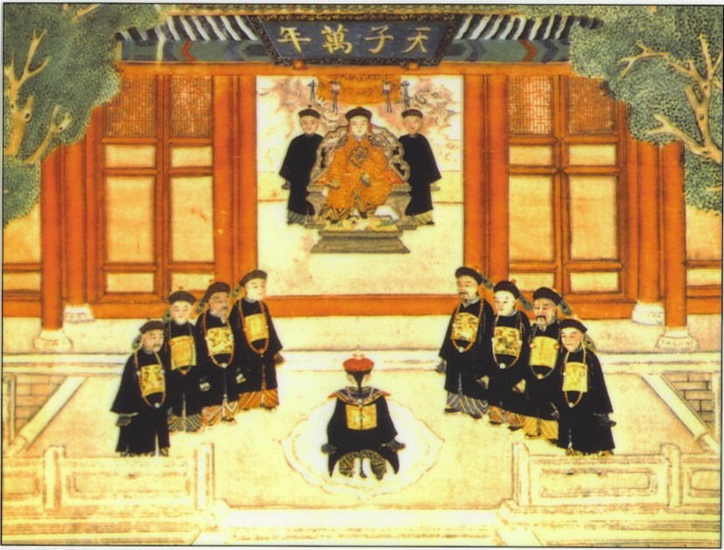
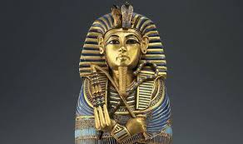
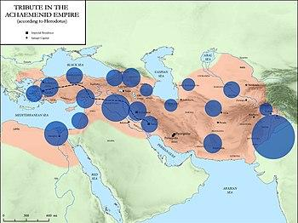
4. Centralization
Kings assisted by bureaucracies
managing government through departments run by appointed officials
Classical Persian satraps or Chinese merit-based bureaucrats
Mandate of Heaven
Scepter – symbol of royal power
Satrapies in Persia

Slide 17
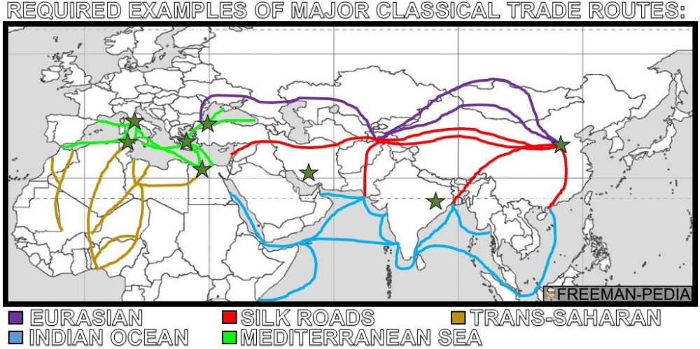
5. Emphasis on Trade
Taxing trade through the empire led to great wealth
Protecting trade routes was an important government role

Slide 18
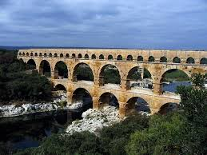
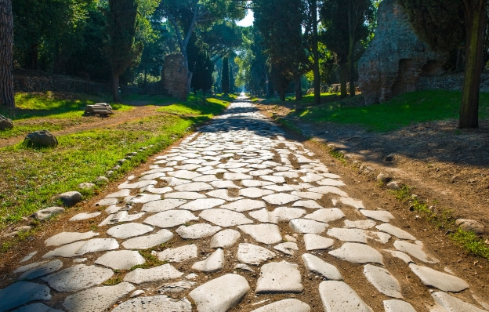
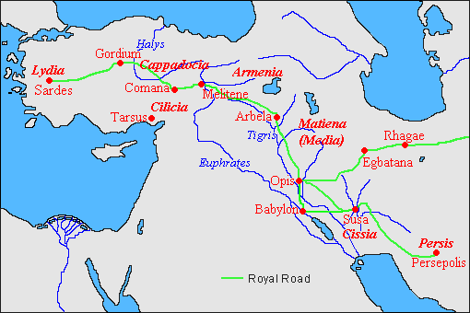
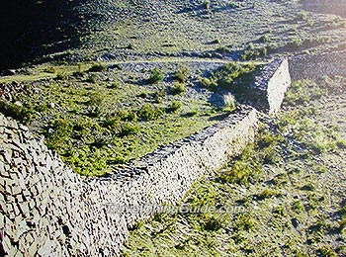
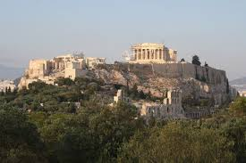
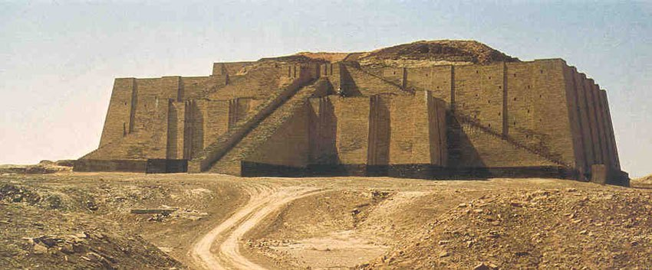
6. Infrastructure/Monumental Architecture
Facilities needed to operate society (roads, bridges)
Walls, roads, fortifications
Roman Aqueducts
Roman Roads
Persian Royal Road
Qin started Great Wall
Athenian Acropolis
Ziggurat

Slide 19
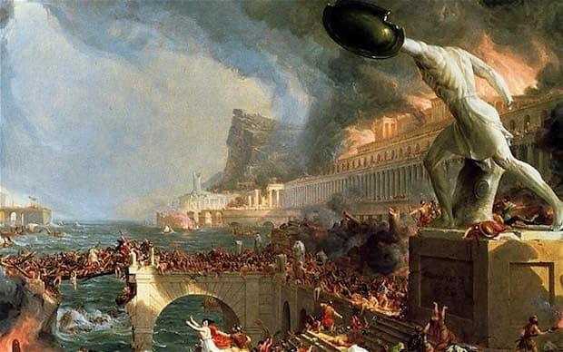
Why Do Empires Collapse?
Over-extension (maintaining borders)
Political corruption
Failing economies
Peasant revolts
Alienation of elite (high taxes)
Disease epidemics
Invasion
220 CE – Han collapses
476 CE – Rome collapses
550 CE - Gupta collapses

Slide 20
List of Empires
Persia- Achaemenid
Persia- Parthian
Persia- Sassanid
China- Han
India- Guptan
Mediterranean- Rome
Americas- Maya
Americas- Teotihuacan

Slide 21
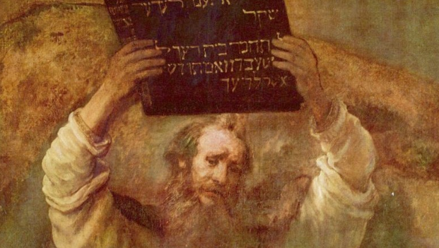
Belief Systems
to 1200
Moses with the 10 Commandments (17th c painting by Rembrandt)

Slide 22
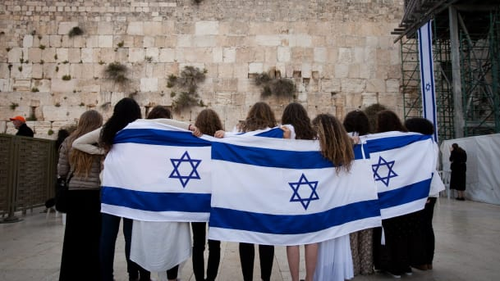
Judaism
Founder: Abraham
Beliefs: monotheism,
10 Commandments
Sacred Text: Torah
AP Loves:
History of living in DIASPORIC COMMUNITIES (living outside the homeland)

Slide 23
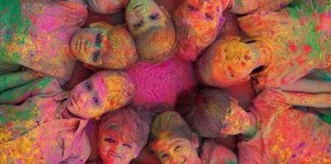
Hinduism
Founder: Unknown
Beliefs: Many forms of one God, karma, reincarnation
Sacred Text: The Vedas
AP Loves:
Caste system
Cultural unity in India

Slide 24
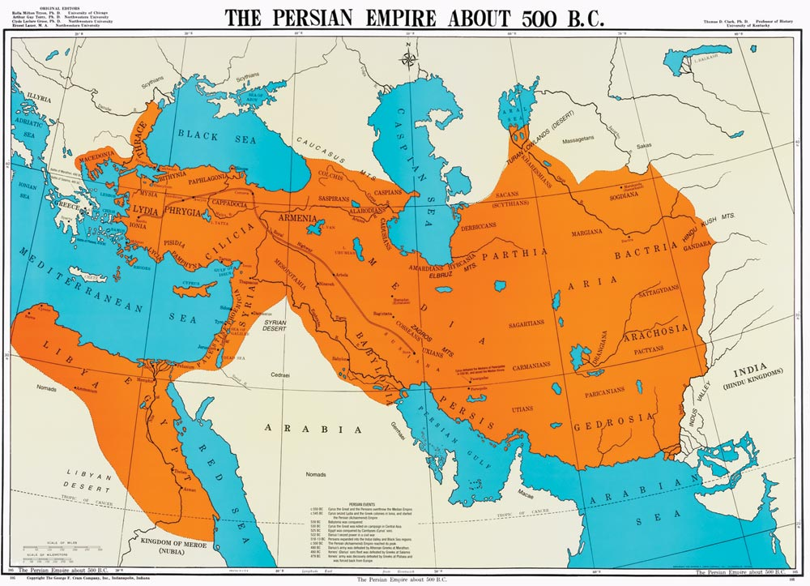
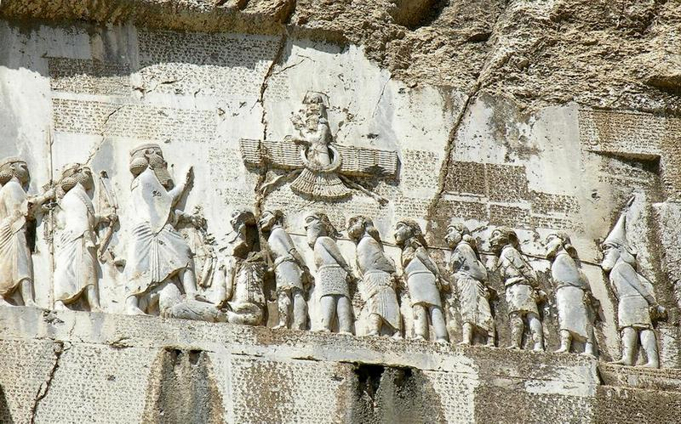
Zoroastrianism
Founder: Zoroaster
Beliefs: free will, right vs. wrong, final judgement
Sacred Text: Zend Avesta
AP Loves:
Cultural contribution of Persia
Influenced later monotheistic religions in the region
Faravahar
Behistun Inscription

Slide 25
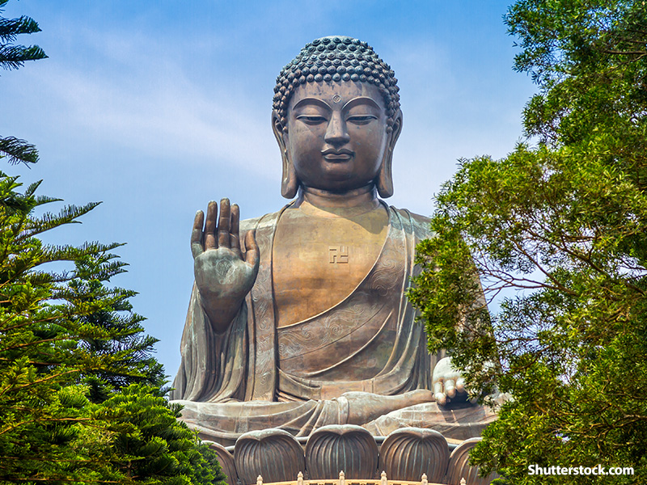
Buddhism
Founder: Siddhartha Gautama
Beliefs: Four Noble Truths, Eightfold Path
Sacred Text: Tripitaka
AP Loves:
Rejected caste system
Monastic communities
Welcomed women & lower classes
Spread on trade routes

Slide 26
Buddhism

Slide 27
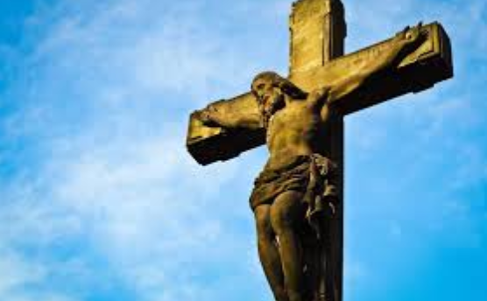
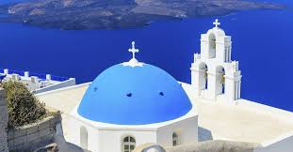
Christianity
Founder: Jesus of Nazareth
Beliefs: Jesus as the messiah, monotheistic
Sacred Text: The Bible (New Testament)
AP Loves:
Rejected caste system
Monastic communities
Welcomed women, lower classes
Spread on trade routes

Slide 28
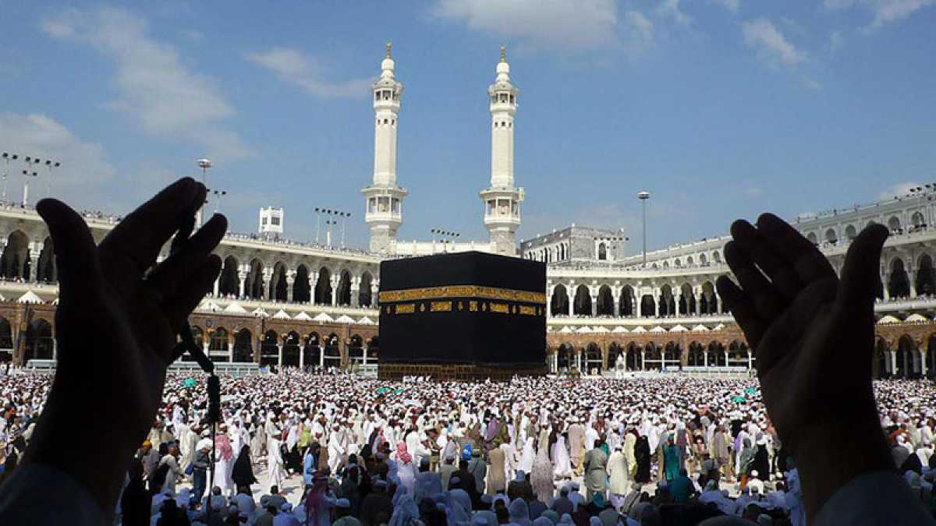
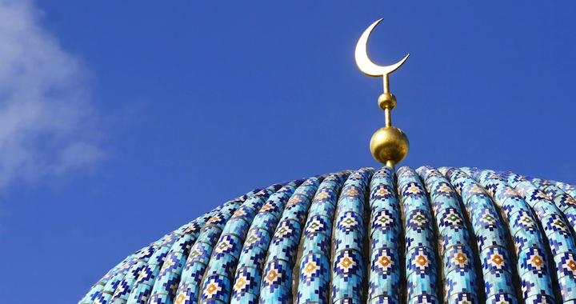
Islam
Founder: Muhammad
Beliefs: monotheistic, 5 Pillars, Mecca & Medina are holy cities
Sacred Text: Qur’an (Koran)
AP Loves:
Displaced Zoroastrianism
Islam/Arabic provided a sense of unity in the Middle East

Slide 29
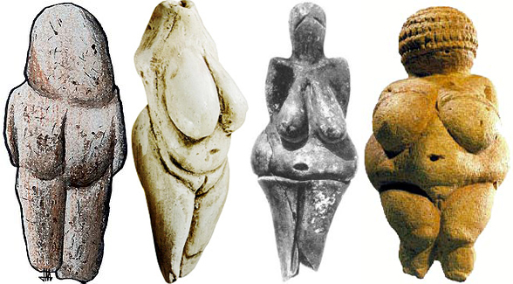
Polytheism
Animism – religious belief that focuses on the roles of various gods/spirits in the natural world and human life
Shamanism – the practice of identifying special individuals who interact with spirits for the benefit of the community (Korea, Central Asia)

Slide 30
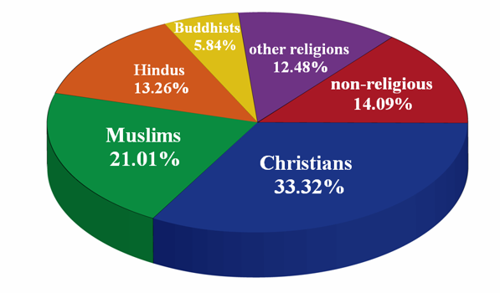
World Religions by Percentage

Slide 31
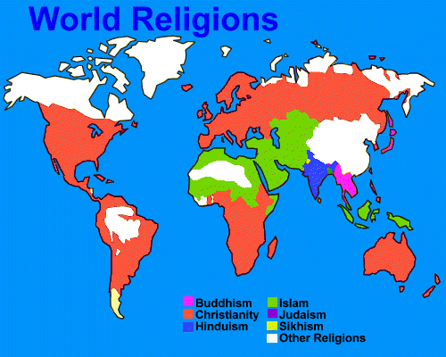
World Religions on the Map

Slide 32
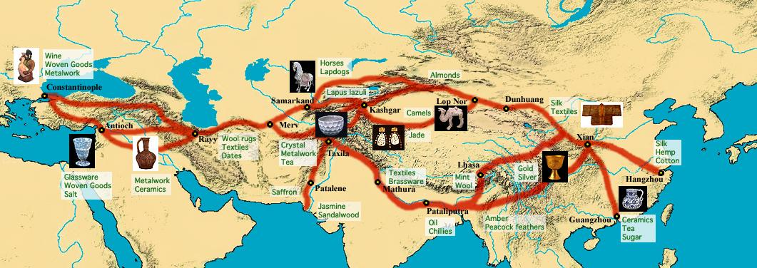
Trade

Slide 33
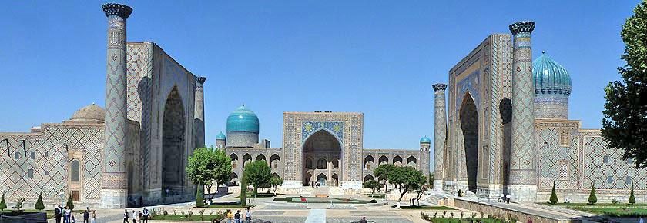
Trade Routes: Silk Road
Relay trade done mostly by camel caravans
Cities: Samarkand and Kashgar
Often dangerous routes, these were luxury products
Trade | West to East: Horses East to West: Silk, Porcelain, Paper
Cultural Diff. & Technology | Chariots, Horse stirrups, Buddhism, Christianity, disease Bills of exchange, banking houses, paper money
Samarkand

Slide 34
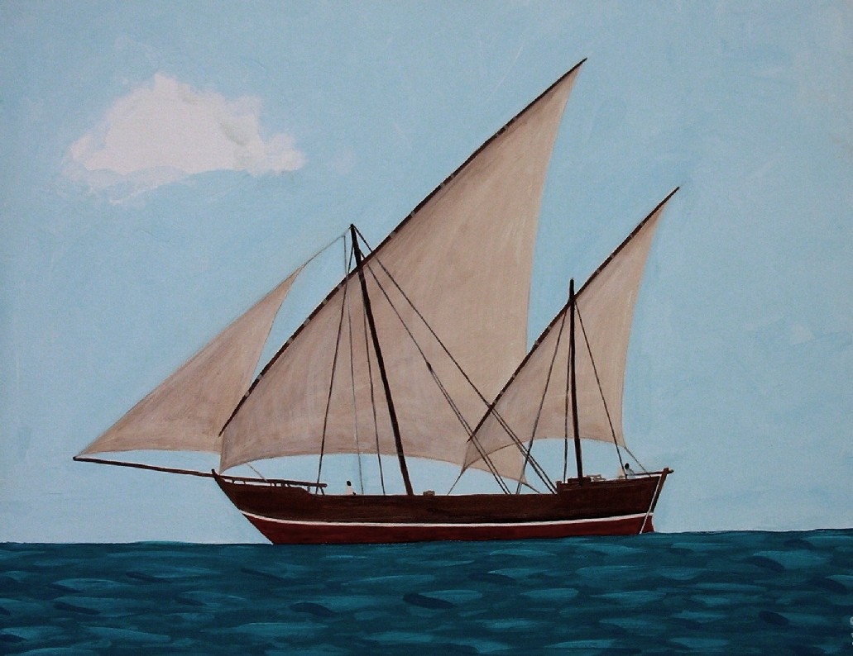
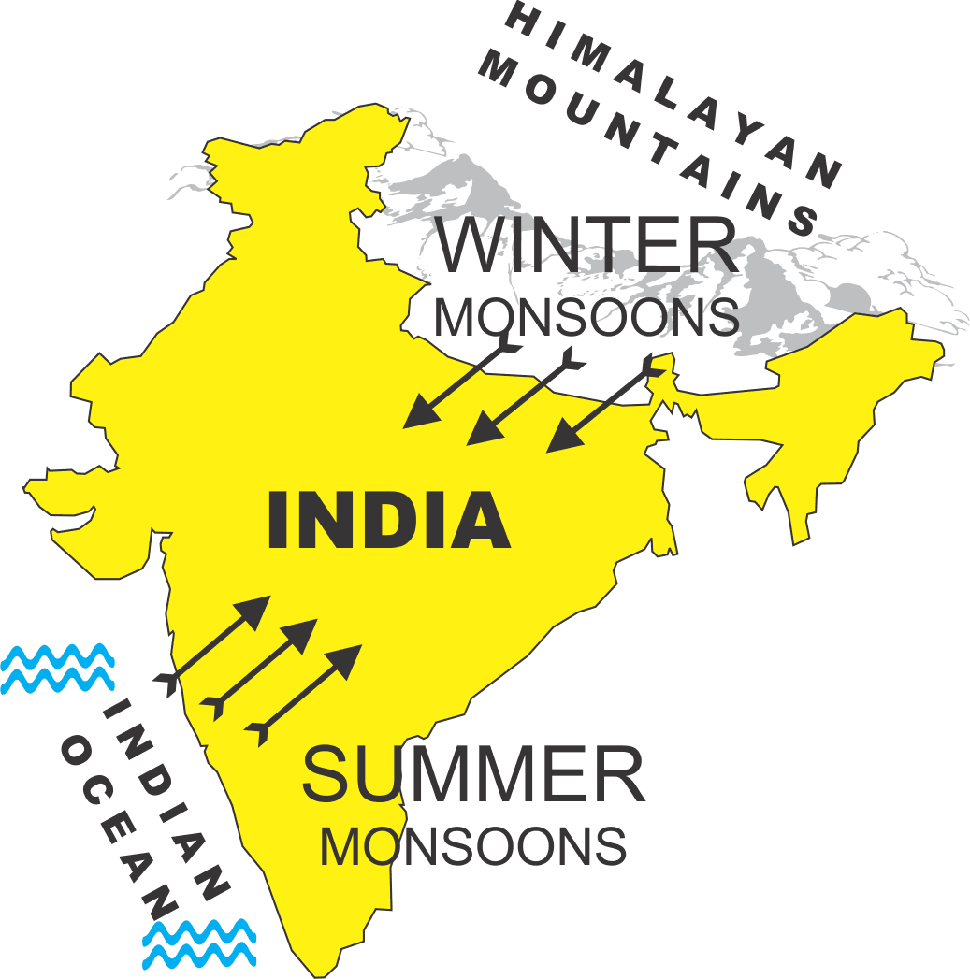
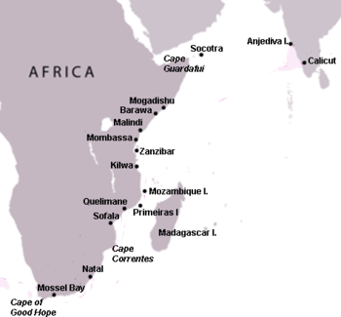
Trade Routes: Indian Ocean
Cities: Aden, Gujarat, Calicut
Depended on monsoon winds (seasonal winds in the Indian Ocean)
Trade | Pigments, pearls, spices, tropical fruits
Cultural Diff. & Technology | Buddhism into SE Asia Compass, astrolabe, larger ship designs, lateen sail (triangular)
Lateen Sail

Slide 35
Trade Routes: Trans-Saharan
Cities: Timbuktu and Gao
Connected Europe with West Africa
Trade | Salt from South and West Sahara Gold from West Africa
Cultural Diff & Technology | Islam Camel saddle, caravan
Camel Caravan

