Slide 1
Post-WW II
De-Colonization
Credit to Susan Pojer

Slide 2
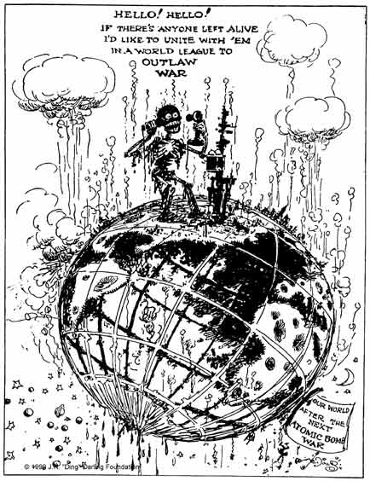
The Impact of Globalization

Slide 3
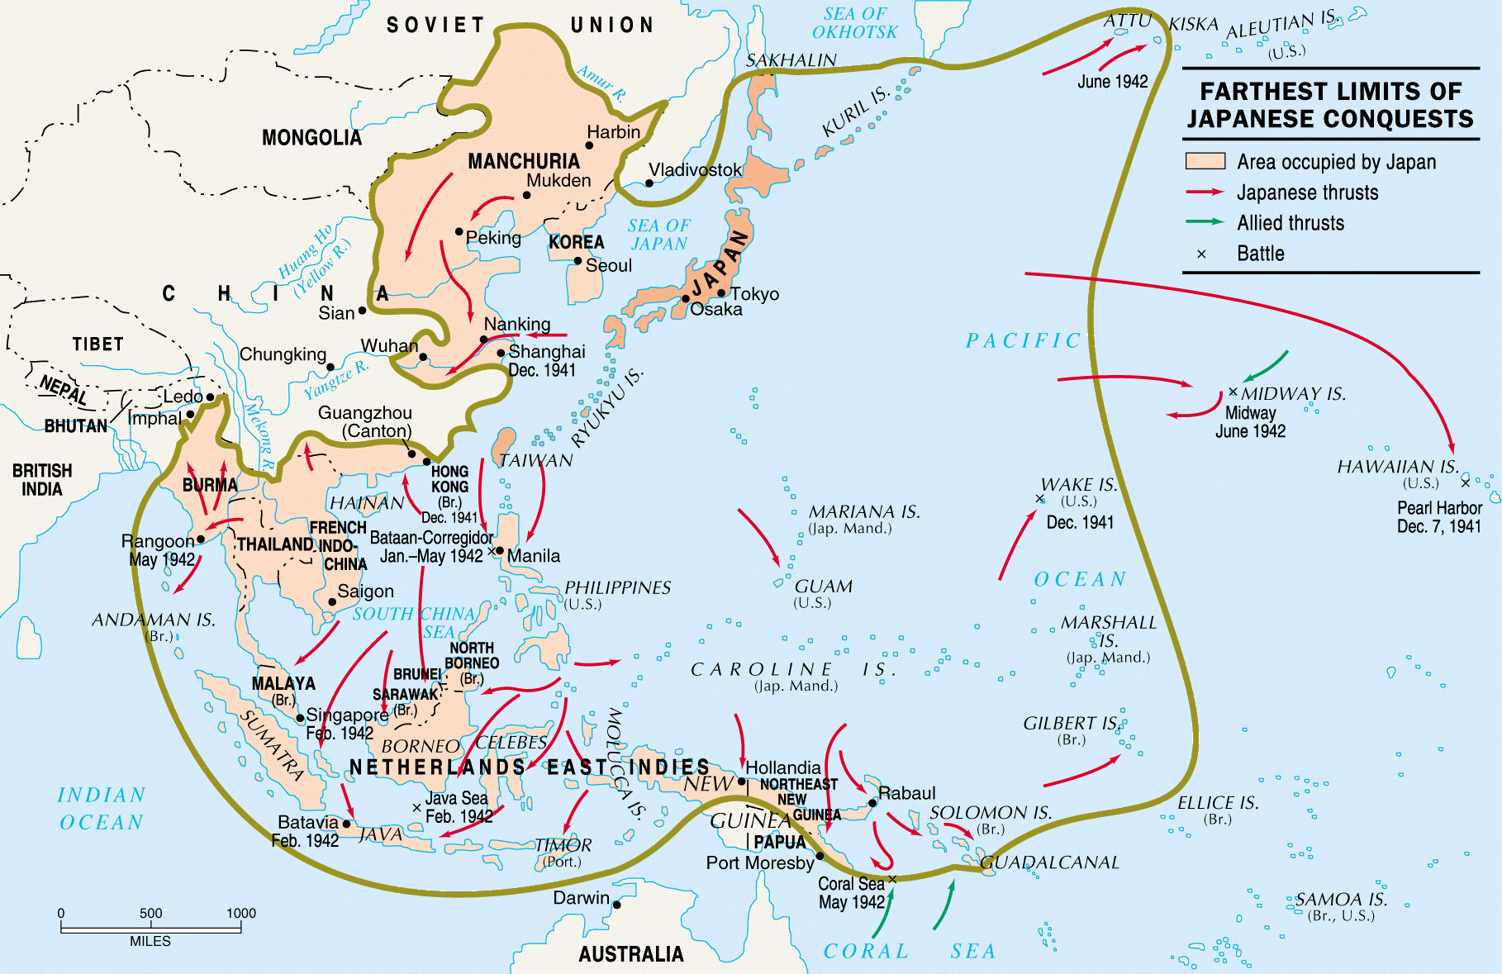
Who would stop the Japanese Co-Prosperity Sphere (1939)?

Slide 4
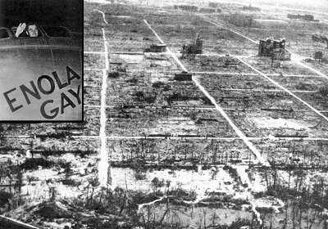
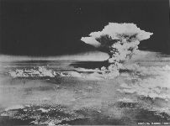
How Was Japan Defeated? At What Cost??

Slide 5
Results of World War II
Defeat of dictatorships.
Unparalleled destruction.
The decline of colonial powers.
The rise of the superpowers and the Cold War.

Slide 6
Defeat of Dictatorships
Germany, Japan, and Italy were occupied and turned into democratic, peaceful nations.

Slide 7
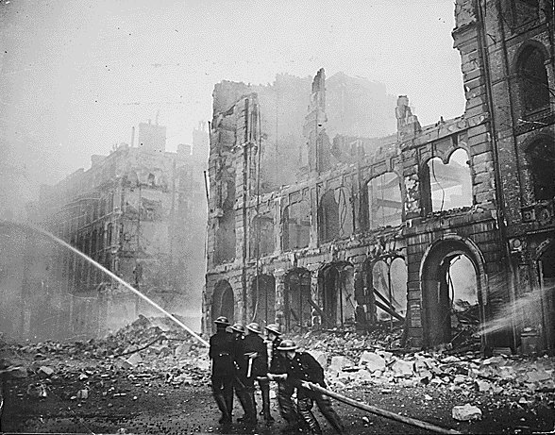
Unparalelled Destruction
Much of Europe, North Africa and East Asia lay in ruins.
Total war had destroyed cities, factories, railroads, homes – and lives.

Slide 8
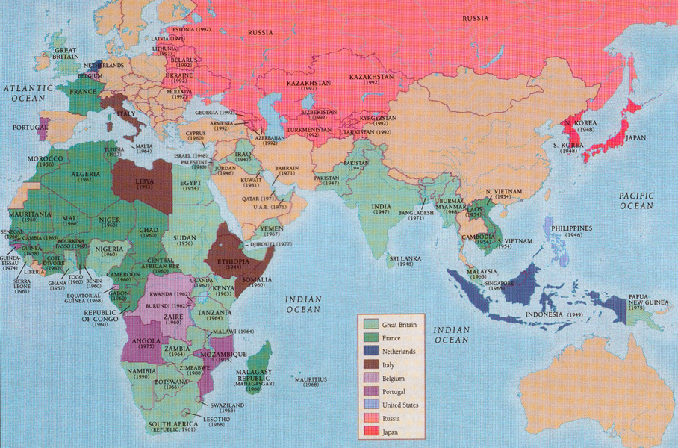
The Decline of the Colonial Powers

Slide 9
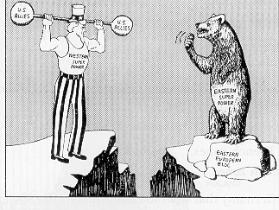
The Rise of the Superpowers

Slide 10
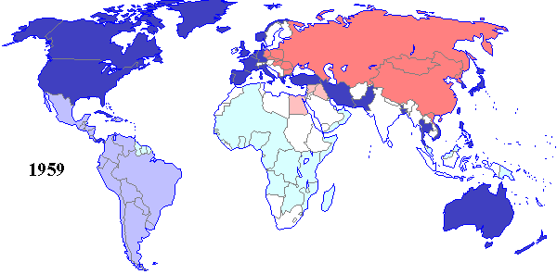
And the Cold War

Slide 11
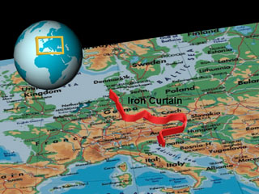
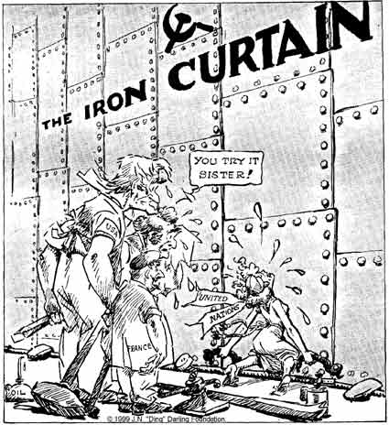
With Its “Iron Curtain”

Slide 12
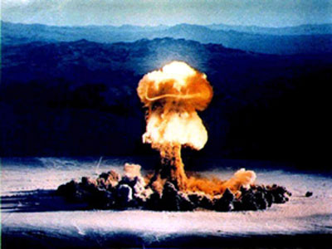
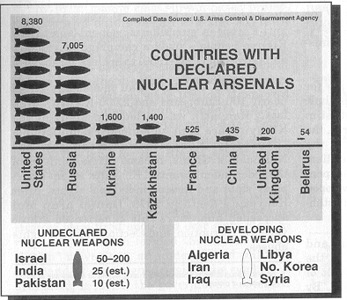
And Its Arms Race!

Slide 13
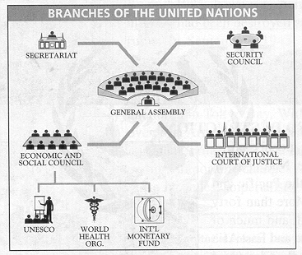
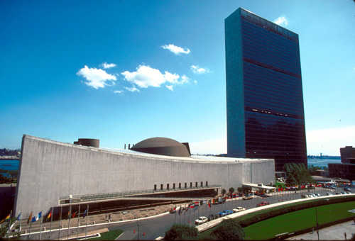
Made a United Nations Essential, But….

Slide 14
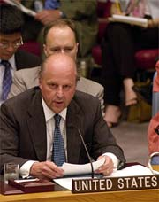
Permanent Members Have Veto Power
The BIG 5
United States.
United Kingdom.
France.
Russia.
Nationalist China (Taiwan) until 1972.
Associated Press
"I came, I saw, I vetoed" The Economist

Slide 15
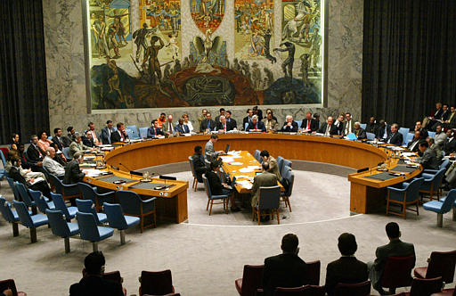
In the U. N. Security Council

Slide 16
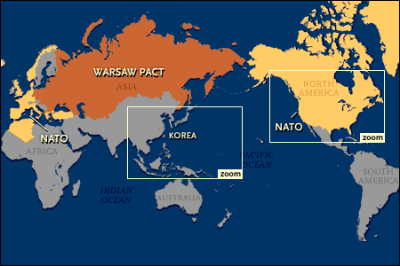
And Remained Divided by Cold War Issues

Slide 17
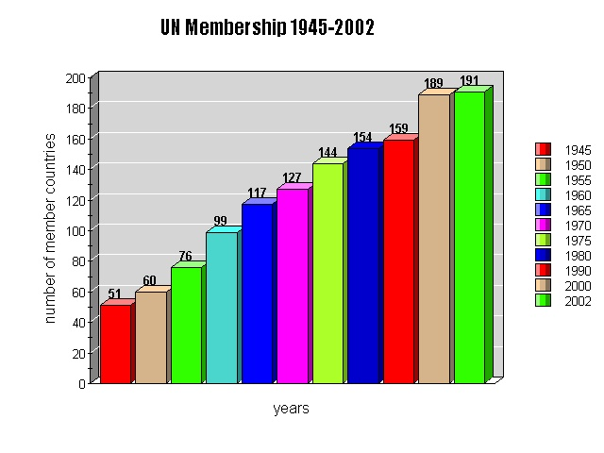
Decolonization of Asia & Africa Changed the Makeup of the UN

Slide 18
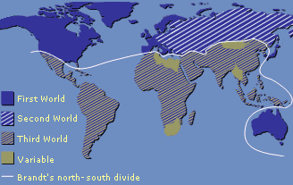
First, Second, & Third Worlds with a North-South Divide

Slide 19
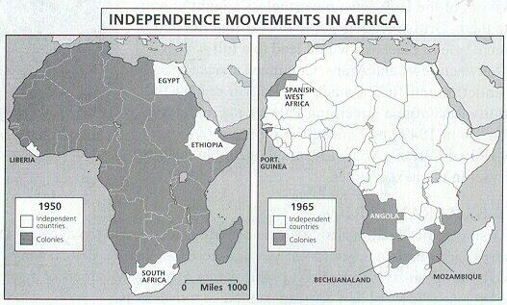
Africa Produced Many Newly-Independent Nations in a Very Short Time

Slide 20
who often found themselves caught in a battle between the two superpowers

Slide 21
British Colonies Were Some of the First to Seek Independence because
Britain felt hypocritical about colonialism.
War left her weak and unable to afford colonies.
A New African educated middle class began to emerge in the cities.

Slide 22
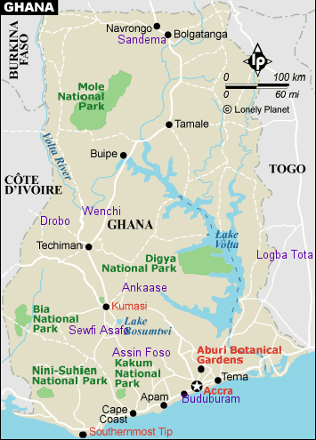
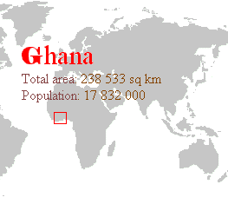
Ghana: First African State to Gain Independence

Slide 23
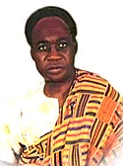
Kwame Nkrumah Led the Former Gold Coast to Independence
Educated abroad.
Schoolteacher.
Preached nonviolence.
Used boycotts and strikes.
Ultimately successful 1957.

Slide 24
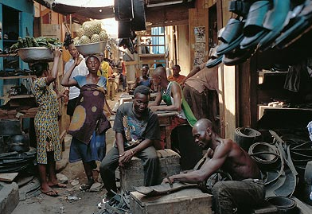
Ghana today still needs to modernize
Market in Kumasi.
Sells shoes crafted from old automobile tires.
Sprawls across 25 dusty acres in ancient Ashanti capital.
One of the largest marketplaces in West Africa.

Slide 25
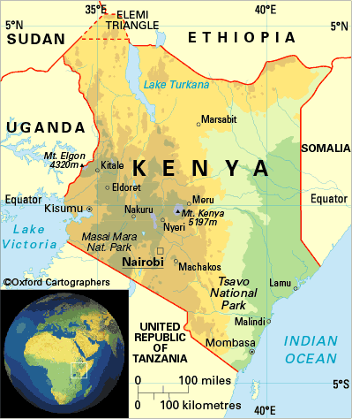
Kenya

Slide 26
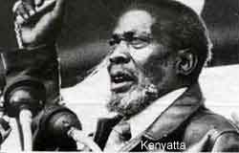
Kenyan Independence: 1963
London educated Jomo Kenyatta provided strong nationalist leadership.
Mau Mau Rebellions made up of Kikuyu farmers weaken British settlers opposition.

Slide 27
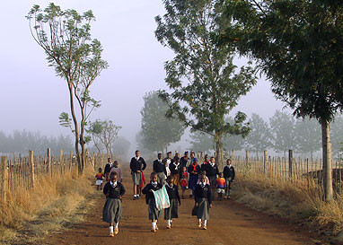
Today famous athlete opened school for orphans
Kip Keino, famed distance runner.
Opened school for grades 1-8.
Down road from his Baraka ("Blessing") farm.
He and his wife, adopted more than 100 orphaned and abandoned children in past 30 years.

Slide 28
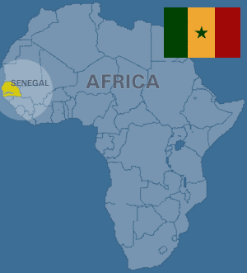
Senegal: Home of the Negritude Movement

Slide 29
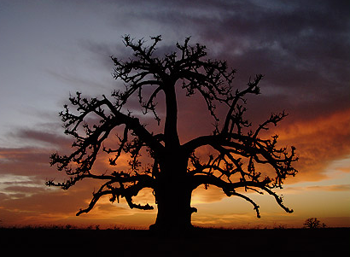
The Solitary Baobob Tree
The national symbol of Senegal, baobab trees often mark burial sites and inspire the poetry of de-colonization…

Slide 30
I heard a grave voice answer,
Rash son, this strong young tree
This splendid tree
Apart from the white and faded flowers
Is Africa, your Africa
Patiently stubbornly growing again
And its fruits are carefully learning
The sharp sweet taste of liberty.
David Diop 1956

Slide 31
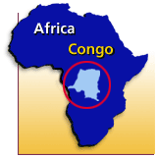
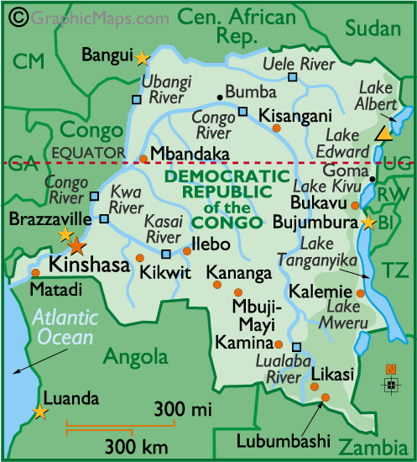
The old Belgian Congo, Formerly Zaire, Faces Many Challenges Today!

Slide 32
Mobutu Sese Seko
Ruled 1965-1997.
Supported by U.S. as Cold War ally.
Changed name to Zaire.
Left “a house that had been eaten by termites” NYTimes.
Reign described in 2002 documentary as an “African Tragedy.”

Slide 33
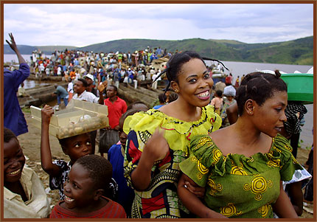
Congo Makes Up for a Lack of Roads & Highways
Congo River barge carries hundreds of passengers on its 1000 mile journey from Kinshasa to Kisangani.
Many people travel on barges without shelter for as long as a month, crowded together with their belongings, livestock, furniture and wares for sale.

Slide 34
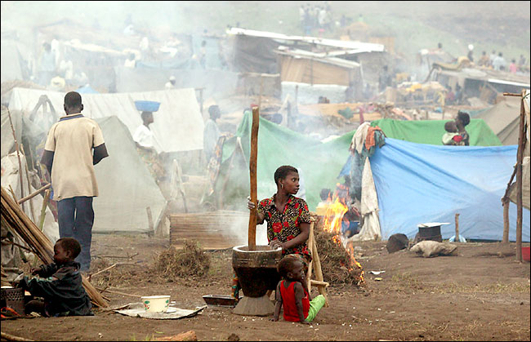
Today the Congo Is Experiencing Punishing War!
Michael Kamber for The New York Times
About 5,000 people fleeing the ethnic warfare in and around Bunia, Congo, sought safety at a camp on Monday.

Slide 35
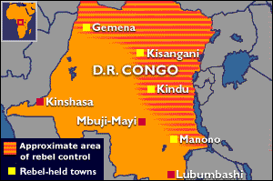
Death in the Congo!

Slide 36
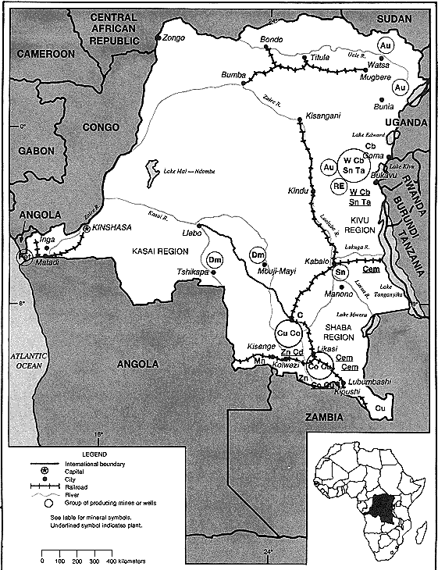
The Allure
Rich Mineral Resources:
Gold
Diamonds
Copper
Have Often Drawn Foreign Exploitation.

Slide 37
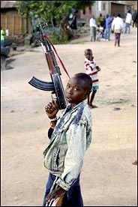
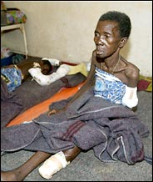
Young Soldiers & a Victim

Slide 38
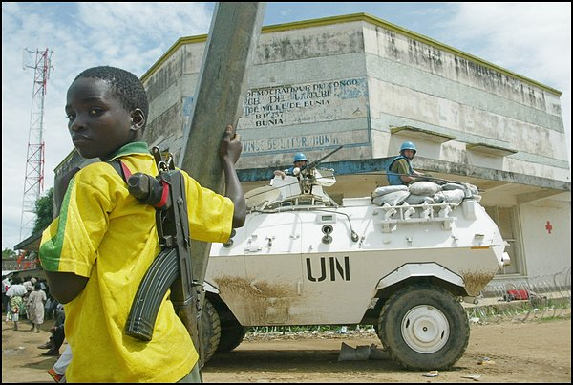
Child Rebels
A child fighter in a rebel group stands watch with a U.N. armored vehicle in Bunia, Congo, where there have been reports of rape and cannibalism.

Slide 39
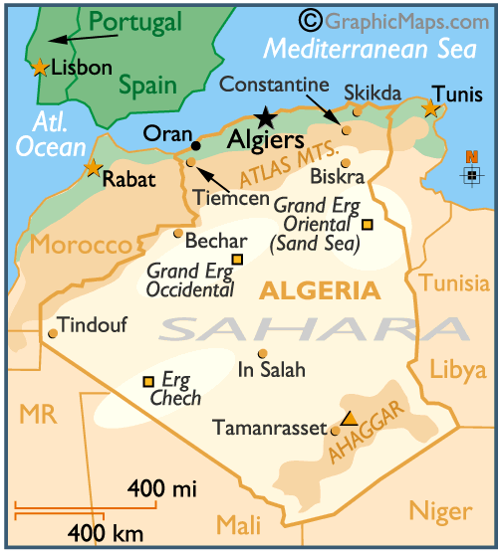
Algeria
French settlers fought fiercely to keep Algeria a French colony.
DeGaulle realized after the war that France could not hold onto Algeria by force.
Independence came in 1962.

Slide 40
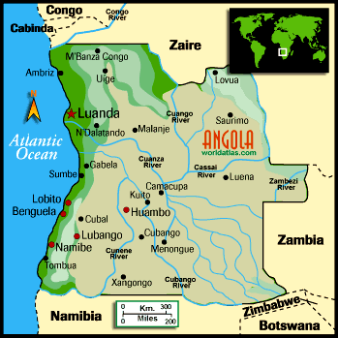
Angola
400 years: Portuguese are the first the arrive and the last to leave in 1975.

Slide 41
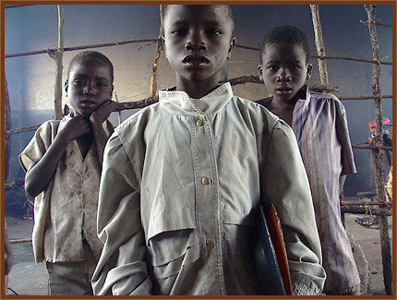
Angola Left With Bitter Civil War
Mateus Chitangenda, Fernando Chitala and Enoke Chisingi and their families have been displaced by war to the town of Kunhinga, in central Angola.

Slide 42
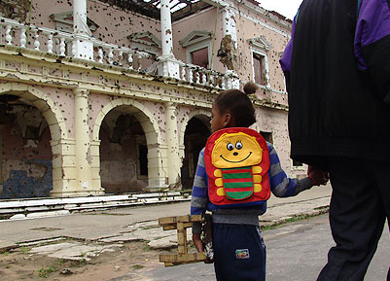
Going to School
A father walks his daughter to school in Kuito, Angola. All students in the town bring their own small benches to class.

Slide 43
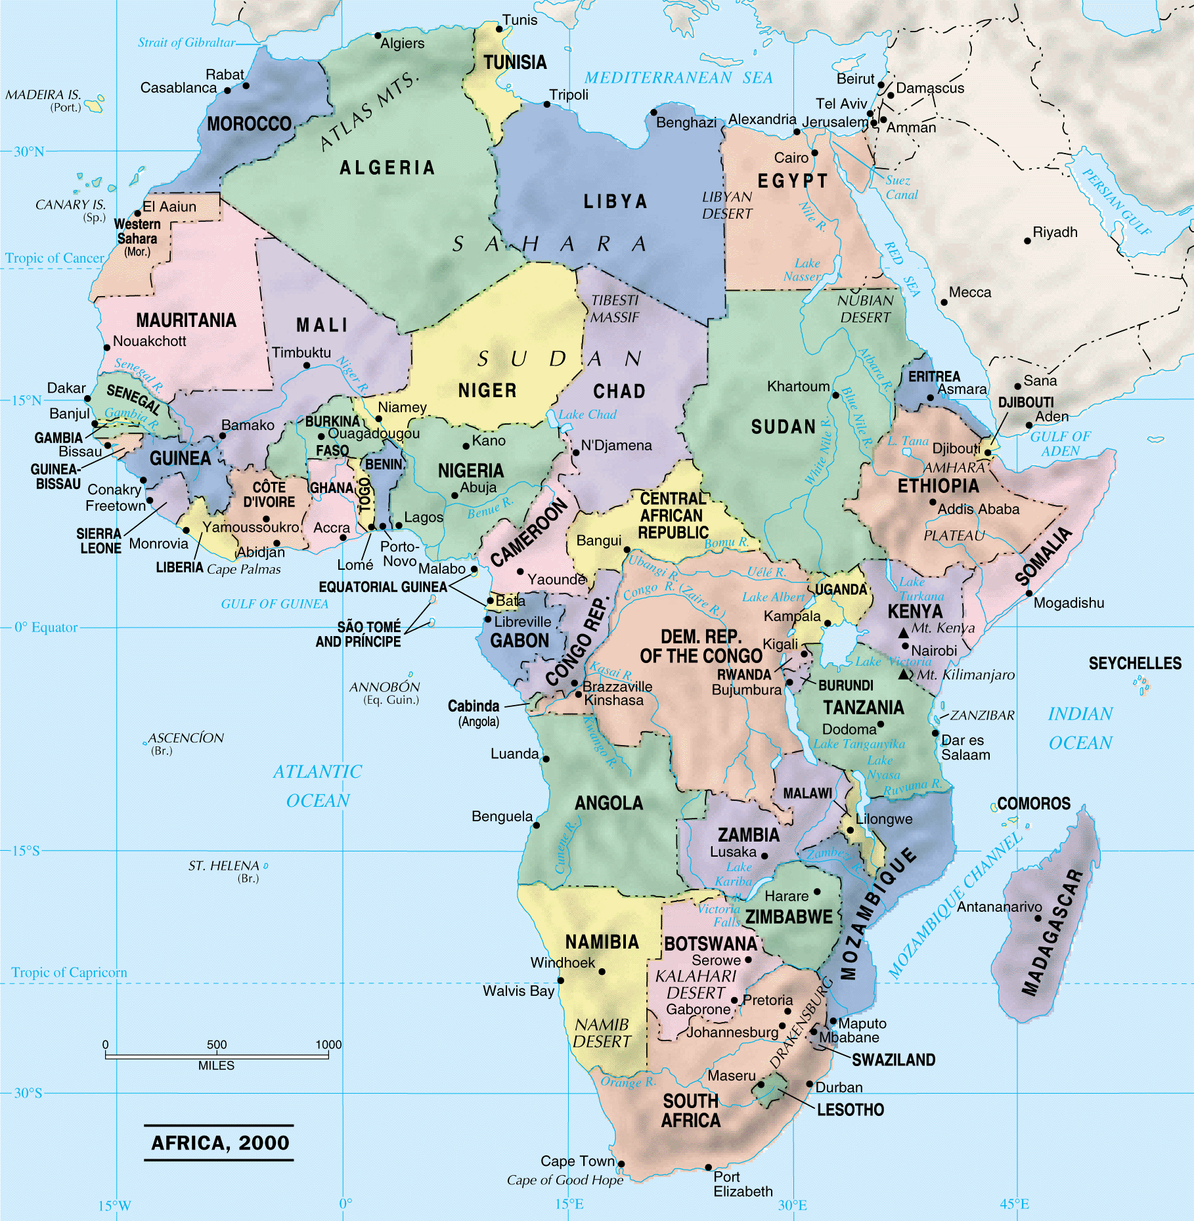
Africa: 2000

Slide 44
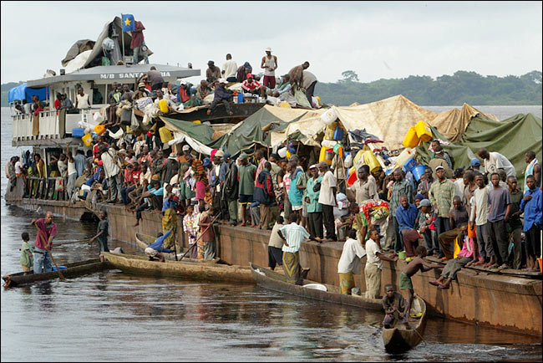
Nigerians today travel the same way as the Congolese

Slide 45
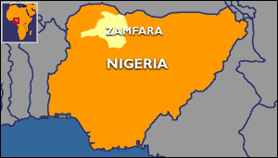
Nigeria Struggles With Ethnic & Religious Rivalries
Nigerian Muslims welcome Sharia law. January 2000

Slide 46
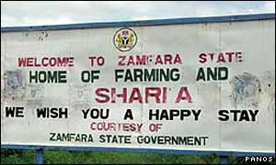
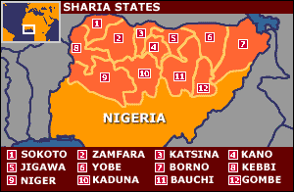
Sharia Law

Slide 47
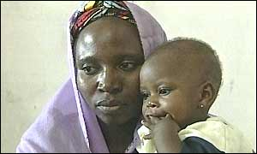
This adulterous woman was sentenced to death by stoning

Slide 48
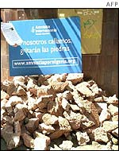
Woldwide attention has given her hope
Amnesty International is campaigning against the stoning sentence July 2002.

Slide 49
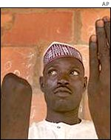
Some find Sharia a blessing
I Thank God for the Amputation – Buba Jangebe

Slide 50
South Africa

Slide 51
Nelson Mandela jailed for 20 years in his fight against Apartheid

Slide 52
Lived to vote in the first racially democratic election
1994

Slide 53
And Become President of South Africa
South African President Nelson Mandela, center, flanked by his two deputy presidents, Thabo Mbeki, left and F.W. de Klerk, right, celebrate the new constitution, May 8, 1996. (AP/WWP Photo Leon Muller)

Slide 54
Age-Group Differences

Slide 55
Less Developed Regions

Slide 56
Global Water Stress

Slide 57
Share of World’s GDP

Slide 58
Health Statistics

Slide 59
Bits Per Capita: An Information Revolution?

Slide 60
All across Africa
using ICTs for social and economic development
(Information and communication technologies)

Slide 61
A Cyber Shepherd in Senegal’s Sahel
2004-04-15 Pastoralists tracking wandering cattle herds using cell phones and Global Positioning Systems.

Slide 62
South Africa: Eco-tourism
Small tourist businesses operating out of the townships attracting customers from around the world by using the Internet.

Slide 63
Mozambique stops poaching with radios

Slide 64
Healthcare in Uganda
A health care worker conducting a survey using a PDA. (SATELLIFE Photo: Mark Grabowsky)

