Slide 1
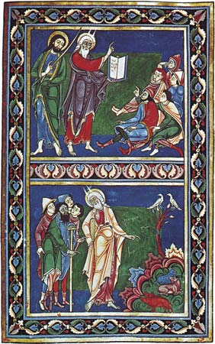
Europe in the Middle Ages 1000-1500

Slide 2
Important Dates
First European Universities Appear: c. 1158
Black Death begins to devastate Europe: 1347
Joan of Arc is burned at the stake for being a witch: 1431
Hundred Years War ends: 1453

Slide 3
Peasants, Trade, and Cities
Between 1000 and 1300 the population of Europe grew dramatically, the population grew from about 38 million to 74 million people.
Conditions were more peaceful and people felt more secure.
There was a warming trend in Europe’s climate.
There were vast improvement in agricultural technology which allowed them to grow more food.

Slide 4
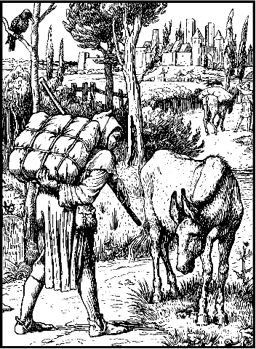
Improvement in Agricultural Technology
Windmills
Water Wheels
Iron tools
Iron plow (could go down
much deeper into the soil)
Horse collar
System of crop rotation

Slide 5
The Three Field System
The method of crop rotation, or the three field system, was developed during the middle ages.
Originally half the land would be planted and the other half would be fallow (unplanted)
Under the new system the land was divided into three fields. Two were planted and one would be left fallow. Crops which used different nutrients would be planted in the two fields and would rotate to let the soil rest.

Slide 6
Crops
In the three field system one was planted with grains which were harvested in the summer.
The second was planted in the spring with grains such as oats and barley and vegetables such as peas and beans. Which were harvested in the fall.
The third field was left fallow, or unplanted.

Slide 7
Many peasants at this time became serfs. A serf was a peasant who was bound to the land and didn’t really own any land of their own.
As the population of Europe increased during this time there was less land to go around. Many peasants lost their holdings and became serfs.
Serfs could not leave the manor, they had to work to pay rent, and had to pay fines and fees for various services on the manor. Serfs also could not marry without the Lord’s permission.
In exchange for their labor, the lords of the Manors did owe the serfs protection in the event of invasion.
They also were able to keep a percentage of the crops they produced on the manor for their own families.

Slide 8
Daily Life of Peasants
Peasants lived a hard-working simple life.
They lived in houses which had thatched roofs resting on timber framework with the spaces filled with mud and straw. There were few, if any windows.
Many houses only had one to two rooms, there was little privacy.
The hearth in the main room was used to both heat the house and cook the food. The smoke from the fire crept out through the roof.

Slide 9
Hygiene
It is a common misconception that people did not bathe during the Middle Ages.
The public baths which were popular during the time of Rome fell out of favor, but people did continue to bathe. There is evidence of public baths in Medieval cities. Many of these public baths were shut down after the break out of the Black Death between 1347-1351.
Baths were more common for the wealthy who could afford to bathe in tubs filled with hot water as well as scented oils and perfumes.
The poor would bathe in wooden basins or barrels filled with cold water. Although they didn’t bathe as often as we do today, they did take a bath more than once a year.
Soap was made of sheep fat with ashes and soda mixed in. Teeth could be cleaned by scraping them with a hazel twig and rubbing them with a woolen cloth.

Slide 10
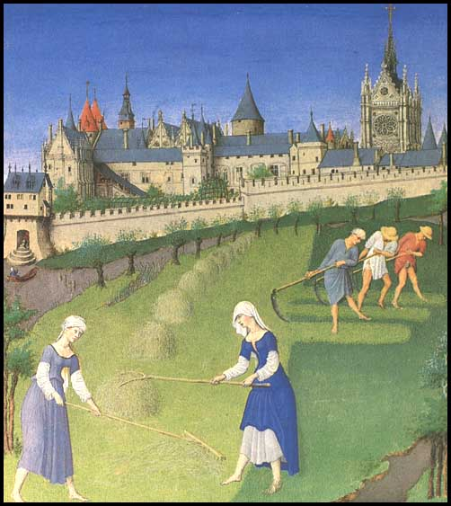
The Cycle of Labor
For peasants there were different jobs to be done throughout the year. The job depended on the growing season and what could be produced during the time.

Slide 11
Different Seasons
October was the beginning of the cycle of labor, during that time peasants prepared to plant the winter crops
November was the time when they would slaughter extra livestock and preserve the meat by salting it so they could have meat during the winter.
During the winter people stayed at home repairing tools, mending clothes, spinning and maybe grinding grain into flour.

Slide 12
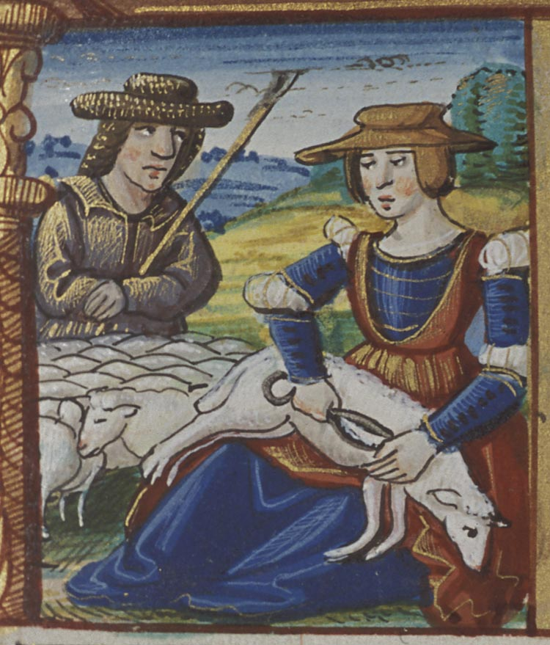
In February and March (early spring) peasants would plant spring crops, such as oats, barley, peas and beans.
In early summer peasants would weed the fields and shear their sheep so they could cart the wool, spin it, and weave it into clothing.

Slide 13
Feast Days
Although it seems like it, peasants did not work all of the time. They did get some holidays.
There were many feast days, or holidays, which were celebrated throughout the year. These holidays coincided with important events of the Catholic Church including the celebration of Christmas, Easter, Pentecost, and other feasts dedicated to saints or the Virgin Mary. There were about 50 such feast days a year.
Feast days provided an opportunity for dancing, drinking, and informal sports such as wresting, archery, cockfighting, and even an early form of soccer.

Slide 14
The Village Church
The Village church was the center of all religious and most social activities.
Village priests would teach peasants the basic beliefs of Christianity, although many local priests had very little education themselves.
On festival days the village churchyard was used for dancing and drinking, much to the dismay of the priest.

Slide 15
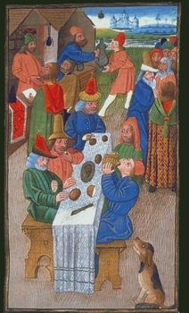
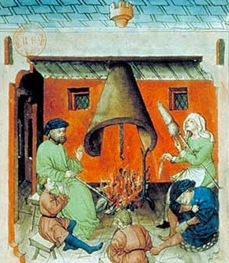
Peasant Diet
The staple item of the peasant diet was bread. Women made the dough with contained many different types of grain, including wheat, rye, barley, millet, and oats. This was usually called “black bread” because of its dark color.
Peasants would also eat cheese, which they made, nuts, berries, and whatever fruits were in season. They may also eat eggs from their chickens. Meat was a rare treat.

Slide 16
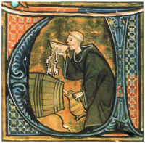
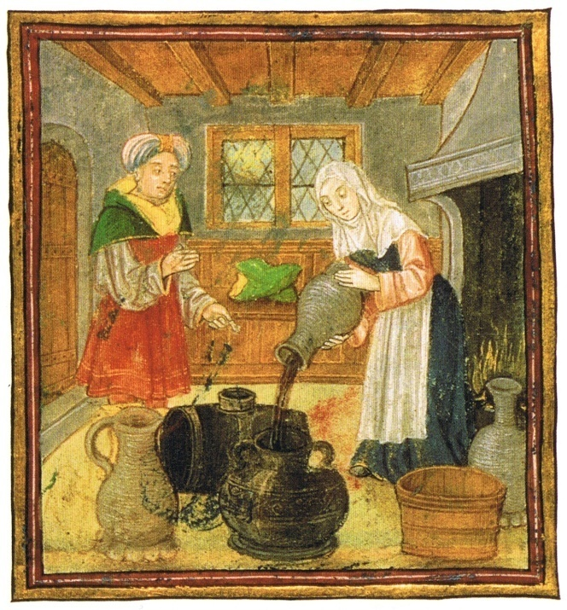
Drink
Water was usually not easy to find and was not very clean to drink, so peasants drank many beverages which were brewed and fermented because the alcohol killed bacteria.
Peasants usually drank ale made from grain, water, and fermented with yeast. The difference between ale and beer is the addition of hops.
The upper class usually drank wine which was fermented from grapes.

Slide 17
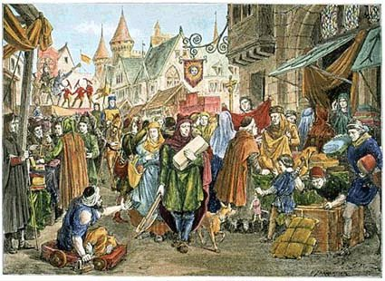
The Revival of Trade
Medieval Europe was a mostly agrarian society, but during the eleventh and twelfth centuries Europe experienced a growth in towns and cities.
The increase in agricultural output allowed for the development of trade. By the end of the tenth century people emerged with skills and products for trade. Invasions were also diminishing during this time and the increased stability helped to foster trade.

Slide 18
Cities has been around since Roman times, and many of the old Roman cities began to reemerge as trade centers.
There were also new trading centers.
Some of these cities included:
Venice in Northern Italy was a center with ties to the Byzantine Empire and the Middle East.
Flanders in Northern France was famous for its wool industry.
Trade also helped Europe culturally, the Crusades introduced Middle Eastern good into European markets. Europeans also learned about the cultivation of oranges, sugar, and rice as well as techniques for irrigation, papermaking and how to use a compass.

Slide 19
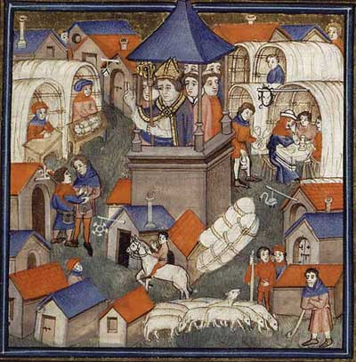
Trade Fairs
Fairs were large markets where merchants got together to exchange their goods.
As trade increased, there was a demand for gold and silver instead of bartered goods. This led to the development of a money economy based on the exchange of coins for goods.
This increase in trade led to commercial capitalism, an economic system in which people invest in trade and goods in order to make profits.

Slide 20
The Growth of Cities
Increased trade led to merchants settling in old Roman cities, they were later joined by craftspeople and artisans. This influx of people revitalized these old cities.
There were also new cities founded by the same groups. Merchants would build near and castle or along a trade route where a lord offered them protection, if things went well a wall was built around the new city to offer protection.

Slide 21
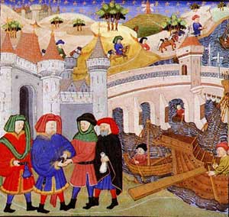
Bourgeoisie
Residents of the cities were called burghers or bourgeoisie, from the German word burg, meaning a walled enclosure.

Slide 22
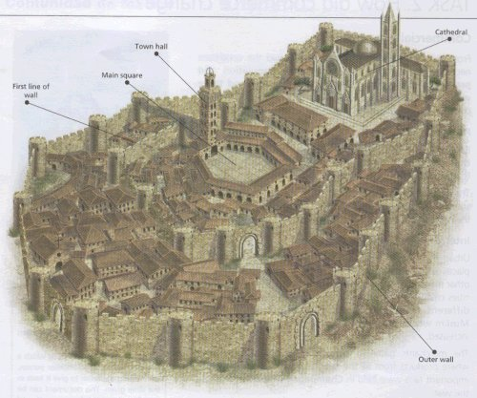
Medieval Cities
Medieval cities were smaller than other ancient cities. They were limited by the wall which surrounded them.
Medieval London had a population of around 40,000.

Slide 23
Residents of these cities would attempt to gain independence for the lords of the manor near them so they would have more control over their money and trade.
Townspeople began to buy or win rights from their local lords, a city could gain a charter, or a “charter of freedoms” from their local lord which would allow them to run their own affairs.

Slide 24
City Government
Medieval cities developed their own governmental systems.
There would usually be a city council which would serve as judges and city officials and also passed laws.
The Patrician, or upper, class tended to dominate the politics of the towns and cities.

Slide 25
Daily Life in the Medieval City
Medieval cities were surrounded by walls which made space a premium.
Buildings were very close together and had narrow, winding streets.
Cities were often dirty and smelled from animal and human waste.
There was air pollution from coal and wood fires as well as water pollution from tanning and animal-slaughtering industries including blood, tannic acids, animal fat, animal hair, and all other waste. Most of this waste was dumped in rivers and so all “clean” water came from wells.

Slide 26
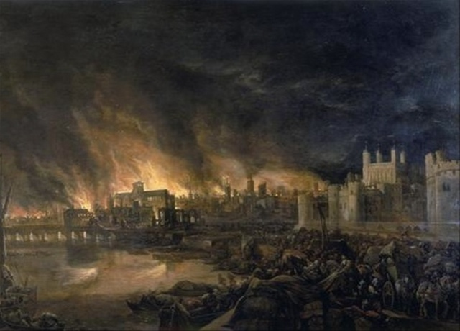
Dangers
Aside from poor sanitation, the crowded conditions of cities made fire a constant danger. Many structures were made of wood and the people used fire to both heat and light their homes.

Slide 27
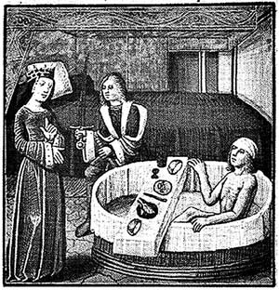
Public Baths
There were public and private baths located in Medieval cities.
Communal bathing made sense from the point of resources because preparing baths took a lot of effort and resources.
The Church frowned upon the public nudity of the baths and attempted to have them closed down.
The break out of the Bubonic Plague (black death) of the 14th century caused the baths to be closed down because they believed they helped to spread disease.

Slide 28
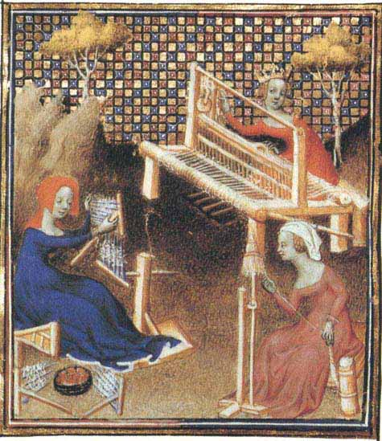
Women
In medieval cities women were expected to supervise the household and would occasionally work outside the home.
Women could help a husband manage a business, but few women worked independently.
The businesses were women did work were often the less lucrative and unpleasant ones such as preparing the dead for burial or spinning wool into yarn.

Slide 29
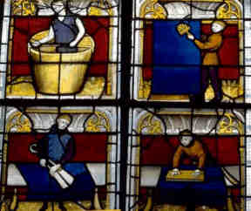
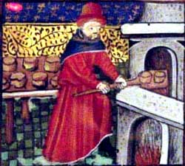
Guilds
Merchants in medieval cities formed guilds, or business associations.
Guilds managed tanners, carpenters, bankers as well as merchants of silk, spices, wool and the banking industry. .
Guilds regulated every aspect of a business. The set quality standards, specified methods of production, and fixed prices.
In order to operate a business, one had to belong to a guild.

Slide 30
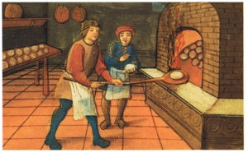
Joining a Guild
There was a process to becoming a member of a guild.
The first step was to be an apprentice: A young boy, around the age of 10, would go and work for a craftsman without pay to help learn the craft.
Later apprentices became journeymen, who worked for a wages for craftsmen.

Slide 31
The Masterpiece
For a journeyman to become a master craftsman, he had to complete a Masterpiece.
This was their audition for the guild to determined if their work made the qualified enough to join the guild and start their own business.
Then they could become a Master Craftsman and own their own business.

Slide 32
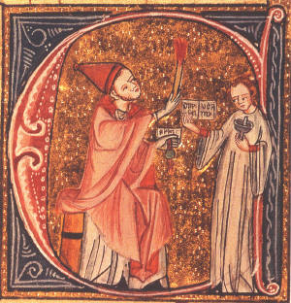
Section 2: Christianity and Medieval Civilization

Slide 33
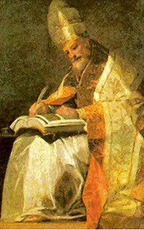
Pope Gregory VII
Pope Gregory VII, though unpopular,
initiated many reforms for the church.
These reforms became known as the Gregorian reforms.
Pope Gregory Stated:
The Church was founded by God Alone
The pope alone can with right be called universal.
The pope alone can depose or reinstate bishops
The pope’s name alone can be spoken in churches
The pope may depose of emperors
The pope may be judged by no one
The Roman Church has never erred; nor will it err to all eternity, the Scripture bearing witness.

Slide 34
Papal States and Simony
The Papal States were the territories surrounding Rome which were controlled by the Pope and the Church.
As the Middle Ages went on the church became more involved in political affairs. The feudal government of the time complicated matters. Lords appointed these bishops and other church officials as their vassals, and they had to be loyal to their lords, bishops and abbots became more worldly and neglected their spiritual duties.
A practice known as simony developed where lords would sell church offices. This became an important source of income for lords and nobles.

Slide 35
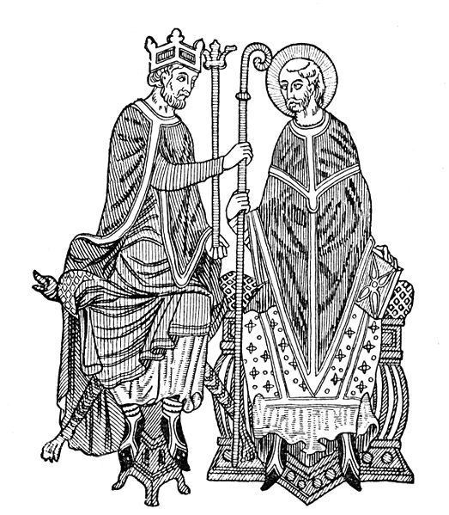
Church Reform
By the 11th century church officials realized that they need more control over appointments to the church.
They wanted to eliminate a practice which had developed which was known as Lay Investiture.

Slide 36
Lay Investiture
When an Abbot or Bishop was appointed to the church they were given symbols of their new office.
These objects were a ring and a staff, they symbolized the spiritual authority which was being granted, or invested, by the church. The ring represented marriage to the church and the staff was symbolic of the duty to be a good shepherd to the people.

Slide 37
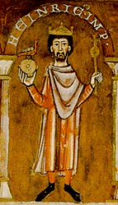
Pope Gregory VII and the Church wanted to end the practice of lay investiture and take that power back for the church.
Pope Gregory Declared that only the church had the authority to appoint church officials. He claimed that the church’s power was supreme and that the nobility did not hold any power over the church.
This led to a conflict with Holy Roman Emperor Henry IV.

Slide 38
Henry IV vs. Pope Gregory VII
Henry sent a letter to the Pope which declared that the Pope was a fake and had no real authority. His letter ended, “I, Henry, king by the grace of God, with all of my Bishops, say to you, come down, come down, and be damned throughout the ages”
Obviously, the Pope was not pleased by this. Pope Gregory VII excommunicated Henry IV and supported the overthrow of his power.

Slide 39
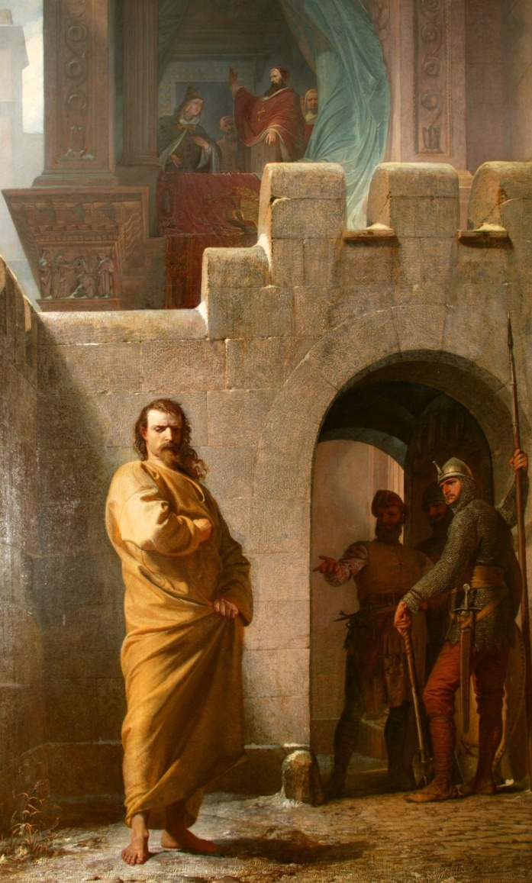
Henry IV, was faced with the prospect of losing his kingdom to lords who were rebelling against him and supporting the overthrow of his power.
Henry decided to go apologize to the Pope and be reinstated with the Church. Henry traveled to Canossa in northern Italy to meet the pope and apologize in person. He wore a hair shirt and stood outside barefoot in the snow. As a priest, the Pope had to accept Henry’s penance and lift his excommunication.

Slide 40
The Concordat of Worms
The dispute over lay investiture continued. Henry overthrew the Pope and then, Gregory died in exile. After they were both dead the conflict continued for several generations.
Finally in 1122 at Worms the Concordat of Worms passed. In this agreement the Church won the power to appoint church officials and the emperor got to give the new bishop the symbols of government authority while the church instilled the ring and staff which were symbols of spiritual authority.

Slide 41
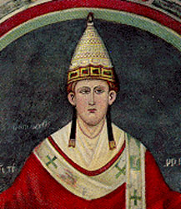
The Church Supreme
The attempts to make the church more powerful did not end with Gregory VII. During the 12th and 13th century the Popes continued to strengthen the papacy.
Pope Innocent III declared the Act of Papal Supremacy. He stated that the Pope was,
“lower than God but higher than man . . . Judges all and is judged by no one. . . . Princes have power on earth, priests over the soul. As much as the soul is worthier than the body, so much worthier is the priesthood than the monarchy . . . NO king can reign rightly unless he devoutly serve Christ’s vicar.”

Slide 42
“Weapons” of the Church
The Church claimed that it held the power of salvation through the administration of the sacraments. The church could manipulate people and their leaders through the control of these sacraments.
The church could excommunicate someone, this was where they cut off a single person from receiving the sacraments.
The church could also place an interdict over an entire country. In this case no one in the entire country or region could receive the sacraments.

Slide 43
The Sacraments
The church had seven sacraments
Baptism: Done at birth to cleanse original sin.
Confirmation: Young men and women were confirmed in their baptism and were able to receive communion.
Eucharist: Communion, the bread and wine which was believed to be the body and blood of Christ.
Penance and Reconciliation: Also known as extreme unction, an attempt to remove sin from the soul before death.
Anointing of the sick
Holy orders: When men and women joined the church.
Matrimony: Marriage

Slide 44
New Religious Orders
From the mid 11th century to the mid 12th century a wave of religious enthusiasm swept through Europe. Many men and women joined monasteries and convents.
This increase in religious activity led to the formation of new holy orders. Several new monastic groups emerged which would shape the church.

Slide 45
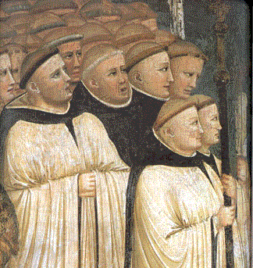
The Cistercians
This order was founded by a group of monks who believed that the Benedictine orders were not well disciplined.
This group was strict, they ate a simple diet and had only a single robe. They removed all decorations from their churches and buildings and split their time between prayer and manual labor. They weren’t allowed to speak unless absolutely necessary.
This order developed a new spiritual model, they strove to withdraw from the outside world, but ultimately, became involved through the success of their movement.

Slide 46
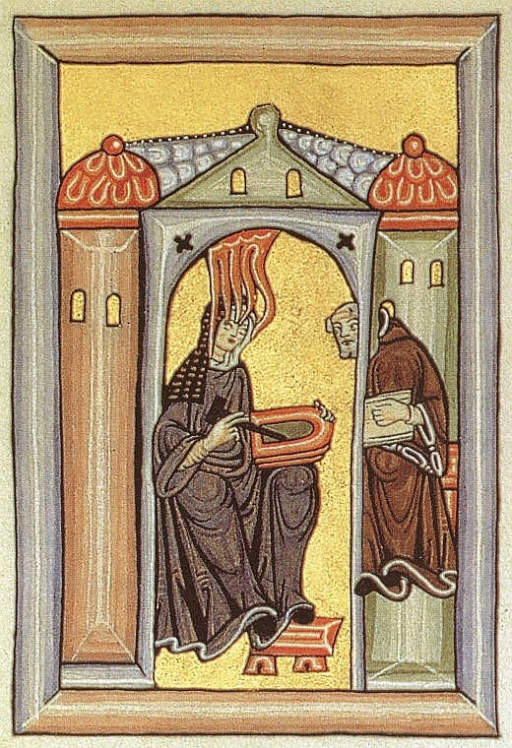
Women
More women began to join convents during this time. Although their presence was not always welcomed, more women began to seek spiritual involvement.
The church was an intellectual haven for women. It was one of the few areas where women could get an education.
Convents also became popular places for women who were unable or unwilling to marry.

Slide 47
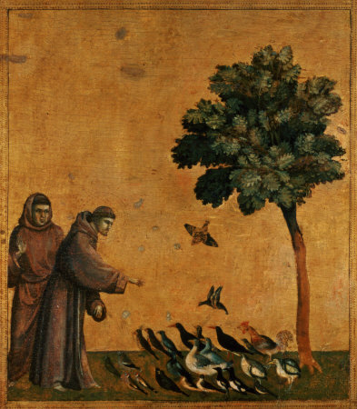
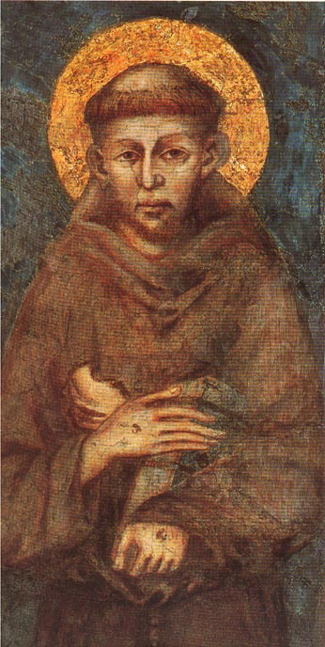
The Franciscans and the Dominicans
The Franciscans
The Franciscan order was founded by Francis of Assisi. He was a widely admired figure of the Middle Ages for his humility and spiritual work.
The son of a wealthy merchant, he lived a bit of a wild youth and had a religious conversion in his early 20s.
Francis gave up all of his material possessions and began to teach to the poor. Although he was not a member of the clergy he gained followers and his movement was eventually approved by the church.

Slide 48
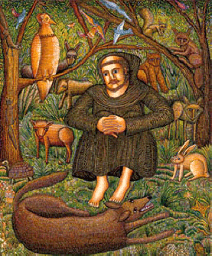
Franciscan Beliefs
The Franciscan order tried to live as Christ had lived. The followers of the order became known as “Little Brothers” and they believed the following-
They believed in a vow of absolute poverty. Monks were to own no personal possessions.
St. Francis also taught that there was beauty and holiness in nature as it was a creation of God.
The Franciscans took an active role aiding the poor and doing missionary work through Europe and the Muslim world.

Slide 49
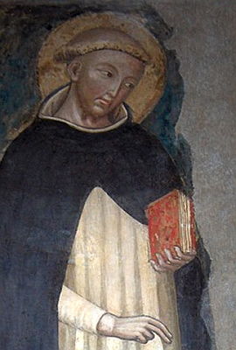
The Dominican Order
The Dominican Order was founded by a Spanish priest named Dominic de Guzman.
Dominic believed in a vow of poverty, like the Franciscans, he believed; however, that poverty was a way to attract converts and save heretics.
He saw the true mission of his order to end heresy, or beliefs that went against the Catholic Church. The Dominicans were proud of their nickname “Hounds of God,” as they were watchdogs of the Catholic faith.

Slide 50
The Inquisition
The Church appointed a special court, usually headed by the Dominicans, to find and try heretics.
If an accused heretic confessed, he or she was forced to perform public penance.
Beginning in 1252, those that did not confess voluntarily were tortured until they did confess.
Many did not confess but were still considered guilty and turned to the state for execution.
If a heretic relapsed, they were also subject to execution.
Christians of this time believed that the only path to salvation was through the Church, heresy was a crime against God and humanity, the church believed it was doing this to save peoples’ souls.

Slide 51
Popular Religion in the High Middle Ages
The Sacraments of the church were vital to people of the time because they believed that without them they would be condemned to Hell.
Veneration of Saints was also important. Saints were men and women who were considered especially holy and had earned a special place in Heaven. This allowed them to ask for favors for those still living.

Slide 52
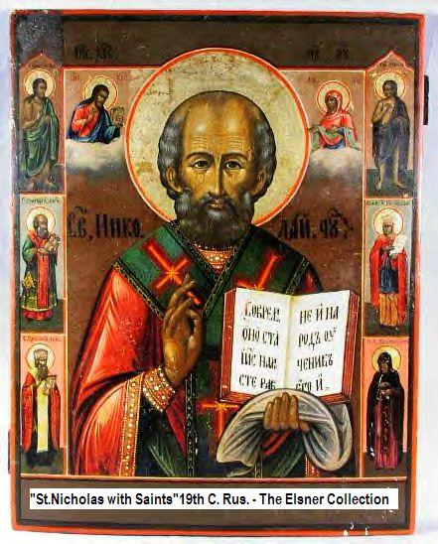
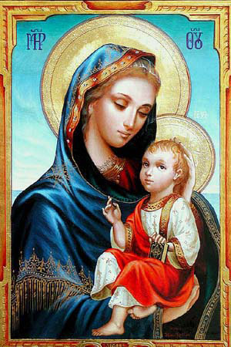
Saints
St. Nicholas: The Patron Saint of Children, was originally from Turkey.
The Virgin Mary: The mother of Jesus was the most popular and most highly regarded of the saints.

Slide 53
Relics
Relics were objects such as bones of saints or objects connected with saints which were considered worthy of worship because they provided a link between the earthly world and God.
It was believed they could produce miracles.
Many people would make pilgrimages to visit relics because it was believed they could heal or grant forgiveness from sin.

Slide 54
Religious Teachings
The church had many ways to teach its followers
Miracle and Passion plays would act out stories from the Bible. Frequently these plays would involve an entire community. Each guild or organization would perform one story from the Bible.

Slide 55
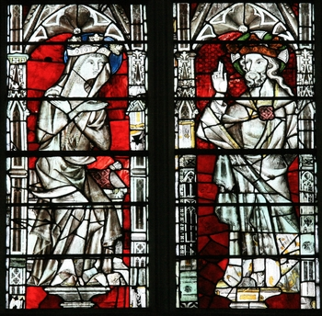
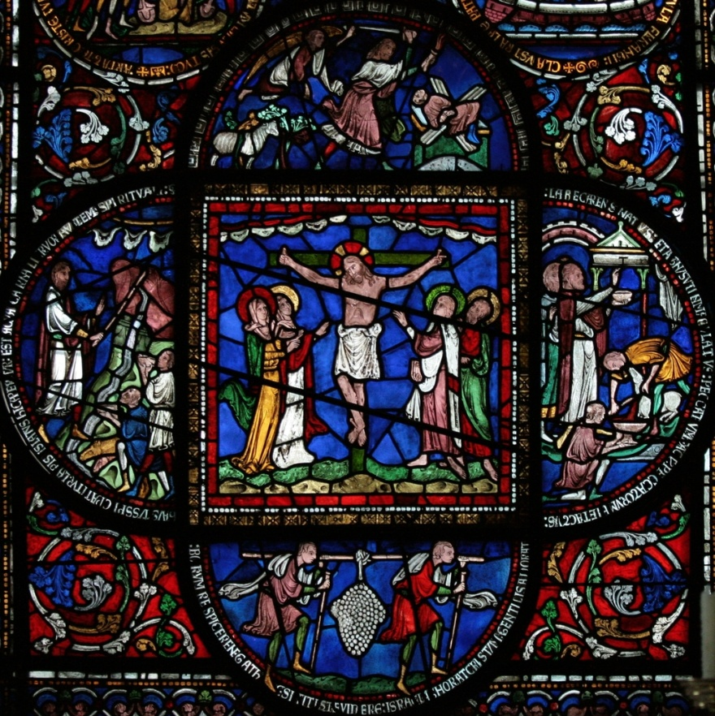
Stained Glass
The stained glass windows of churches were also used to teach stories from the Bible to a mostly illiterate population.

Slide 56
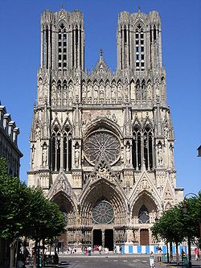
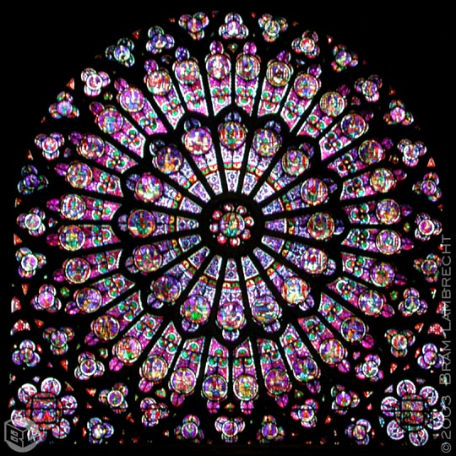
Section 3: The Culture of the High Middle Ages
Dates:
Architects begin to build in the Gothic Style: 1150

Slide 57
The Rise of Universities
Medieval Universities got their start as educational guilds
The first Medieval University was in Bologna, Italy . The students at the school formed their own guild in 1158.
Later came the University of Paris, and then the University at Oxford England.

Slide 58
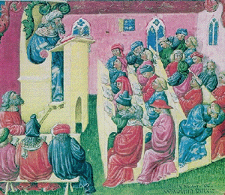
Areas of Study
Students in medieval universities studied the following subjects
Grammar: The proper way to write
Rhetoric: Public speaking, learning how to make arguments (debate)
Logic: Using reason
Arithmetic: Basic Math
Geometry
Music
Astronomy

Slide 59
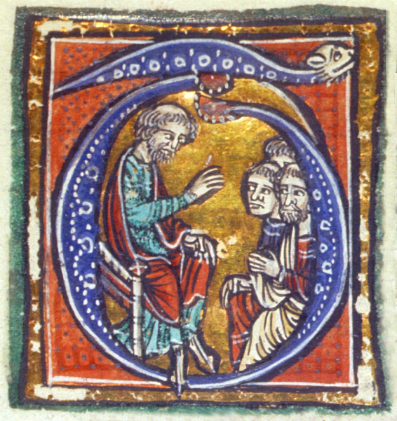
Teaching Style
Books were rare and expensive in the Middle Ages. The main method of teaching was by lecture. Teachers would read from books and students would take notes.
There were not regular exams given, but when a student applied for a degree, they were given an exam.

Slide 60
Degrees
There were various types of degrees awarded by medieval universities
Theology: The study of religion and God
Law
Medicine
Upon completion of 4-6 years of study they would earn a Bachelor of Arts degree. If they continued in school they could earn a doctor’s degree and would be able to teach. A doctor’s degree could take ten years of more.

Slide 61
The Development of Scholasticism
As people began to make more scientific discoveries there emerged a crisis-how to reconcile new scientific discoveries with the teachings of the Church.
The field of Scholasticism attempted to do this. Scholasticism was an effort to reconcile faith and reason and show that what was accepted on faith was in harmony with what could be learned through reason and experience.

Slide 62
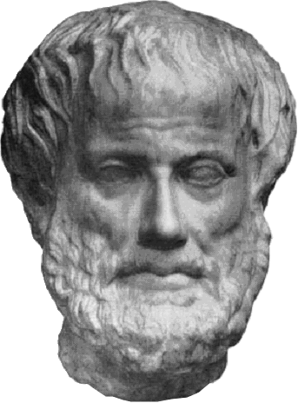
Greek Influences
The thinking of the Greek philosophers had
a great influence on medieval (and Renaissance) thinking.
Aristotle proposed that our view of the world is learned through the senses and through what we experience.
Aristotle taught that the universe was eternal which was in conflict with the Christian teaching of Creation.
Aristotle believed that God was an impersonal principle that made caused order in the universe, but was unmoved, Christianity believed that God was concerned with the deeds of people.

Slide 63
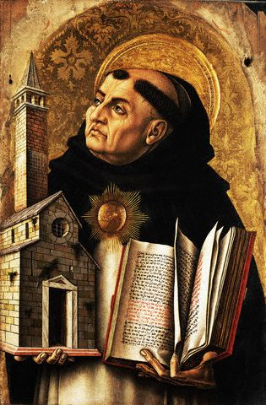
St. Thomas Aquinas
St. Thomas Aquinas made the most famous effort to reconcile the teachings of Aristotle with the teachings of the Church.
His best known work is Summa Theologica.

Slide 64
Teachings of Thomas Aquinas
St. Thomas Aquinas believed that there were two types of truth
Religious Truth: Things that are revealed by faith and cannot be proven by science.
Scientific Truth: Things that can be proven by science.
He believed that things related to faith did not need truth to be valid became they came from God who was infallible.
Also, he believed knowledge was not the enemy of faith because it did not corrupt faith. Both faith and reason come from God and were not in competition with each other but supported each other.

Slide 65
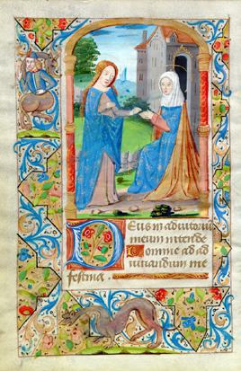
Vernacular Literature
The universal language of medieval civilization was Latin.
Latin was the language of Rome and was a common language which could be used in churches and at Universities.
A common language at universities allowed students from many different countries to be able to understand the teachings there.

Slide 66
Vernacular
The vernacular was the language of the common people.
This included Spanish, French, English, and German.
People began to produce literature in their own languages.
The most popular form of vernacular literature in the 12th century was troubadour poetry, which was mostly love stories about life at court between knights and ladies of the court.

Slide 67
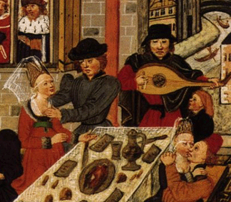
Troubadours
Troubadours were usually travelling poets and musicians who would go from court to court telling their stories of courtly love.

Slide 68
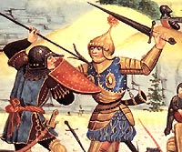
Chanson de Geste
Another popular type of vernacular literature was the Chanson de Geste. The Chanson de Geste was heroic epic poetry.
A popular work of this type was the Song of Roland.
This work, in French, tells the story of a battle between a Muslim army and Charlemagne.

Slide 69
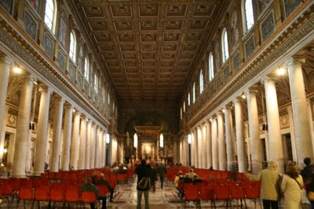
Medieval Architecture
During the 11th and 12th centuries there was a boom in architecture and building.
Originally buildings were built in a Basilica style which consisted of a rectangular building with a flat wooden roof.
Later, Romanesque architecture replaced this flat roof with a rounded arch.

Slide 70
Romanesque Architecture
Romanesque architecture developed to have some specific traits.
Rounded Arches
Thick walls with small windows with stone roofs.
The dark environment of the church was meant to suggest the power and mystery of God.

Slide 71
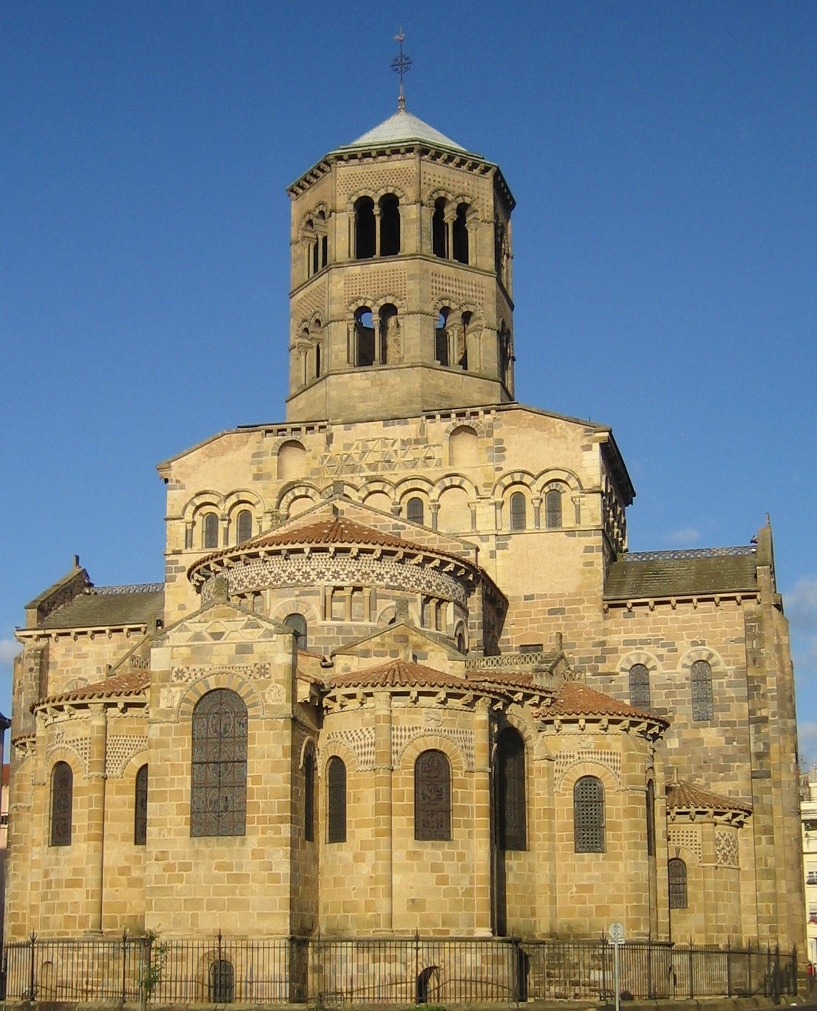
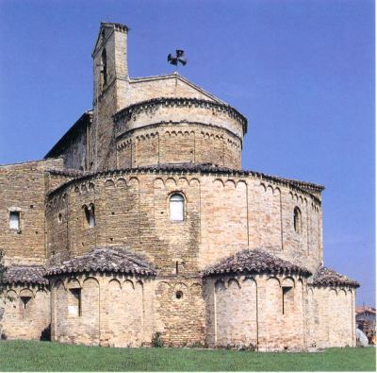

Slide 72
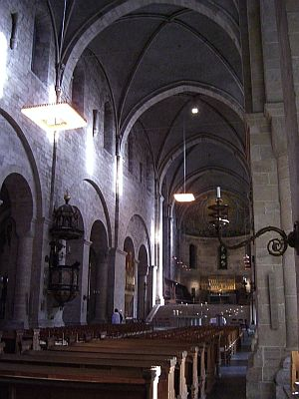
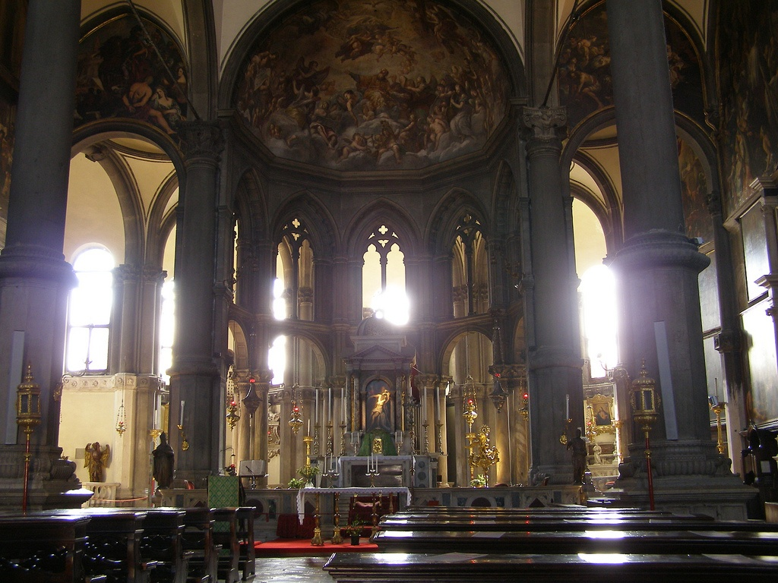

Slide 73
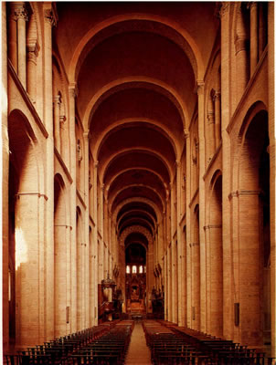

Slide 74
Gothic Architecture
Later, changes were made to the Romanesque style which developed a new style known as Gothic Architecture.
Gothic architecture developed some distinct characteristics of its own.
Vaulted Arches (Pointed)
Flying Buttresses
Thinner walls and stained glass windows
The advancements allowed thinner walls and larger windows, which allowed for these new churches to have much more natural light.
The Gothic style was much more serene and self-confident.

Slide 75
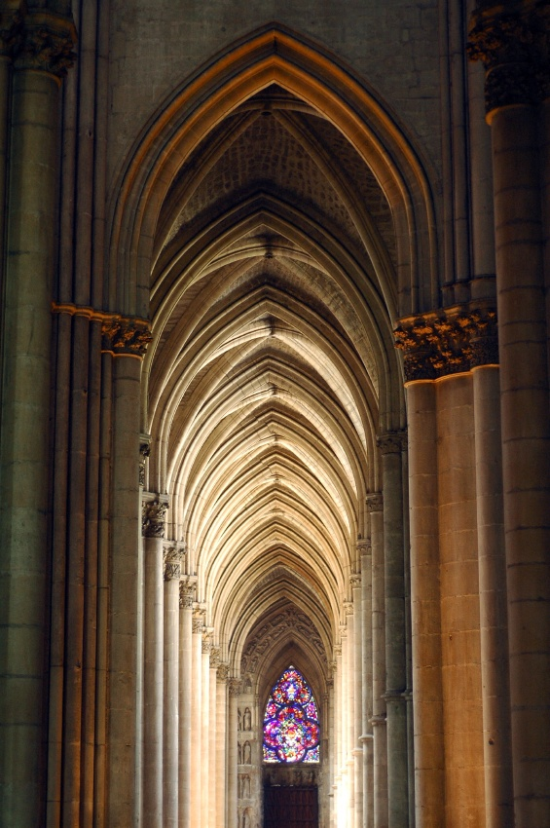

Slide 78
Flying Buttresses

Slide 80
Gargoyles
A Gargoyle functioned as a grotesque. They were meant to scare away evil spirits, but often also acted as water spouts for the churches.

Slide 82
Section 4: The Late Middle Ages
Important Dates
The Black Death spreads throughout Europe: 1350
The Great Schism (Avignon Papacy) begins: 1378

Slide 83
The Black Death
During the 13th century the middle ages had reached a high point, the population had grown and there was an explosion of learning and culture.
The 14th century would bring about many changes in medieval Europe.
Europe had become overpopulated and people were beginning to feel the effects of that overpopulation.
Prior to the plague, there was a famine from 1315 to 1322 which killed off about 10% of Europe’s population.

Slide 84
What was the Black Death?
The Black death was the most devastating natural disaster in European history.
The Black Death, or bubonic plague, was a bacterial infection which killed 38 million people throughout Europe out of a pre-plague population of 75 million.
In urban areas, the death rate was 50-60% of the population.

Slide 85
Types of Plague
The most common form of plague was bubonic plague, which was carried by fleas which lived on black rats.
There was also pneumonic plague, which was bubonic plague which settled in the lungs and was spread by coughing.
There was also septicemic plague which attacked the bloodstream and could be spread from one person to another.
It is thought that the plague originated in Asia and was spread via trade routes to Europe.

Slide 86
The first area hit was Italy, ships which had been trading with Asia sailed into Italian ports with plague-infested rats.
The ships were quarantined, but the rats got to shore.
The poor sanitation of the time allowed for the quick spread of the disease. The plague spread more quickly in the crowded urban areas where people lived close together. Rural areas did not fare quite as badly.
The plague travelled via trade route throughout Europe.

Slide 87
People could be infected with the plague and not show symptoms for weeks.
When plague broke out in a town people would flee, not knowing they were infected, and start plague in another town.
The plague would spread faster during the warm months and go dormant for most of the colder months.
The plague was worst from 1347-1351, but broke out sporadically for many years afterward.

Slide 88
The Spread of the Black Death

Slide 89
Impact of the Black Death
Decline in population: 38 million people died from the black death. This caused a labor shortage throughout Europe. Where land had been scarce before, people could not gain access to it.
Scarcity of Labor: The scarcity of labor caused by the plague actually helped improve working conditions for peasants in Europe. Many could demand wages for the first time.

Slide 90
Towns freed from feudal obligations: Many towns lost large numbers of the populations. Many of these towns asked for freedom for their lords or had lost their lords to the plague.
The power of the church declined because people lost faith in a church which had been unable to save them from such as disaster.
Disruption of Trade: The plague caused trade to break down. People feared travelers and “plague goods” which may carry the disease.

Slide 91
Symptoms of the Plague
The plague began with headache and fever, along with chills, nausea, vomiting, and stiffness.
Within a day or two, the swellings appeared. They were hard, painful, burning lumps on his neck, under his arms, on his inner thighs. Soon they turned black, split open, and began to ooze pus and blood. They may have grown to the size of an orange.

Slide 92
After the lumps appeared he would start to bleed internally. There would be blood in his urine, blood in his stool, and blood pooling under his skin, resulting in black boils and spots all over his body (this is where the name “black death” comes from).
The fluids coming out of the body would smell horrible and most people died within a week of the onset of symptoms.
People died so quickly there was little or no time to bury the dead, so the bodies piled up or were buried in shallow graves.

Slide 93
Social Symptoms
The plague contributed to Anti-Semitism in Europe.
People blamed the Jews for the plague. In the city of Strasbourg a Christian mob murdered 2,000 Jews.
Similar massacres occurred throughout Europe.

Slide 94
Economic Consequences
The Plague was actually good for the European Economy.
There was enough farmland to go around.
People were able to afford and buy land.
Workers demanded wages for their labor.
Cities grew as peasants and serfs, now free of feudal obligations, flocked to cities.
Merchants explored new businesses.

Slide 95
The Decline of Church Power
During the 14th century the power of the church began to decline.
European kings, who were gaining power, were no longer willing to accept the idea of Papal supremacy over them.
One of these conflicts was between Pope Boniface VIII and King Philip IV of France.

Slide 96
King Philip IV believed he should be able to tax the clergy.
Pope Boniface VIII said that he could not.
Philip IV refused to accept the Pope’s authority and sent his troops to Italy to bring him to France to stand trial.
The Pope escaped, but died shortly after leaving the office of Pope open for election . . .

Slide 97
The Great Schism/Avignon Papacy
During the conclave, Philip arranged for the election of a French Pope.
The Papacy then moved to Avignon, France, where it remained from 1305-1377.
A later Pope, Gregory XI, returned the Papacy to Rome, but died soon after the move.

Slide 98
The cardinals insisted on the election of an Italian Pope, Pope Urban VI.
Five months later, the French cardinals declared the election of that Pope invalid and elected their own, Clement VII.
Now Europe had TWO Popes. This created a lot of problems, the Pope was the head of the Church and people were uncertain as to which Pope they should follow.
The French and their allies supported the French Pope.
England and the Holy Roman Empire supported the Italian Pope.
The two Pope excommunicated each other and there was chaos within the Church.

Slide 99
The Council of Constance
Church cardinals called a Church council at Pisa and tried electing a new Pope and then there were three!
The Holy Roman Emperor finally called the Council of Constance to resolve the Great Schism.
The two Popes were deposed, the third resigned and a new Pope was elected.

Slide 100
Attempts at Church Reform
All of this corruption and chaos within the Church made some want to reform the Church.
In England John Wycliffe made arguments that salvation came from faith and not from the Church itself.
He and his followers translated part of the Bible into English.
His reforms helped to lay the foundations for later change, but were unsuccessful at the time.

Slide 101
Jan Hus
Wycliffe's teachings may have influenced a Czech reformer by the name of Jan Hus.
Hus acted upon the ideas of Church reform. He spoke out against corrupt church practices.
He was invited to the Council of Constance where he had been told he would be safe, but was burned has a heretic.

Slide 102
The Hundred Years War
This war was a conflict between England and France.
There were several factors which led to the war.
England had lands which it claimed in France
England and France were in competition for Flanders.
Edward had a claim to the French throne, but the French were outraged at the idea of having an English King.
Both sides welcomed war as a chance to assert their own agendas.
The war officially stared when King Philip VI of France took English holdings and Edward III declared war on France.
What occurred was a 116-year conflict that changed the two countries.

Slide 103
France vs. England
The French and English had different fighting styles.
The French tended to use the crossbow.
The English used the longbow.
At the battle of Crecy, the English had a sound victory over the French using their bowmen.
After the battle King Henry V of England executed the French prisoners.
At Agincourt, the English won another victory when the French cavalry became bogged down in the mud of the battlefield.

Slide 105
Jeanne d’Arc (Joan of Arc) 1412-1431
Charles was the uncrowned king of France, the douphin.
Joan of Arc was a young French peasant girl who claimed that she heard voices that told her it was her duty to save France.
In 1429 she made it to Charles’ court and convinced him to let her lead his army in battle.

Slide 106
Orleans
At the battle of Orleans, Joan was able to lead the French troops to victory.
Joan was, however, captured by the English in 1430 and was burned as a heretic.
She became a martyr and symbol for the French in the war.

Slide 107
Gunpowder
The French were eventually able to win the war because of Gunpowder.
The French developed cannons and were able to defeat the English.
The French achieved victory in 1453.

Slide 108
Political Recovery
As the power of the Church declined New Monarchs were emerging in Europe who consolidated their power and made their kingdoms strong under their central authority.

Slide 109
France
The Hundred Years war benefitted France by providing it with a sense of national identity.
Later King Louis XI (the spider) strengthened the power of the French Monarchy by instituting the taille, or tax, on the French Monarchs.
Through deals and alliances, Louis managed to gain control over the nobles of France.

Slide 110
England
The Hundred Years War devastated England.
The country lost territory and the nobles lost confidence in the monarchy
This led to a conflict called the War of the Roses between the houses of York and and Lancaster.
Eventually the house of Lancaster won and Henry Tutor (Henry VII) became the first Tutor King.

Slide 111
Henry abolished all private armies so that the nobles would not be able to rebel against him.
Henry set up an effective system of government administration.

Slide 112
Spain
Ferdinand and Isabella
In Spain King Ferdinand and Queen Isabella eliminated the power of the Nobles.
They took control of the national church.
They tried to make Iberia (Spain and Portugal) Homogeneous.
Reconquista: Ferdinand and Isabella forced all non-Catholics to leave Spain or convert to Christianity.

Slide 113
Central and Eastern Europe
The Holy Roman Empire was different from France, England, and Spain in that it never consolidated power under a strong king.
In 1438 The Hapsburg dynasty gained power over the office of Holy Roman Emperor.
In Eastern Europe different religious groups came into conflict
Roman Catholics, Eastern Orthodox Christians and Muslims began to fight each other.

Slide 114
Russia
In Russia the Mongols were ruling over the Russian Nobles.
The Prince of Moscow Ivan III (Ivan the Great) threw off Mongol rule and established his own kingdom.

Slide 115
The Kremlin
Ivan the Great built the Kremlin, or fortress as a show of his strength.

Slide 116
Czars
Ivan saw himself as heir to the Byzantine Empire, he eliminated the power of the Boyers (Nobles) and centralized authority.
The title Czar (Tsar) came from the Roman Caesar, as the emperor viewed himself the heir to Rome through the Byzantine Empire.
Ivan married a Byzantine princess, thus increasing Byzantine influence in the new Empire.

