Slide 1
British North America: Colonial Governments and Imperial Policy

Slide 2
British Colonial Trade Regulations
During the reign of James II, economic restrictions were imposed on the colonists to foster economic dependence.
Navigation Act (1651):
All crews to be 1/2 English in nationality
Most goods must be carried on English ships.
Navigation Act (1660):
Required all colonial trade to be on English ships
Master and 3/4 of crew must be English
List of "enumerated goods" developed that could only be shipped to England or an English colony
Navigation Act (1663):
Required goods bound for the colonies from Africa, Asia, or Europe to first be landed in England before shipping to America.
The Triangular Trade Route

Slide 3
The Dominion of New England, 1688
English colonists exercised a considerable degree of political autonomy.
Most political structures allowed free white men with property an active voice in local affairs.
In 1685, James II began to replace the diverse colonial governments with royal proprietorships.
The King wanted to assert more control over the independent assemblies and enforce economic restrictions.
James II

Slide 4
The Dominion of New England, 1688
In 1686, the colonial charters of New England, New York, and New Jersey were revoked and the region was politically consolidated as the Dominion of New England.
The colonists were deprived of their ability to govern themselves, levy taxes, and control religious expression.
The colonists were subject to the autocratic rule of Sir Edmund Andros for two years.
Sir Edmund Andros

Slide 5
Excerpts from the Commission of Sir Edmund Andros for the Dominion of New England
“…Wee do hereby give and grant unto you full power and authority, by and with the advise and consent of our said Councill … to make constitute and ordain lawes statutes and ordinances … …”
… to impose assess and raise and levy rates and taxes as you shall find necessary for the support of the government …
“…to be a constant and setled Court of Record for ye administration of justice”
“…levy arme muster command … also to execute martiall law in time of invasion insurrection or war…”
What do you think the colonial reaction to this arrangement was? Why?

Slide 6
The Glorious Revolution in America, 1689
In 1688, leading English members of Parliament opposed James II for trying to reestablish absolute monarchy and promote Catholicism.
They arranged for William of Orange to invade England and restore their liberties. King James fled England.
This bloodless coup transformed England into a constitutional monarchy.
William of Orange and his wife Mary became joint rulers after accepting the English Bill of Rights.

Slide 7
The Glorious Revolution in America, 1689
Following the Glorious Revolution, Sir Edmund Andros was deposed as ruler of the Dominion of New England.
Massachusetts and Plymouth were combined in 1691 as the royal colony of Massachusetts Bay.
The other New England colonies reverted their previous forms of government.

Slide 8
The English Bill of Rights, 1689
The English Bill of Rights assured the English people of certain basic civil rights and became influential in the American colonies as well.
Though most of the colonies were now more directly controlled by the crown, the assemblies followed the example of the British Parliament and maintained their right to vote on taxes and initiate legislation.
Later, the states and the federal government would eventually adopt their own bills of rights

Slide 9
The Policy of Salutary Neglect
“Salutary neglect” was the unwritten, unofficial stance of benign neglect by England toward the American colonies.
The colonists were allowed to govern themselves with minimal royal and parliamentary interference.
In turn, they fulfilled their role in the mercantilist system as the suppliers of raw materials for manufacture in England and as markets for those finished goods.

Slide 10
The Policy of Salutary Neglect
In Edmund Burke's 1775 "Speech on Conciliation with the Colonies," the term "salutary neglect" was first used.
“… I know that the Colonies in general owe little or nothing to any care of ours, and that they are not squeezed into this happy form by the constraints of watchful and suspicious government, but that, through a wise and salutary neglect, a generous nature has been suffered to take her own way to perfection; when I reflect upon these effects, when I see how profitable they have been to us…”

Slide 11
The Policy of Salutary Neglect
Sir Robert Walpole served as England's first Prime Minister from 1721 to 1742.
Because Walpole believed interference with the colonies would alienate them and hurt commerce with England, he laxly enforced trade regulations, including the Navigation Acts.
Some historians argue that the policy of salutary neglect gave the American colonists a degree of independence that led directly to the American Revolution.
Prime Minister Robert Walpole

Slide 12
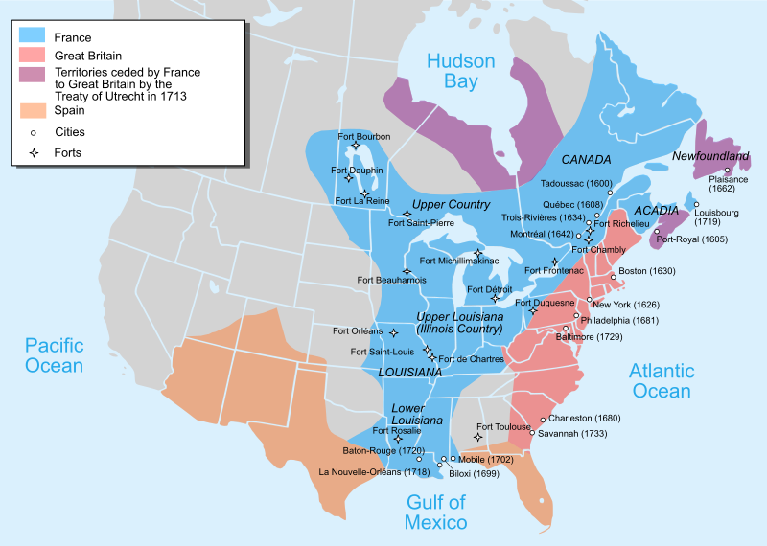
Economics versus Colonial Administration 1689-1748
Conflict in Europe begins to have an impact on both British and French Colonial America

Slide 13
Anglo-French Imperial Competition
France
England
Empire
Background
History
Rivalry
vs.

Slide 14
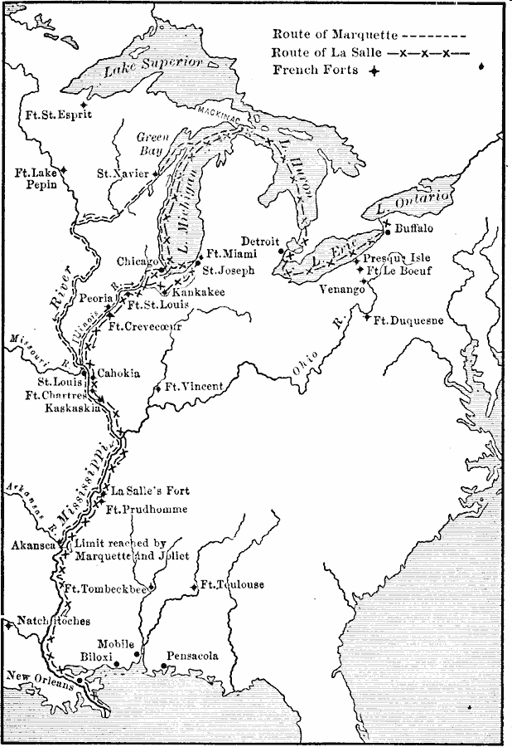
French Forts
Settled in Ohio Valley
Sought to keep British from moving west

Slide 15
Century of Imperial War
Britain’s conflicts with continental rivals like France spilled over to colonies
Security threats from these conflicts forced colonists into more military and political cooperation
British colonies overwhelmingly militarily superior to New France but ineffective

Slide 16
King William’s and Queen Anne’s Wars
King William’s War (1689-1697)
French frontier raids on New York and New England
Queen Anne’s War (1702-1713)
Bloody fighting across entire frontier
European diplomats more concerned with balance of power in Europe than military situation in North America

Slide 17
King William’s and Queen Anne’s Wars
Wars fought for control of the Mississippi River Valley
France extended its presence from Canada into Louisiana
British saw French expansion as encirclement
Native Americans tried to hold middle ground
Iroquois favored British
Algonquian favored French

Slide 18
King George’s War and Its Aftermath
Fought 1743-1748
1745—New England troops captured Fort Louisbourg on Cape Breton Island
1748—Louisbourg returned to France by Treaty of Aix-la-Chappelle
French built Fort Duquesne to keep British from seizing Ohio River Valley
Virginians under George Washington failed to expel French
Showed one colony alone could not defeat French
Notes:
Lft off hre

Slide 19
A Century of Conflict: Major Wars, 1689–1763

