Slide 1
New Era to New Deal
The New Era: 1920s
The business of America and the consumer economy
Republican politics: Harding, Coolidge, Hoover
The Culture of Modernism: science, the arts, and entertainment
Responses to Modernism: religious fundamentalism, nativism, and Prohibition
The ongoing struggle for equality: African Americans and women
The Great Depression and the New Deal
Causes of the Great Depression
The Hoover administration’s response
Franklin Delano Roosevelt and the New Deal
Labor and union recognition
The New Deal coalition and its critics from the Right and the Left
Surviving hard times: American society during the Great Depression

Slide 2
Key Unit Themes
What changes occurred between 1918 and 1941 that affected Americans’ perceptions of race, class, gender, and ethnicity? What were the consequences of those changes?
How did the Harlem Renaissance alter American perceptions of race?
What was the impact of the Red Scare on American perceptions of ethnicity, and how were those perceptions manifested?
To what degree did the Nineteenth Amendment expand the role of women in American society?
What was the impact of World War I on Americans’ perceptions of race, ethnicity, class, and gender?
Analyze the ways in which the Great Depression and the resulting New Deal affected class distinctions.

Slide 3
Chapter 31
American Life in the “Roaring Twenties”
1919- 1929
America’s present need is not heroics but healing; not nostrums but normalcy; not revolution but restoration;… not surgery but serenity”
Warren G. Harding, 1920

Slide 4
Election of 1920
1st election in which women can vote
Republicans (united again)-nominate Warren G. Harding (Ohio) & VP running mate Calvin Coolidge
Platform: appealed to pro-League & anti-league Republicans (“would work for a league but not the League”)
Advocated for a “RETURN TO NORMALCY”
Democrats (met in San Francisco) nominated James M. Cox (Ohio) & Franklin Roosevelt as VP.
Platform- pro-League of Nations
Socialist Eugene V. Debs (imprisoned) garnered 919,000 votes

Slide 5
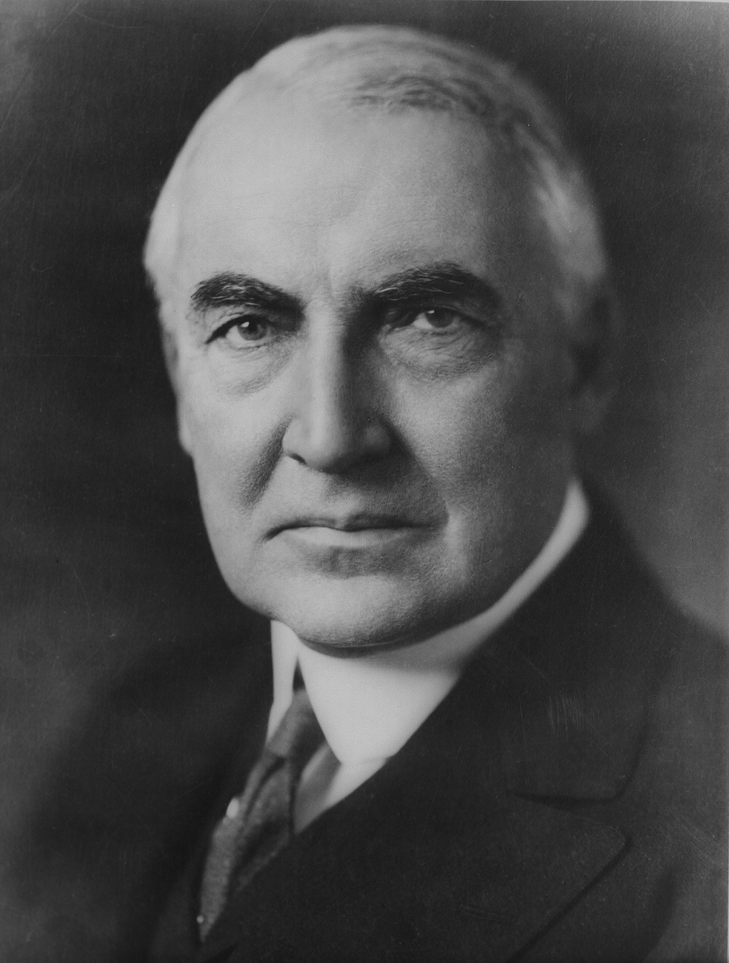
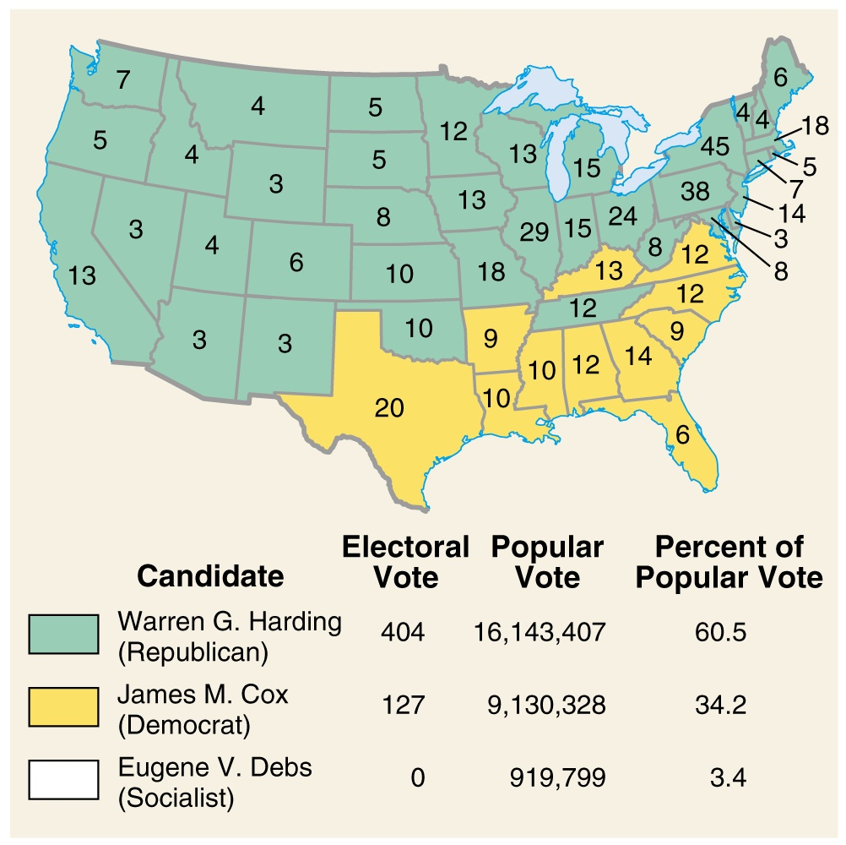
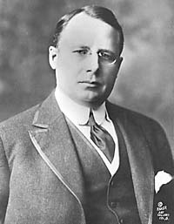
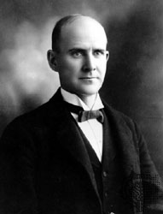
The 1920 Election

Slide 6
The 1920 Election
Wilson’s idealism and Treaty of Versailles led many Americans to vote for the Republican, Warren Harding…
US turned inward and feared anything that was European…

Slide 7
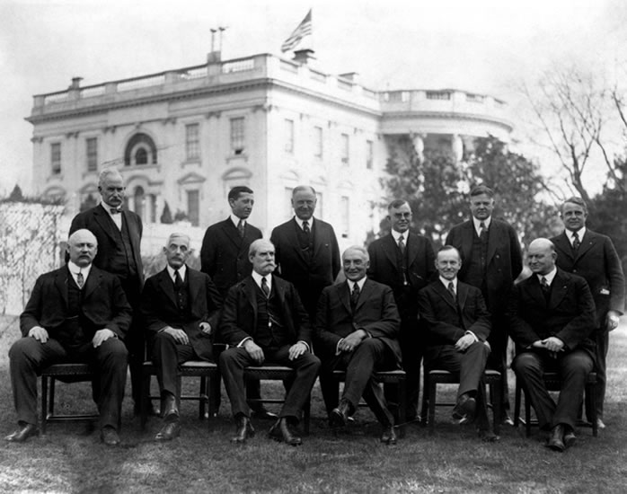
The 1920 Election
The Ohio Gang: President Warren Harding (front row, third from right), Vice-President Calvin Coolidge (front row, second from right), and members of the cabinet.

Slide 8
Republican Policies
Return to "normalcy"
  tariffs raised
  corporate, income taxes cut
  spending cuts
Government-business cooperation
  “The business of government, is business”- Calvin Coolidge
  “The man who builds a factory, builds a temple; the man who works there worships there” Coolidge
Return to “isolation” –End Progressivism

Slide 9
REPUBLICAN FISCAL PROGRAM
REPUBLICAN ECONOMY SUPPORTED LAISSEZ FAIRE AND BIG BUSINESS……….
$
=
+
+
Lower Taxes Less Federal Higher Strong
Spending Tariffs National
Economy
Fordney-McCumber Tariff---1923
Hawley-Smoot Tariff ---1930
raised the tariff to an unbelievable 60%!!!

Slide 10
One of the most important shifts of power in 20th century
Pre-WWI= US is a debtor nation
Post-WWI= US is a creditor nation
#1- industrial, technology, stronger federal government
more isolationist???
** Development of mass culture

Slide 11
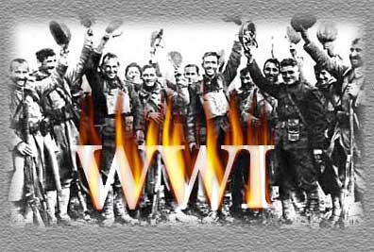
POSTWAR ADJUSTMENTS
Return to a peacetime industry and economy
War boosted American economy and industry.
United States became a world power, largest creditor and wealthy nation.
Soldiers were hero’s but found that jobs were scarce.
African American soldiers, despite their service returned to find continued discrimination.
The Lost Generation of men who were killed in WWI.
US returned to neutrality and isolation.
Did not accept the responsibility of a world power that President Wilson believed the US should take on.

Slide 12
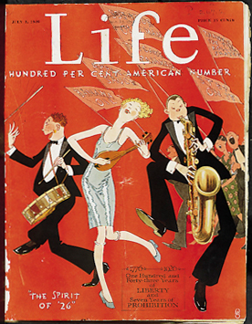
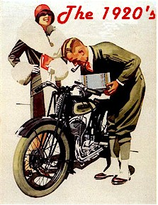
THE ROARING TWENTIES
** Birth of the Modern Era

Slide 13
Traditional vs. Modern
Turned inward (isolationism)
Condemned “un-American” lifestyles; “radical ideas”
Pro-business = higher tariffs
Immigration restrictions
Protestant work ethic
Self-denial
Frugality
Fundamentalism- literal interpretation of Bible
Cult of Domesticity
Rural
New technologies-movies, radio
Youth movement, “New Negro”, “Feminism”
Consumer products on credit
Consumer consumption
Leisure/ self realization
Secular/ Darwin/Freud
Art, literature, music (modern)
Urban

Slide 14
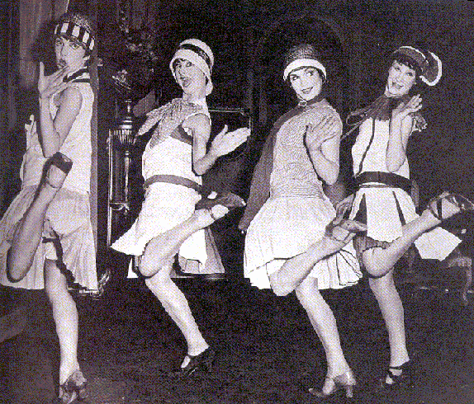
Post -war 1920’s-America looks inward
America more “isolationist”
Return of Big Business/Republicanism & High Tariffs
more limits on immigration
Rise of the KKK
The Red Scare
Modernism vs. Traditionalism (Fundamentalism)
“Flappers”

Slide 15
***The Red Scare 1919-1920
Bolshevik Revolution in 1917- caused fear in the US
Seattle General Strike (1919)- mayor called in troops- labor unions seen as dangerous & red.
Red Scare- nationwide movement to root out left-wing radicals (communists).
**The Palmer Raids
Led by Attorney-General Mitchell Palmer
2 raids (Nov. 1919 & Jan. 1920)
6,000 people jailed (243 deported to USSR)
1919- Palmer’s house bombed
1920- Wall Street- bomb killed 38 & injured 100’s
IWW members harassed
Justice Department –creates General Intelligence Division to find radicals; headed by J. Edgar Hoover (later it becomes - THE FBI).

Slide 16
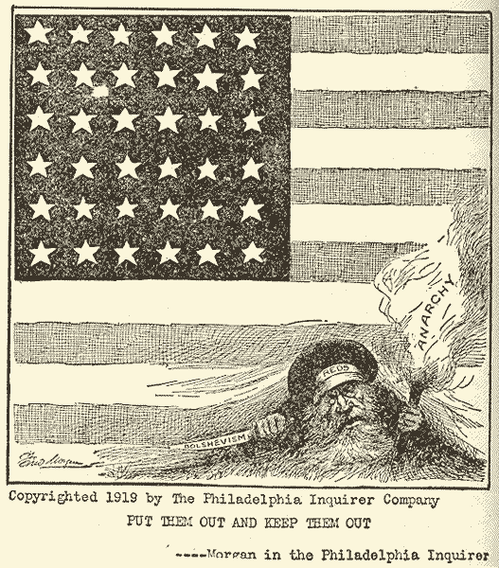
Cartoon from 1919: “Put them out and keep them out”

Slide 17
Effects of the Red Scare
1919-1920- state legislatures passed criminal syndicalism laws (illegal to advocate for violent social change).
IWW members prosecuted
Conservative businessmen used red scare to break labor unions
**Sacco-Vanzetti Case (1921)- demonstrated the anti-immigrant & anti-red sentiment in the US.
1927- Sacco & Vanzetti were executed

Slide 18
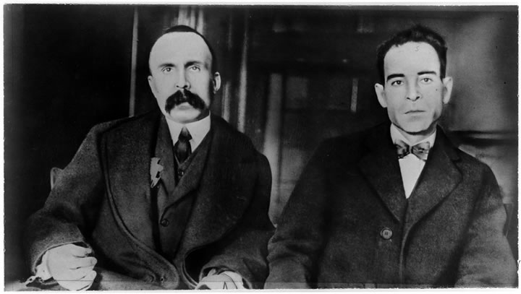
**Sacco and Vanzetti
Nicola Sacco and Bartolomeo Vanzetti were Italian immigrants charged with murdering a guard and robbing a shoe factory in Braintree, Mass.
The trial lasted 1920-1927. Convicted on circumstantial evidence, many believed they had been framed for the crime because of their anarchist and pro-union activities.
In this time period, anti-foreignism was high as well.
Liberals and radicals rallied around the two men, but they would be executed.

Slide 19
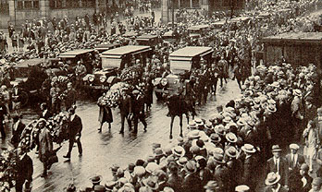

Slide 20
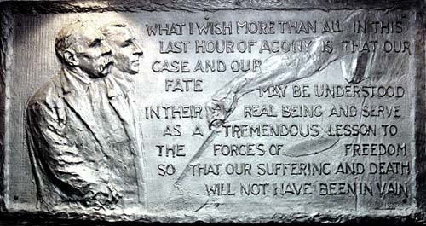

Slide 21
Emergence of The “New” KKK
Membership grew during the 1920’s-hired PR experts to promote the Klan
membership growth= South & Mid-West; 5 million members by 1925-26.
Anti-everything- more a reaction against the diversity (new immigration) of the time period
Potent Political Force- “Birth of a Nation” movie by D.W. Griffith (glorified the Klan) ;shown in the Whitehouse by Wilson.
** Example of conflict between tradition & modernism
Klan membership declined by end of the decade due to embezzlement scandal.

Slide 22
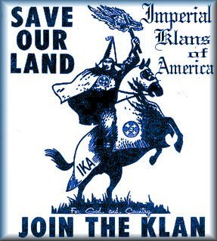
IKA
Imperial Klans of America

Slide 23
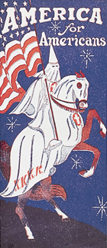

Slide 24
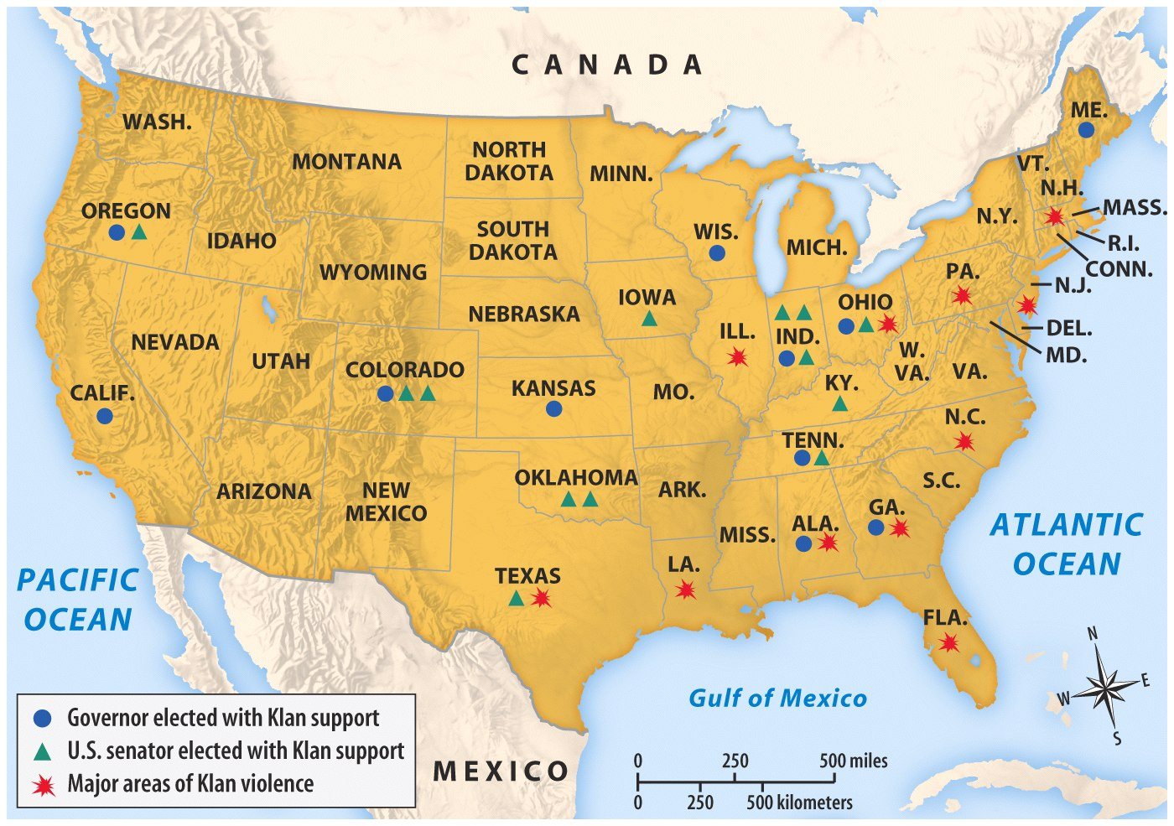

Slide 25
Immigration in the 1920’s
After WWI- more immigrants came to the US from Southern & Eastern Europe.
1900-1921- 17 million to the US (largest in human history)
Melting pot (assimilation) vs. Salad Bowl (pluralism)
Emergency Quota Act (1921)- limited immigration to 3% of those living in US in 1910
Favorable to new immigrants
Immigration Act of 1924- lowered the limit to 2% of those living in the US according to the 1890 census (why the change?)
closed the door to Japanese immigrants
exempted Latin Americans & Canadians

Slide 26
Immigration
3. Immigration Act 1929- limits total # to 150,000 per year= national origin quota system abolished.
Lasted until 1965= increased to 170,000 & exempted spouses, children, parents, people from communist countries.

Slide 27
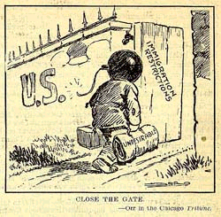
IMMIGRATION RESTRICTIONS

Slide 28
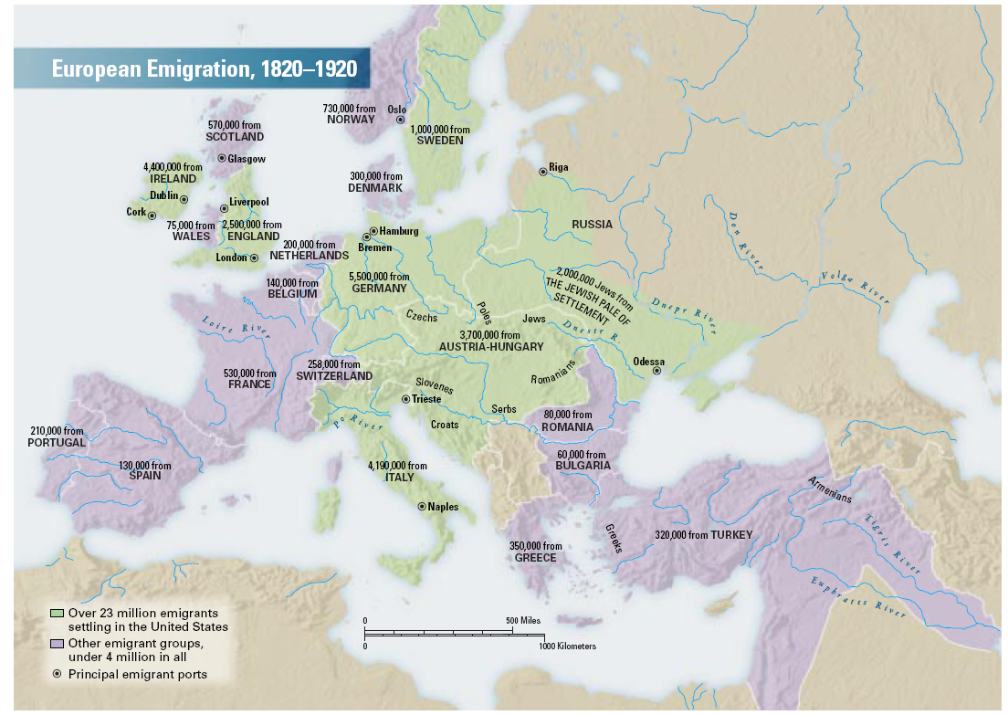

Slide 29
Immigration Policy in the 1920’s
1920- used as quota base (Quota total= 152,574
By 1931- more foreigners left the US than were coming here
Patchwork of ethnic communities isolated from each other & larger society by language, custom
Hurt efforts to organize labor unions= employers used ethnic differences to divide & conquer.
“Cultural Pluralists”- argued that the “melting pot” did not eliminate differences
Horace Kallen- newcomers should practice ancestral customs-preservation of identity.
Randolph Bourne- advocated cross-fertilization among immigrants= “cosmopolitan interchange”

Slide 30
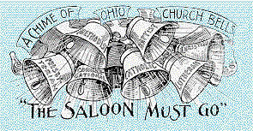
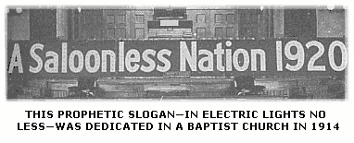
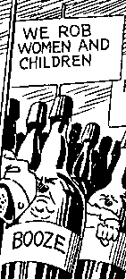
PROHIBITION

Slide 31
Prohibition
18th Amendment (1919) made alcohol illegal.
*Volstead Act (1919)- enabled the Federal government to enforce prohibition (expanded police powers of the US).
Popular in South & Mid- West
Unpopular in larger cities of the East
Weaknesses & Effects
Federal Agencies = Understaffed & underpaid
People blatantly broke the law- “speakeasies”
1930- crime syndicates took in $12 to $18 billion
Led to organized crime in NYC, Chicago, etc. = bribery of police, gang wars, gambling, prostitution- gangster Al Capone.
Positives: saving increased, absenteeism decreased

Slide 32
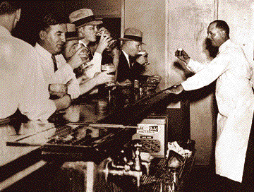
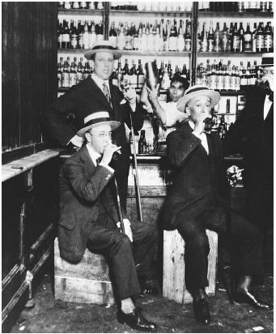
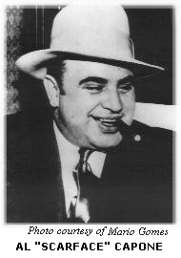
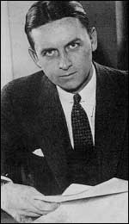
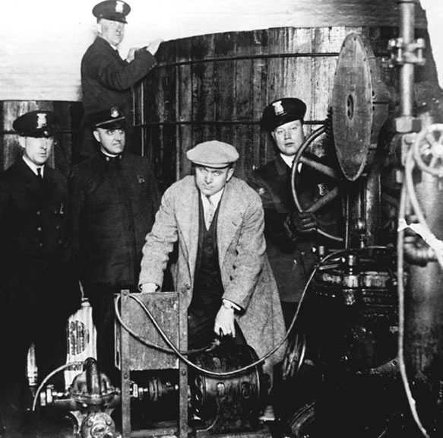
PROHIBITION
Al Capone
Elliot Ness, part of the Untouchables
Chicago gangster during Prohibition who controlled the “bootlegging” industry.
Detroit police inspecting equipment found in a hidden underground brewery during the prohibition era.
Agent with the U.S. Treasury Department's Prohibition Bureau during a time when bootlegging was rampant throughout the nation.

Slide 33
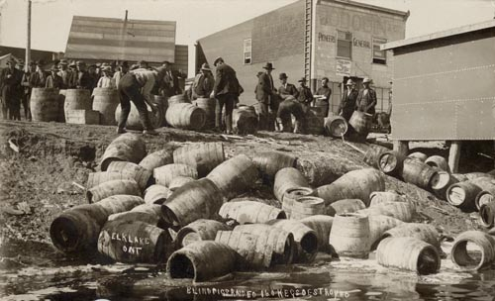
Prohibition Raid

Slide 34

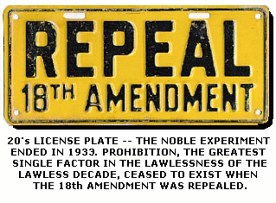
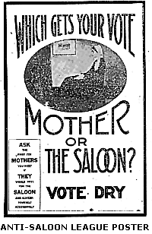
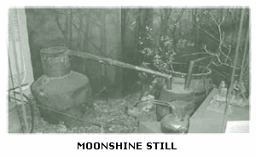
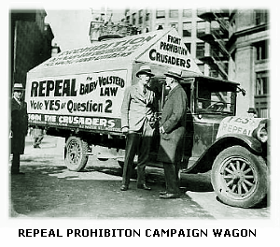
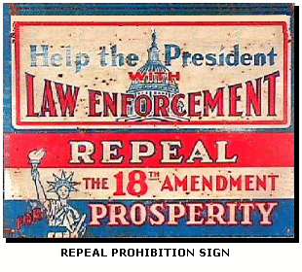
PROHIBITION
The "Noble" Experiement

Slide 35
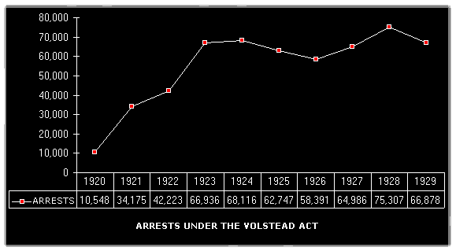

Slide 36
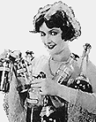
PROHIBITION
The "Noble" Experiement
“Prohibition is an awful flop.
We like it.
It can't stop what it's meant to stop.
We like it.
It's left a trail of graft and slime,
It's filled our land with vice and crime,
It can't prohibit worth a dime,
Nevertheless we're for it.”
Franklin Pierce Adams, New York World
“It is impossible to stop liquor trickling through a dotted line”
A Prohibition agent

Slide 37
Creationism vs. Fundamentalism
Tradition vs. Modernism
School Reform
1920-25% of Americans finished High School
John Dewey- professor at Columbia University, advocated “learn by doing” & “education for life”
Science
Public Health Programs- virtually wiped out hookworm in the South
Better nutrient & healthcare= life expectancy increased to 59 years old (1901= 50).

Slide 38
The Fundamentalists in the 1920’s
* believed in a literal interpretation of the Bible
Successes: limiting immigration, deporting communists, Prohibition, attack the teaching of Darwinism.
Several states in the South passed laws which forbade the teaching of evolution.
The ***“Scopes Monkey Trial”- teacher arrested in Tenn. for teaching evolution; famous trial.
William Jennings Bryan- led the prosecution
Clarence Darrow led the Defense team
Darrow cross-examines Bryan-confuses him
Scopes loses & is fined $100
Effect- shows Southern & Mid-west conservatism (rural vs. city), laws against teaching evolution existed until 1960’s.
Law in Tenn. Until 1967

Slide 39
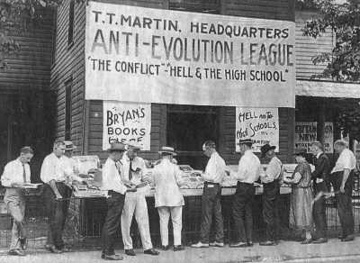
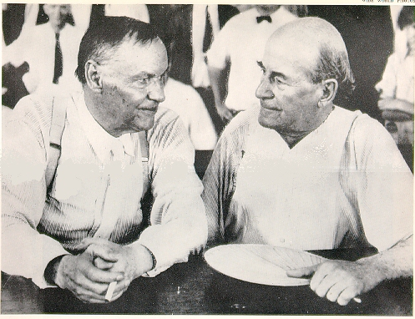
SCOPES MONKEY TRIAL
1925
The first conflict between religion vs. science being taught in school was in 1925 in Dayton, Tennessee.

Slide 40
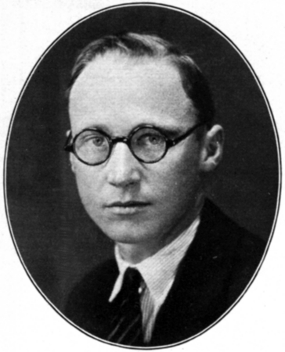
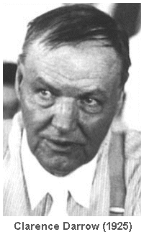
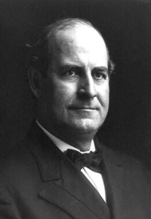

SCOPES MONKEY TRIAL
John T. Scopes
Respected high school biology teacher arrested in Dayton, Tennessee for teaching Darwin’s Theory of Evolution.
Clarence Darrow
Famous trial lawyer who represented Scopes
William J. Bryan
Sec. of State for President Wilson, ran for president three times, turned evangelical leader. Represented the
prosecution.
Dayton, Tennessee
Small town in the south became protective against the encroachment of modern times and secular teachings.

Slide 41
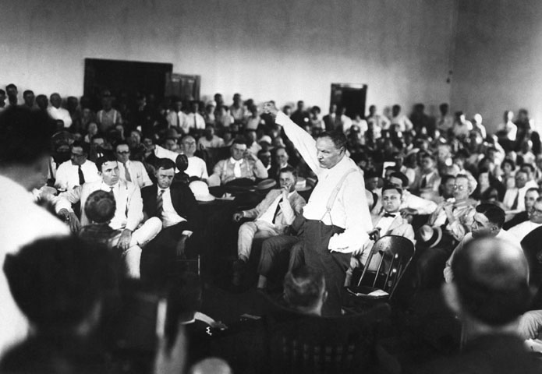

Slide 42
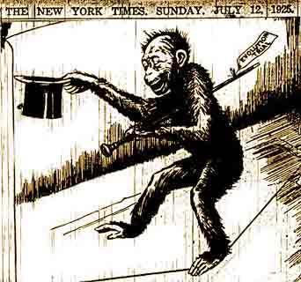
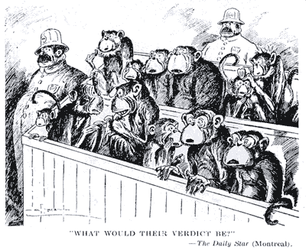
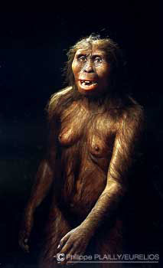
SCOPES MONKEY TRIAL
The trial is conducted in a carnival-like atmosphere. The people of Dayton are seen as ‘backward’ by the country.
The right to teach and protect Biblical teachings in schools.
The acceptance of science and that all species have evolved from lower forms of beings over billions of years.

Slide 43
America’s Economy in the 1920’s
Economy boomed in 1919– slight recession in 1920-21--- boomed 1922-29.
Sec. of Treasury Andrew Mellon- worked for all presidents of the 1920’s.
Mellon’s tax policies- reduced debt, decreased taxes= prosperity= “trickle down” theory (supply- side economics)
High Tariffs= protectionism
New Technology - growth of the airline industry, automobile, electricity generation, radio, movies.

Slide 44
Mass Consumption Economy
Creating a desire for “newer, best, improved”
Electricity- Edison (Westinghouse) –company provided electric services for cities etc.
Advertising- as businesses mastered mass production– turned to advertising to lure consumers to products.
used sex, suggestion & other ploys to lure consumers
Sports as Big Business- workers have more leisure time
Baseball- Babe Ruth
Boxing- Jack Dempsey
Consumer Credit- consumers bought items on credit like radios & cars

Slide 45
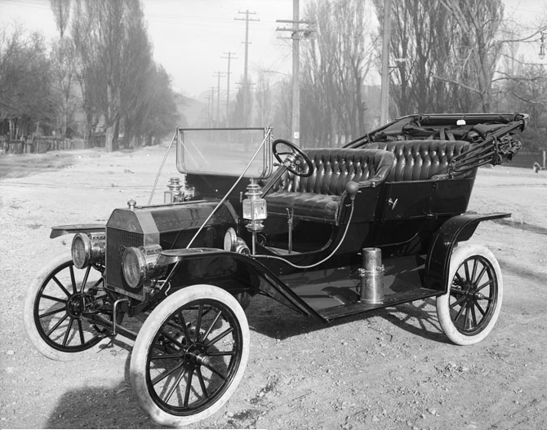
Henry Ford, assembly line & the car
1890’s- Henry Ford, Ransom Olds & others were developing their own version of the auto
1913- Ford installed 1st moving assembly line= auto every 93 minutes.
1925- car every 10 seconds= lowers price as well.
1908- Model T- sold for $850; 1914= $490
other products made in the 1920’s used the assembly line method
Spawned other industries
Detroit car industry capital

Slide 46
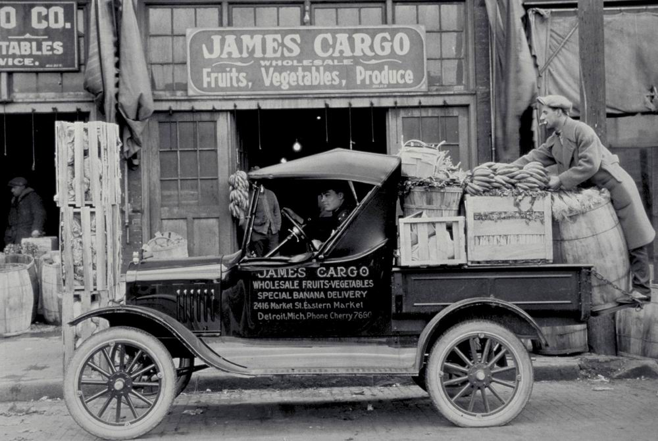
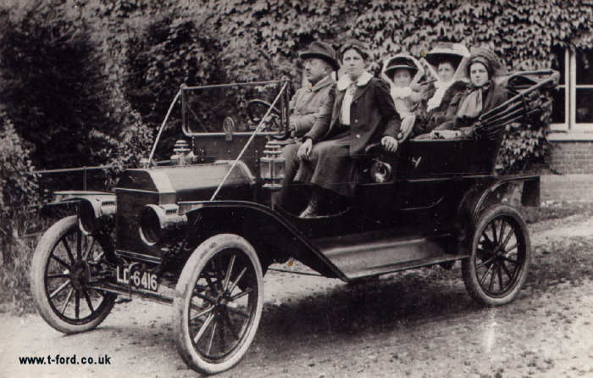
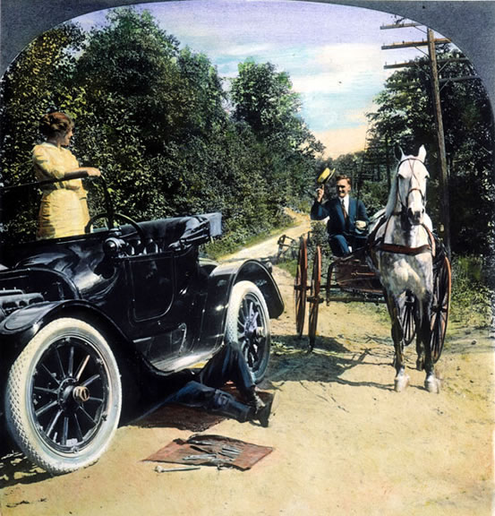

Slide 47
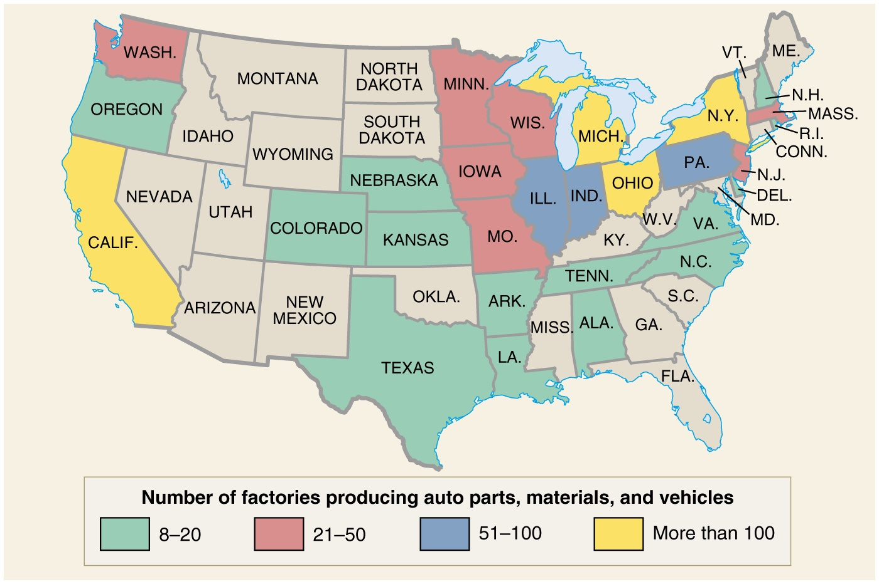

Slide 48
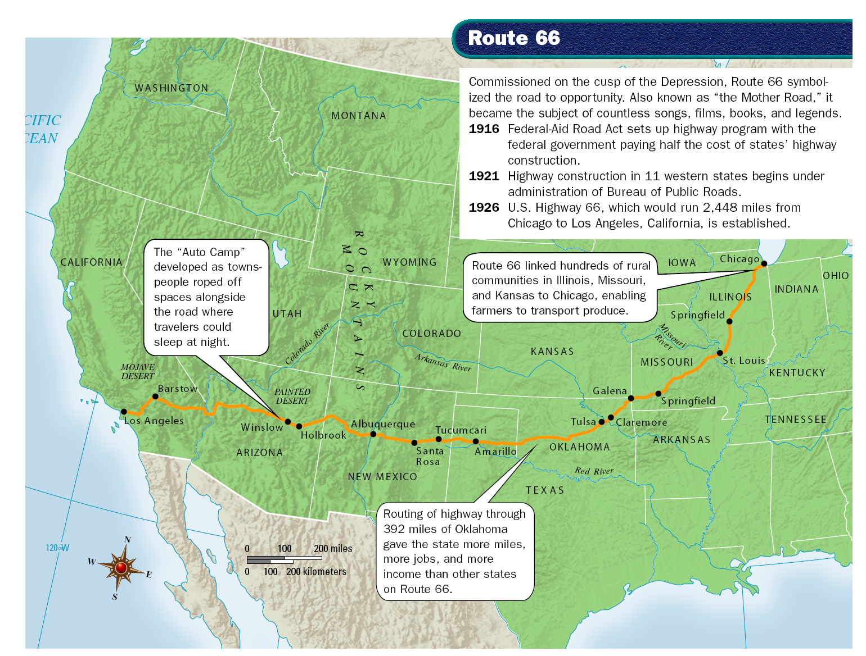

Slide 49
Ford launches a new Industrial Revolution
New industries spring up when the car industry takes off
“Taylors” Frederick Taylor – “Father of Scientific Management”
1914- Ford raised worker’s pay to $5 a day & reduced workday to 8 hours (worker loyalty & under cut unions).
1929- 26 million cars registered in the US
US Economy is booming in the 1920’s = materialism, consumerism, & debt also.

Slide 50
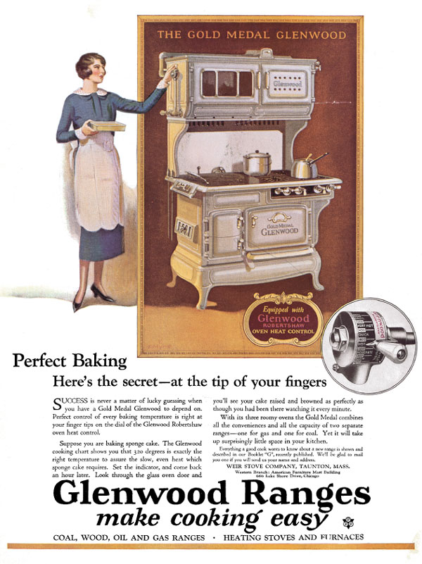

Glenwood Stove and Washing Machine

Slide 51
The Gasoline Age
Auto industry employed 6 million people directly or indirectly by 1930.
Petroleum Industry- grew (California, Texas, Oklahoma)
Railroad Industry- began to decline
Marketing of fresh fruits= eastern cities= prosperity for some farms.
Social Change: autos changed us;
Badge of freedom & equality
Women free from dependence on men
Isolation of rural life broken down
Freedom from parents= greater mischief for youth
Autobuses= consolidation of schools & churches
More auto related injuries & deaths (1 million by 1951)

Slide 52
The Airplane
Dec. 17, 1903- Orville & Wilbur Wright flew first gas powered plane at Kitty Hawk, NC
1914-1918- Planes used during WWI
Private companies operated commercial air mail service- subsidized by the US after World War I
1ST Transcontinental airmail route from NY to San Francisco (1920)
1927- *Charles Lindberg flew The Spirit of St. Louis from NY to Paris (1st solo transatlantic flight) 33 hours/39 minutes
1930’s & 1940’s- travel on commercial planes safer than autos
Change- increases tempo of life, lethal weapon of war, hurt ailing RR industry, shrinking of the world – AIR LINE INDUSTRY EMERGES

Slide 53



Slide 54
Radio
1890’s Guglielmo Marconi- invented wireless telegraphy-- RADIO (used during WWI)
1920- KDKA broadcast Harding’s election victory
(1st public broadcast in the US)
1920’s tech allowed long range broadcasts possible
1920’s commercial broadcast companies appear (CBS, NBC, ABC)
“Commercials”- BY SOAP Co’s = Soap Operas
Radio shows (Amos n’ Andy), sports, Politicians changed the way they addressed citizens, brought news & music to living rooms of average Americans= standardize language & culture

Slide 55


RADIO
Radio sets, parts and accessories brought in $60 million in 1922…
$136 million in 1923
$852 million in 1929
Radio reached into every third home in its first decade.
Listening audience was 50,000,000 by 1925

Slide 56


Slide 57


Slide 58
Movies
1890’s- Thomas Edison perfects the movie camera
1st used at naughty peep shows
1903- The Great Train Robbery (5 cent theaters called “nickelodeons”)- 1st full length story on screen
1915- Birth of a Nation (W.D. Griffith) movie glorified the Klan.
Hollywood, California became the movie capital
1st movies included nudity= calls for self censorship
Movies used during WWI as propaganda
1927- The Jazz Singer- 1st talking movie (starred-Al Jolson)
Change- movies & radio criticized by traditionalists, broke down cultural barriers (standardized tastes).

Slide 59
Social Change: the 1920’s
**1920- more Americans live in cities than rural areas (1st time in US history).
a. Women
Women found opportunities in cities (“women’s work”)
Margaret Sanger- championed birth control
1923 Alice Paul- called for Equal Rights Amendment (7 decades push)
b. Churches- modernist infiltrated churches “God is a good guy”
c. Advertisers – used sex to sell products
d. “Sex O'clock in America”- seen in advertising, hemlines going up- “necking” & “pecking”, dancing to jazz
Dr. Sigmund Freud- don’t repress your sexuality.
“flapper” epitomized the new independent woman

Slide 60
THE FLAPPER
“Flappers” sought individual freedom
Ongoing crusade for equal rights
Most women remain in the “cult of domesticity” sphere
Discovery of adolescence
  Teenaged children no longer needed to work and indulged their craving for excitement

Slide 61


Slide 62

Rural Americans identify urban culture with Communism, crime, immorality
Sex becomes an all-consuming topic of interest in popular entertainment
Communities of home, church, and school are absent in the cities
Conflict: Traditional values vs new ideas found in the cities.

Slide 63
African-Americans in the 1920’s
1900- 1920- “Jim Crow’ expanded
**The Great Migration (during WWI)-1915-1930 over 1.5 million African-Americans migrate to northern & west cities from the South.
Growth in Chicago, Detroit) – cultural center=Harlem
25 cities= race riots
**The Harlem Renaissance- a flourishing era of African-Americans in the arts- expressed pride in their culture
Harlem, NY- largest black community (100,000 strong)
Key Renaissance writers: Langston Hughes, Claude McKay, Zora Neale Hurston (There Eyes Were Watching
God).
Music- Blues/Jazz (Louis Armstrong, “Duke” Ellington, “Jelly Roll” Morton)

Slide 64

Langston Hughes
Raised in the Mid-west; arrived in NY in 1921.
“Poet Laureate of Harlem”
What happens to a dream deferred?
Does it dry up
like a raisin in the sun?
Or fester like a sore--
And then run?
Does it stink like rotten meat?
Or crust and sugar over--
like a syrupy sweet?
Maybe it just sags
like a heavy load.
Or does it explode?

Slide 65
A Negro Speaks of Rivers
I've known rivers:
I've known rivers ancient as the world and older than the flow of human blood in human veins.
My soul has grown deep like the rivers.
I bathed in the Euphrates when dawns were young. I built my hut near the Congo and it lulled me to sleep. I looked upon the Nile and raised the pyramids above it. I heard the singing of the Mississippi when Abe Lincoln went down to New Orleans, and I've seen its muddy bosom turn all golden in the sunset.
I've known rivers: Ancient, dusky rivers.
My soul has grown deep like the rivers. By Langston Hughes

Slide 66
The “New Negro” Movement
Progressive Era- blacks began to help themselves---
Niagara Movement (1905)
NAACP est. 1910
National Urban League
1920’s “Black is beautiful”- arts, music, mass marketing of products.

Slide 67
Black Nationalism
U.N.I.A. (United Negro Improvement Association) founded by Marcus Garvey.
emphasized black pride, self-reliance, black nationalism, black separatism
Black economic development- keep money in the pockets of blacks.
promoted resettlement of blacks back to Africa
Black Star Line- business owned by UNIA to resettle blacks.
Garvey convicted of mail fraud- 1927 he was pardoned & deported to Jamaica
** Significance- laid the groundwork for black nationalism (Black Muslim) of the 1960’s (Malcolm X)

Slide 68
The “Ashcan” School of Art
Centered in NY City
William Glackens (1870-1938), Robert Henri (1865-1929), George Luks (1867-1933), Everett Shinn (1876-1953) and John French Sloan (1871-1951). They had met studying together under Thomas Pollock Anshutz
Featured **“social realism”
Economic poverty
Social injustice
Protest against government & establishment hypocrisy, bias, indifference

Slide 69


Snow in New York, 1902
Robert Henri
McSorley’s Bar, 1912
John Sloan

Slide 70
“The Lost Generation” writers of the 1920’s
Disillusioned with American society in the 1920’s
criticized middle-class materialism & conformity
American Mercury (H.L. Mencken magazine) featured many “lost generation” writers; published 1924-1981.
Key Writers:
F. Scott Fitzgerald – The Great Gatsby; The Other Side OF Paradise (Bible for the young- “all gods dead, all wars fought, all faiths shaken in mankind”)
Sinclair Lewis- Babbitt- criticized middle-class conformity; Main Street-
Ernest Hemingway- WWI vet; disillusioned with war
A Farewell to Arms (1929), The Sun Also Rises(1926)
4. William Faulkner- The Sound and the Fury, As I Lay Dying (Southern setting & characters)

Slide 71
1920’s Poets & Playwrights
Poets
T.S. Elliot & Ezra Pound – two ex-patriots living in Europe after WWI- sick of US materialism
EE Cummings- peculiar typesetting & diction in poetry
Robert Frost- born in San Francisco- moved to New England & wrote about life there.
Playwrights
Eugene O’Neil – 12 plays in the 1920’s; won Nobel Prize
Greenwich Village (NY) CENTER of art world in the 1920’s

Slide 72

Architecture in the 1920’s
Frank Lloyd Wright- possibly the greatest American architect; developed unique American designs-not reliant on traditional Greek & Roman styles.
a break from “form follows function”
Falling Water, Mill Run, Penn
1937

Slide 73
1920’s Wall Street Boom
In the1920’s several hundred banks failed- no one really noticed because of general prosperity
Lots of speculation in real estate- Florida swampland sold for big $- overpriced!!!
Stock Buying & Over Speculation on Wall Street
“Buying on Margin”- average person could buy stock by paying only 10% down & financing 90% on credit.
** Trouble- works during economic good times but…
2. US national debt went up TO ALMOST $24 Billion by 1921.

Slide 74
1920’S Wall Street Boom
3. Andrew Mellon - “trickle down” economics shifted too much of the tax burden onto middle class.
1921- income of $1 million /paid $663,000 in taxes
1926- income of $1 million/paid $200,000 in taxes
Mellon did reduce the debt- but may have encouraged the bull market
4. The Federal Reserve – kept interest rates low= encouraged people to borrow money (increased stock buying & consumer spending)

