Slide 1
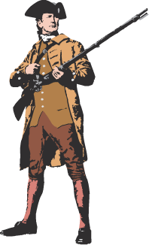
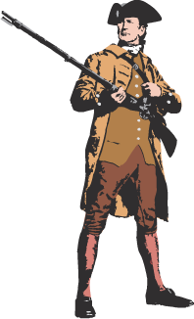
The Road
to Revolution:
(1770-1776)

Slide 2
Was the
American Revolution
Inevitable??

Slide 3
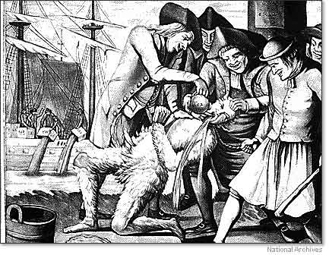
Tar and Feathering
Tarring and feathering from John Adams miniseries
2 problems historically with this scene

Slide 4
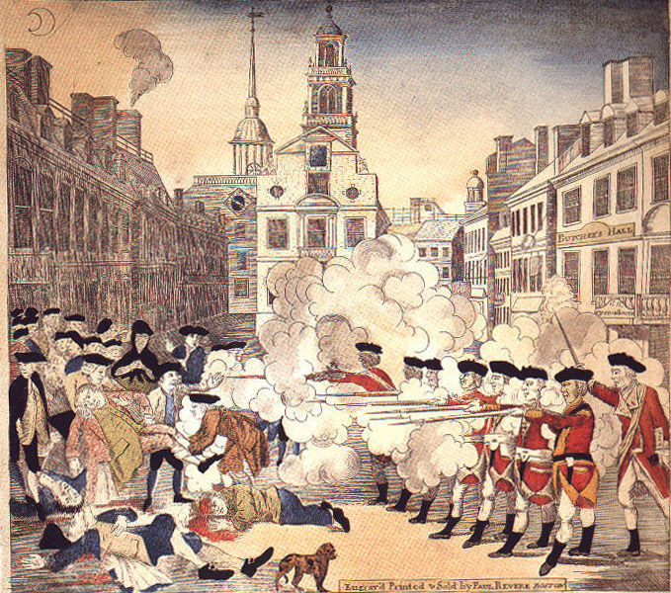
The Boston Massacre (March 5,1770)
Picture Analysis
1. Who produced this image?
2. Is it accurate?
3. Purpose?
John Adams defends the British
http://youtu.be/_rTrUL7ns2E

Slide 5
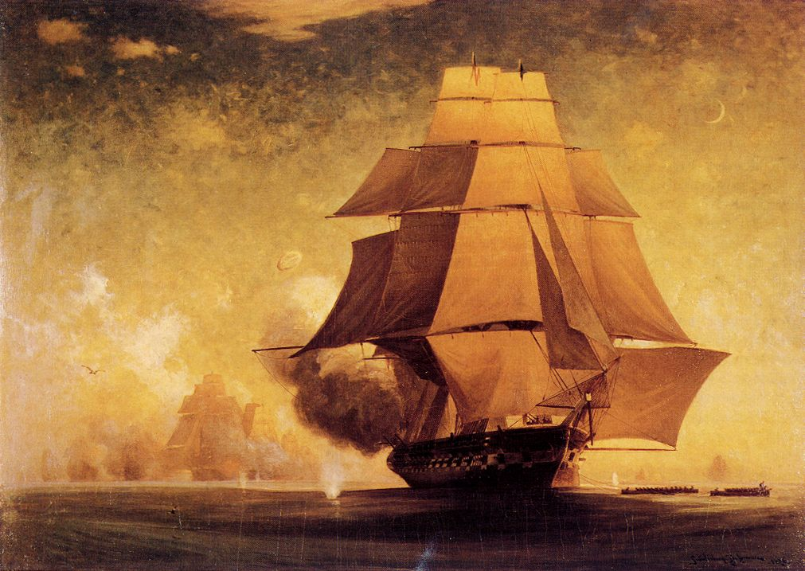
The Gaspee Incident (1772)
Providence, RI coast

Slide 6
Committees of Correspondence
Purpose → warn neighboring colonies about incidents with Br. → broaden the resistance movement.

Slide 7
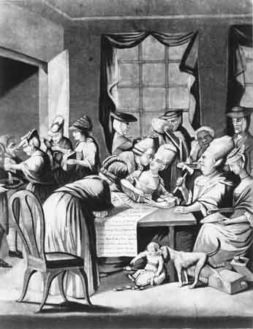
Tea Act (1773)
British East India Co.:
Monopoly on Br. tea imports.
Many members of Parl. held shares.
Permitted the Co. to sell tea directly to cols. without col. middlemen (cheaper tea!)
North expected the cols. to eagerly choose the cheaper tea.

Slide 8
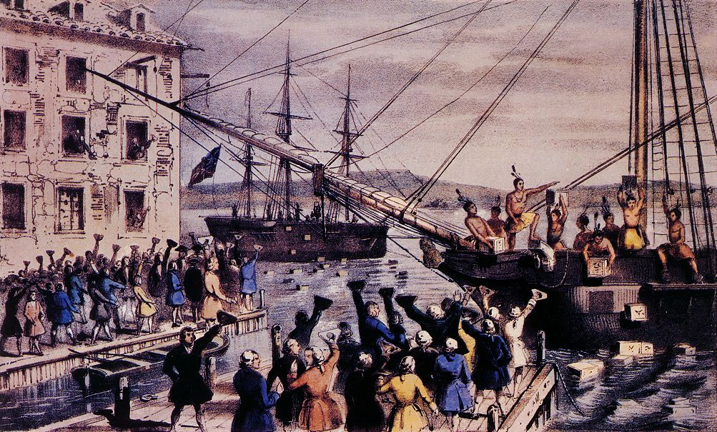
Boston Tea Party (1773)

Slide 9
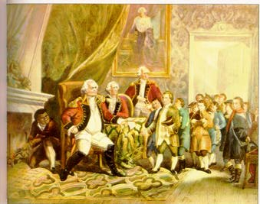
The Coercive or Intolerable Acts (1774)
1. Port Bill
2. Government Act
3. New Quartering Act
Lord North
4. Administration of Justice Act

Slide 10
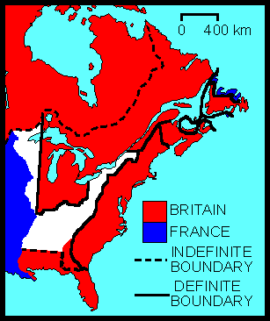
The Quebec Act (1774)

Slide 11
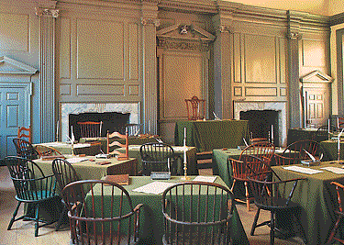
First Continental Congress (begins in Sept. 1774)
55 delegates from 12 colonies
Agenda → How to respond to the Coercive Acts & the Quebec Act?
1 vote per colony represented.
http://youtu.be/GckRP2xRKNw

Slide 12
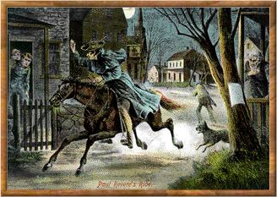
The British Are Coming . . .
Paul Revere & William Dawes make their midnight ride to warn the Minutemen of approaching British soldiers.(April 1775)

Slide 13
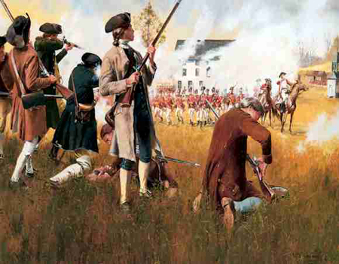
The Shot Heard ’Round the World!
Lexington & Concord – April 18,1775
Aftermath of Lexington and Concord from John Adams
http://youtu.be/0lj6mIDzx9M

Slide 14
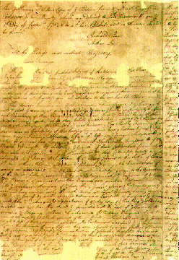
The Second Continental Congress (1775)
Olive Branch Petition
Colonies were divided…..notice the geographical
divisions
http://youtu.be/wINSdGHdfkw
King George Responds to the Olive Branch Petition
http://youtu.be/5JTxVHQAp8w

Slide 15
Was the
American Revolution
Inevitable??

Slide 16
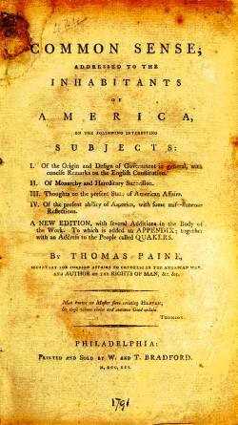
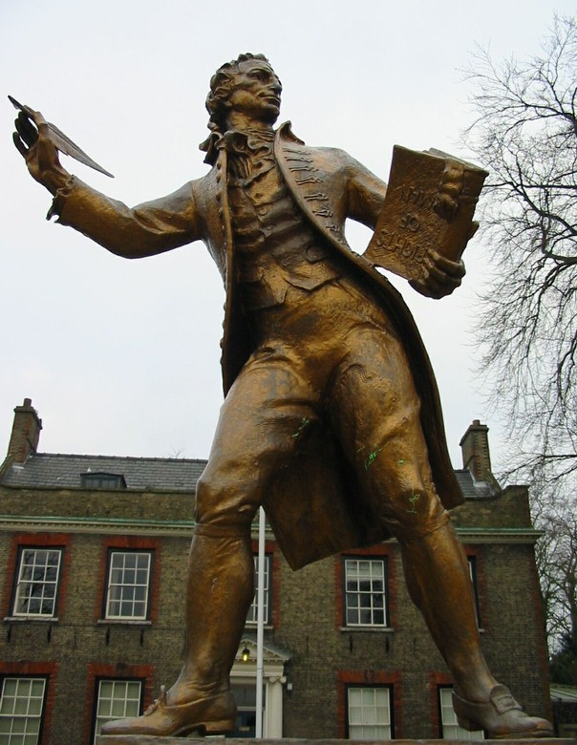
Thomas Paine: Common Sense

Slide 17
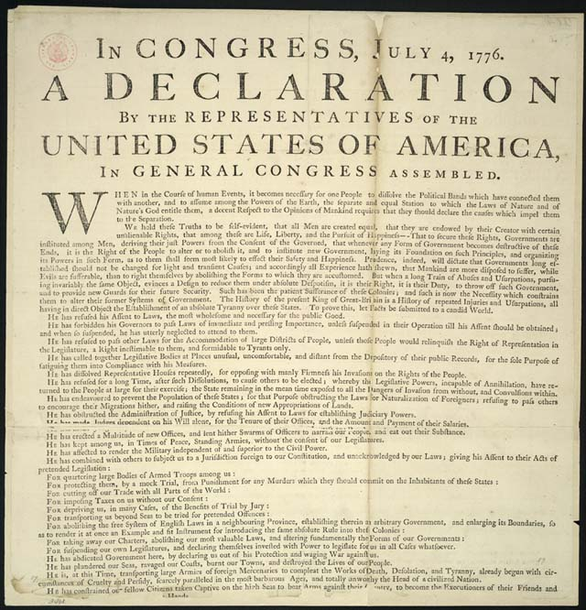
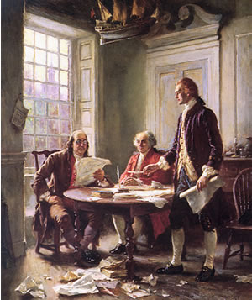
Declaration of Independence (1776)
John Adams meets with Thomas Jefferson
http://youtu.be/13jLQ_-3c8o

Slide 18
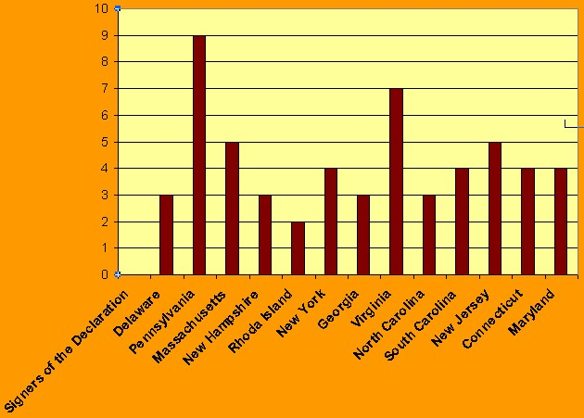
Declaration of Independence

Slide 19
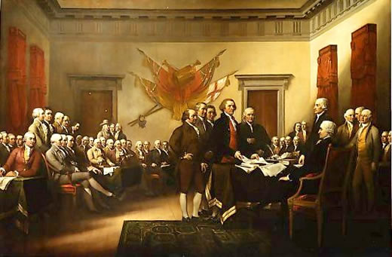
Independence Hall

Slide 20
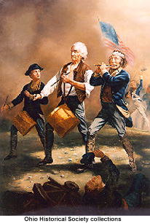
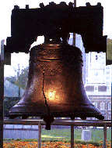
New National Symbols

