Slide 1
The Rise and Fall of the Roman Republic (circa. 800-44 BCE)
-Key Concepts-

Slide 2
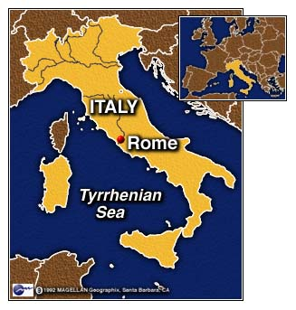
I. The Geography of Early Rome
Jumble of plains, river valleys, hills and mountains
The Alps and the Appenines
More open geography makes political unification easier than in Greece
Geography explains Roman expansion
City of Rome itself
Rome = center of the Mediterranean world

Slide 3
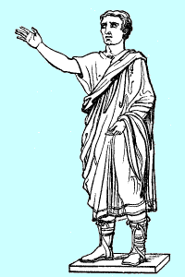
II. The Etruscans and Rome (750-509 BCE)
Early Romans (Latins) and their different neighbors…rural, unorganized
Who were the Etruscans?
The influence of the Etruscans (engineering, art, Greek connections)
First Roman political system rooted in Etruscan precedents
Other developments grounded in Etruscan culture and history (gladiators, demons, etc)

Slide 4
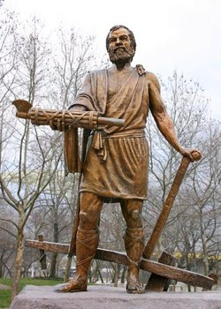
III. Roman Conquest of Italy (509-290 BCE)
Conflict between kings and aristocrats
--legend of Lucretia
-- Romulus and Remus
Wars of self-defense and open fighting style
Treatment of defeated Italians
Legend of Cincinnatus
Cultural unity on the peninsula
Invasion of the Gauls (390 BCE)

Slide 5
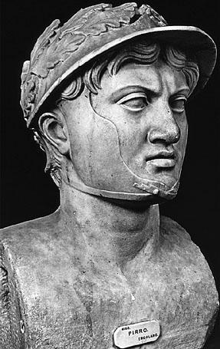
III. Roman Conquest of Italy (cont)
Growth of the city of Rome
Evolution of Roman nobility
Conquest of the Greek colonies in southern Italy (275 BCE)
--leadership of Pyrrhus
--predicts Sicily as future battleground with the Carthaginians

Slide 6
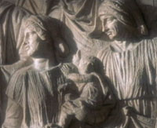
IV. The Struggle of the Orders (500-280 BCE)
Turmoil between patricians and plebeians
Privileges of patricians
Source of turmoil
Plebeian strategy of physical withdrawal
Results in first written code of law—the Twelve Tables (451 BCE)
Other concessions to the plebeians
Struggle actually contributes to Roman unity and value of practical compromise

Slide 7
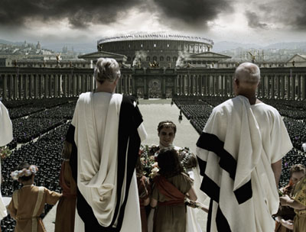
V. The Constitution of the Roman Republic
No written constitution
Republican government was a complex mess that arose out of practical need
The office of Consul
The power of the Roman Senate
The office of Censor

Slide 8
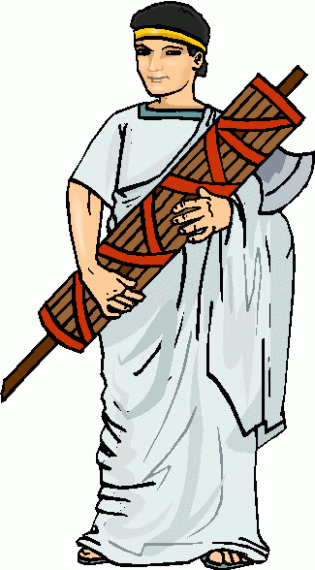
A. The Course of Offices
Ranked according to prestige
The office of Quaestor
The office of Aedile
The office of Praetor
The power of the Consul
--imperium
--auspicia
The office of magister populi
The importance and responsibilities of a Roman political career

Slide 9
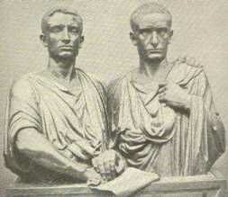
B. The Assemblies
The place of Roman assemblies
--contio
The significance of group voting
The example of the Centuriate Assembly
The Tribal Assembly
The Office of Tribune
Roman political system lacked an overall structure to consolidate it
Reverence for tradition: “The Way of the Elders”

Slide 10
VI. Roman Social Institutions

Slide 11
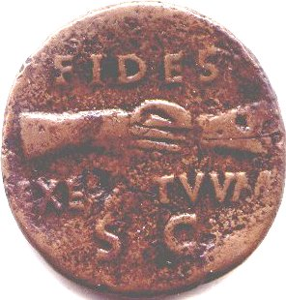
A. The Client-Patron System
Network of reciprocal relationships institutionalized by Roman custom
The duties of the Client
The obligations of the Patron
Patron-client relationships endured over generations in many cases and sometimes across miles
Reflects the central Roman value of fidelity

Slide 12
B. Power in the Roman Family
A Patriarchal Society: “Patria Potestas” (Power of a Father)
Father assumed the power of life and death over his family
Roman fathers conferred with a “council” of friends
Women living in the shadow of men
The power and duties of women
--Tullia (daughter of Cicero)
Now, as in Tullias tombe, one lamp burnt cleare,
Unchang'd for fifteene hundred yeare,
May these love-lamps we here enshrine,
In warmth, light, lasting, equall the divine. . .
English Poet John Donne

Slide 13
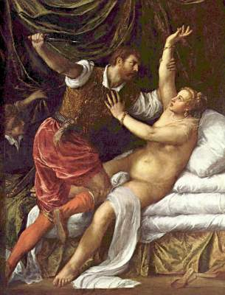
B. Power in the Roman Family (cont)
The lot of poor women
The indirect political impact of women
A day in the life of a Roman household
--Began the day early
--Main meal at midday
--An agricultural economy and practices

Slide 14
C. The Goals of Roman Education for Public Life
Children’s recreation
Formal schooling for children
Important subjects and values to be taught to Roman boys
Education of girls
The place of rhetoric in Roman Education
Cicero: The Republic’s Finest Orator

Slide 15
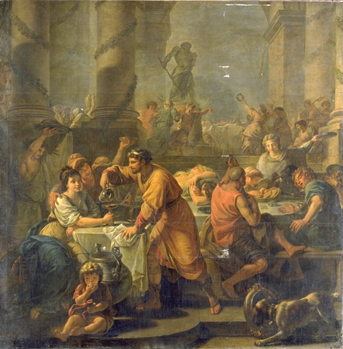
D. The Role of Religion in the Republic
Roman gods: stern, powerful and aloof
No formal priesthood—role of aristocrats
--pax deorum
The Pontifex Maximus and his board of priests
The role of religious festivals and foreign cults
--The Festival of Lupercalia
--The Festival of Saturnalia

Slide 16
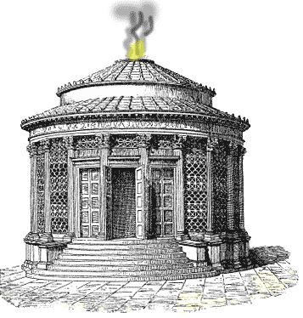
D. Roman Religion (cont)
Three central gods: Jupiter, Juno and Minerva
Main role of the gods was protection and provision
Deification of abstract moral qualities
--fides, pietas, and virtus
The shrine of Vesta and the Vestal Virgins
Household shrines: Penates and Lares
Roman belief in a multitude of spirits

Slide 17
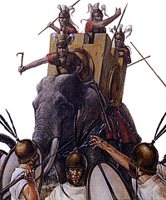
VII. Era of Overseas Conquest (282-146 BCE)
Roman confrontation with the Carthaginians
The First Punic War (264-241 BCE)
Roman seizure of Sardinia and Corsica
The Second Punic War (218-201 BCE)
Hannibal’s invasion and the Battle of Cannae (216 BCE)
Roman general Scipio attacks Carthage and the Battle of Zama (202 BCE)

Slide 18
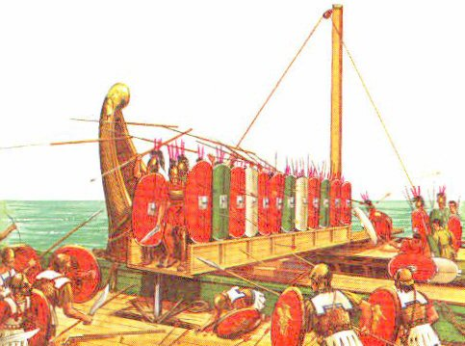
VII. Era of Overseas Conquest (cont)
War against the Gauls—barbarians like the Carthaginians
The “Raven” and the Roman navy
Sacrilege at sea—the sad saga of Claudius Pulcher
The Second Macedonian War (200-197 BCE)
“The Freedom of the Greeks”
The Third Punic War (149-146 BCE)
Motivations and pattern of Roman imperialism

Slide 19
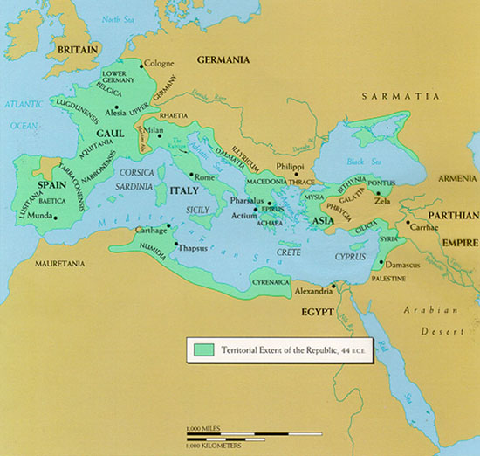
VIII. Consequences of Roman Expansion
Mare Nostrum: “Our Sea”
Widened gap between rich and poor
Disruption of traditional patterns of life in the countryside
Small farmers fall into debt and sell land to rich owners of Latifundia
Growth of unemployed urban poor
An influx of slaves

Slide 20
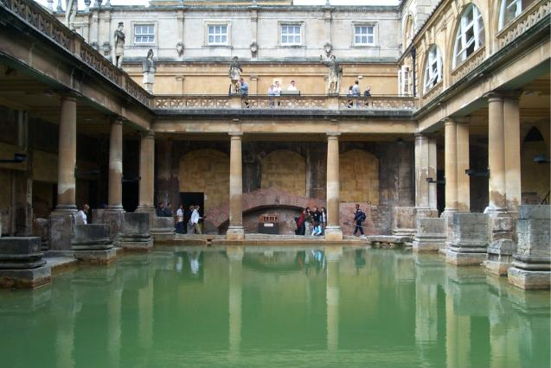
VIII. Consequences of Roman Expansion (cont)
New Hellenized, urban culture
Roman literature imitates Greek models
--Terence
Adopted fad of Greek bathing
Shift in eating habits
More opportunities for Roman aristocrats to enrich themselves politically and materially
Demise of foreign enemies = loss of patriotism and Roman value of frugality

Slide 21
IX. The Decay of the Republic

Slide 22
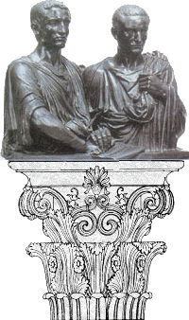
A. Splintering and Violence in Aristocratic Politics
Tiberius Gracchus and land reform
Tiberius’ violation of the “Way of the Elders” (133 BCE)
Gaius Gracchus and the Cause of Reform
Tension between senators and equites
The death of Gaius Gracchus
Populares vs. Optimates

Slide 23
B. The Origin of Client Armies
The concept of the “New Man”
Gaius Marius (157-86 BCE)
Consecutive terms as Consul
Voted a “Triumph”—high military honor
Opened the army to the property-less
The Social War (91-87 BCE)
All freeborn Italians made citizens

Slide 24
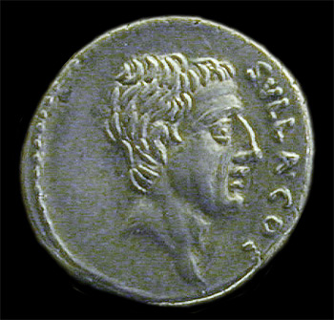
C. The Demise of the Roman Republican Tradition
Social War propelled Sulla to power
Sulla leads his army against Marius and Rome itself
Marius regains power and enters on his own reign of terror
Sulla proscribes his political opponents
Sulla made dictator and tries to strengthen the power of the Senate and Optimates

Slide 25
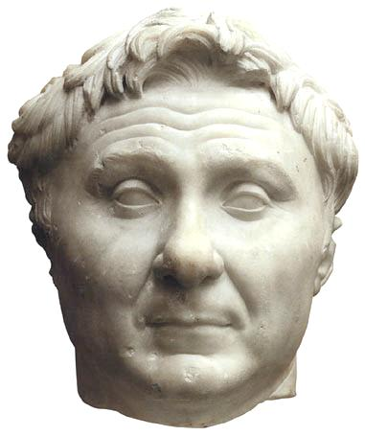
D. The Irregular Career of Pompey
Succeeding generals take Sulla as a model
Pompey and his “triumph”
Pompey’s political and military successes
Behaves as an independent king
Opposition to Pompey arises
Formation of the First Triumvirate
--Crassus, Pompey and Julius Caesar
Julius Caesar’s daughter Julia marries Pompey

Slide 26
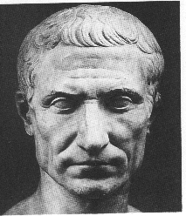
E. The Victory of Julius Caesar
Caesar’s Gallic campaigns
Mounting political violence in streets of Rome
Triumvirate dissolves and Pompey made sole consul—another tradition destroyed
Julius Caesar marches on Rome (49 BCE)
Victory over Pompey and love affair with Cleopatra

Slide 27
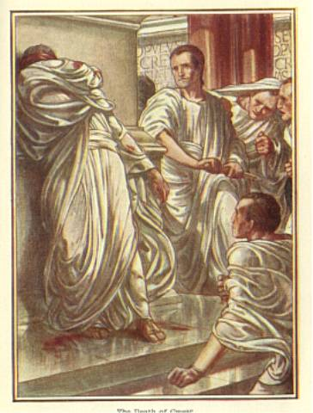
E. The Victory of Julius Caesar (cont)
Caesar’s key problem was ruling Rome alone without violating the oldest tradition of the republic: hatred of monarchy
Caesar’s domestic accomplishments and honors
The assassination of Julius Caesar (44 BCE)
-- “The Ides of March”
Roman literature and portraiture reflects these stormy years of political chaos

Slide 28
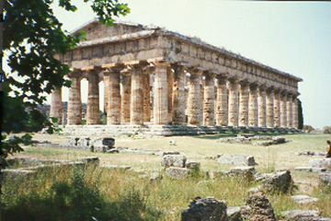
X. The Legacy of the Roman Republic
The spread of Greco-Roman culture
The Concept of Roman Law
--Roman Civil Law
--ius gentium: “the law of the peoples”
Stoic concept of ius naturale: universal, natural law being employed by the Romans
Roman law harmonized with the needs of a world empire and was discerned by reason

